Slide 1
The Making of Europe
The Middle Ages
Byzantine, Muslim, & Frankish Kingdoms

Slide 2
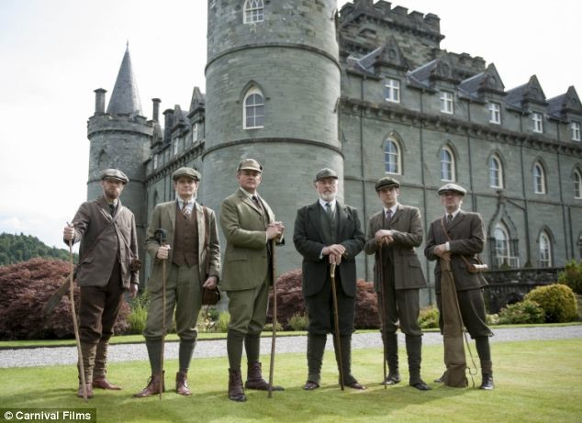
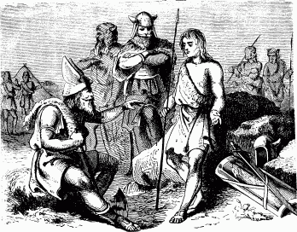
Civilization ???

Slide 3
Aspects of Civilization
Language: Written and Spoken
System of Law and Justice
Cities/State/Government

Slide 4
The Early Middle Ages
This period can be seen as an overlap of epochs.
1. Late Antiquity: 150-750 AD
2. Middle Ages: 476- 1500 AD
The development saw the Birth of Western European Society & Culture.

Slide 5
The Byzantine Empire
The Roman Empire continued in the East.
324 - 1453 AD
The crossroads between Asia & Europe. Constantinople became an epicenter of culture.

Slide 6
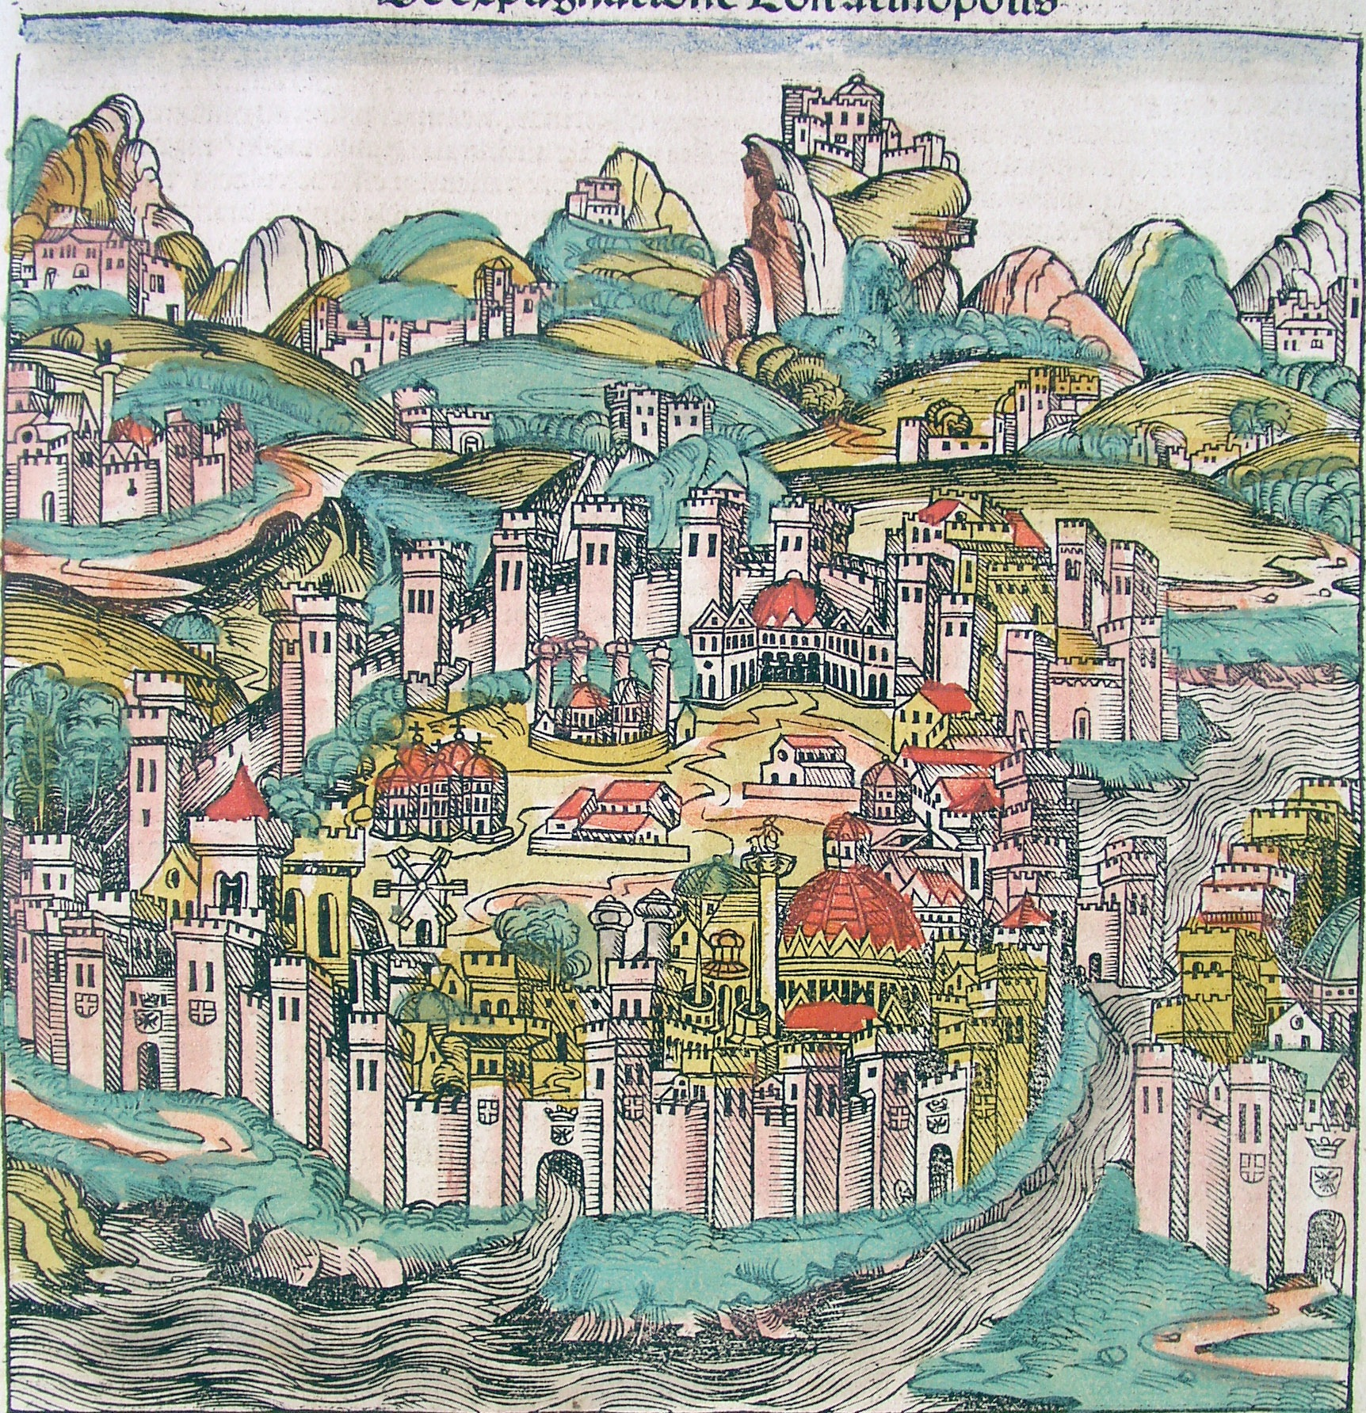

Slide 7
Justinian: 527-565
One of the greats among Byzantine Emperors.
1. Revised Roman Law: CJC
2. Builds the Hagia Sophia
3. Married Theodora

Slide 8
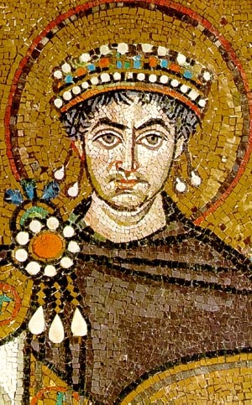

Slide 9
The Recruiter
Theodora: helped his career prosper immensely.
Tribonian: the great lawyer
Belisarius: the successful warrior
John the Cappadocian: the shrewd banker

Slide 10
Corpus Juris Civilis
Justinian’s platform to codify Roman Law in Byzantium
Body of Civil Law – Digest & Codex
Attacked Monophysites as a Heresy.
Procopius: Historian recording this era. Wrote the The Secret History

Slide 11
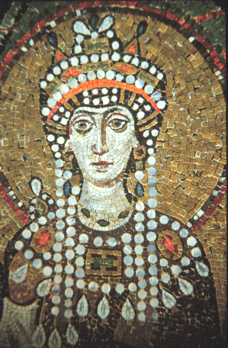
Theodora
Prostitute from the outskirts of the Empire.
Very powerful and persuasive woman
Died young, before Justinian

Slide 12
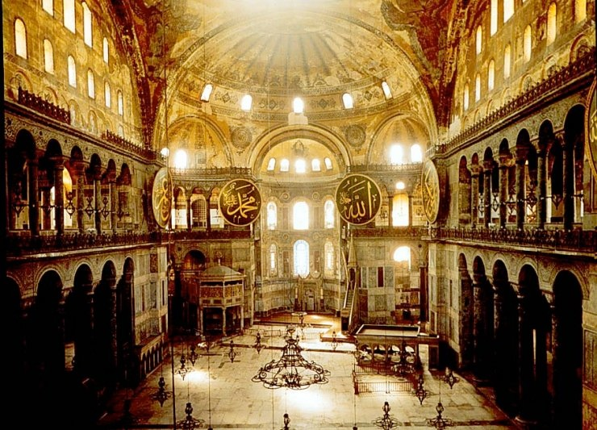
Orthodoxy
The Eastern Church was rooted in Orthodox Christianity.
Hagia Sophia

Slide 13
The Conquests
Justinian attempted to restore the Roman Empire to what it was in Antiquity.
Belisarius: Chief Soldier goes on a series of expeditions to re-conquer Roman territory.

Slide 14
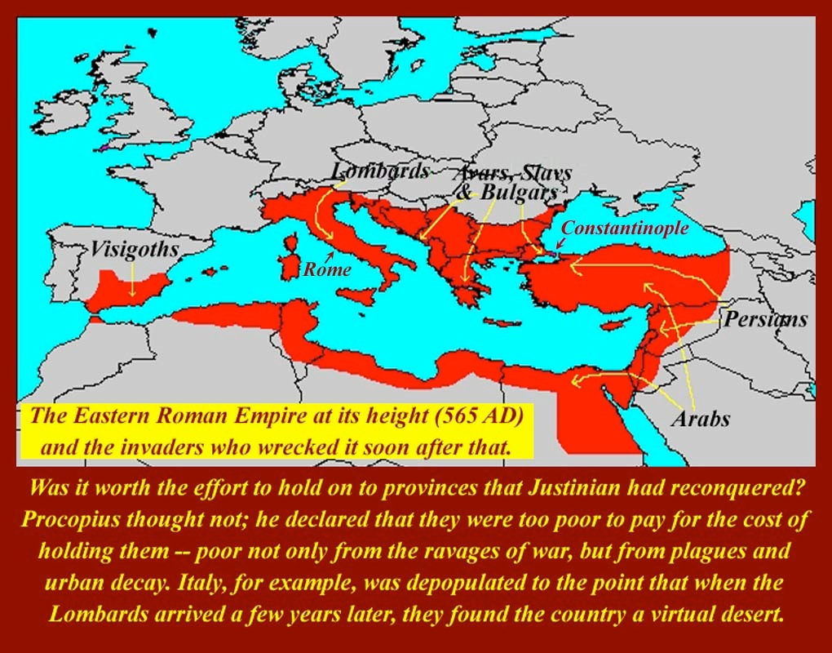

Slide 15
The Rise of Islam
The Prophet Muhammad 570-632
Received a calling in the desert in 610.
Islam: submission to Allah
Muslim: one who submits
Hegira - 622 Muhammad retreats to Medina

Slide 16
Islam Expands
630 Muhammad returned to Mecca with 10,000 followers.
Muhammad quickly converted Arabia.
Islam unified Arab culture by force.

Slide 17
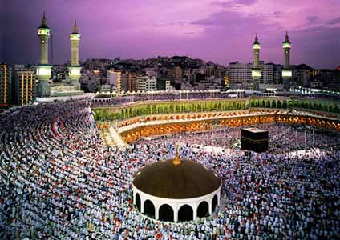
Mecca
The black stone or the Ka’aba
When Muhammad returned he destroyed the Bedouin idols and converted the city
Muhammad died in 632.

Slide 18
Five Pillars of Islam
Shahadah/Faith - There is no God but Allah
Salat/Prayer - Five times a day must face Mecca.
Zakat/Alms - Religious tax to protect the poor.
Sawm/Fasting - During the month of Ramadan fast between dawn and sunset.
Hajj/Pilgrimage- to Mecca once in their lifetime.

Slide 19
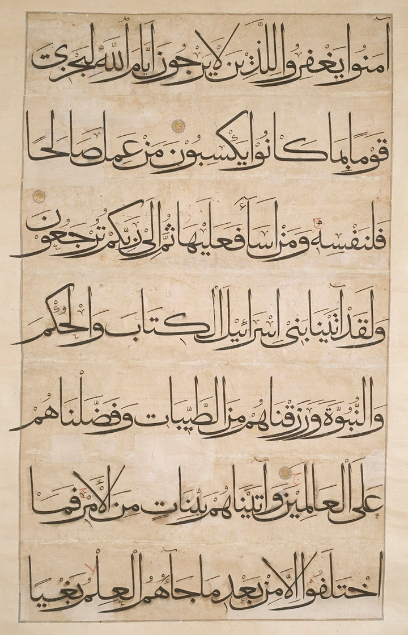
Muslim Civilization
Koran - Holy Word of Allah
Sunna - models of life based on Muhammad.
Hadith - sayings of the prophet Muhammad
Sharia - system of law that regulates family life, moral conduct, and community

Slide 20
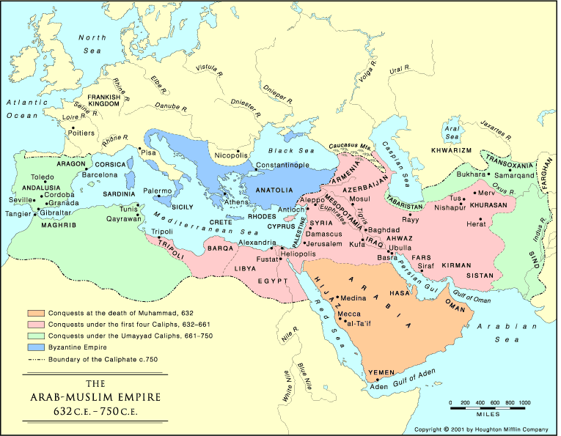

Slide 21
The Birth of Western Europe
Pirenne Thesis: Exams Egyptian papyri to see what was being imported and exported into the West
Islamic invasion differed from Barbarians…no mixing of culture
Marginalization of Western Europe

Slide 22
The Uniqueness of Gaul
400s AD - Franks take over Gaul
486 AD - United under Clovis I
486-751 AD - Merovingian Dynasty
Gregory of Tours - The History of the Franks

Slide 23
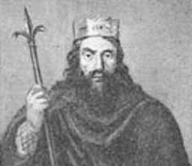
Merovingian Gaul
Clovis: 466-511
United the Franks - Battle of Tolbiac
Strength and Vitality.
Epic Quality
Civilization Process

Slide 24
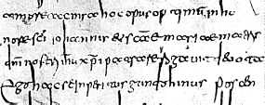
The Kingdom
Signs of Civilization
Develop a method of writing --Merovingian minuscule.
Salic Law
Cities - still small

Slide 25
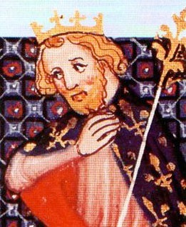
Charles Martel: 736-751
Mayor of the Palace
The “Hammer” defeats Muslims.
Pepin the Short - Charles’ son
Carolingian Dynasty

Slide 26
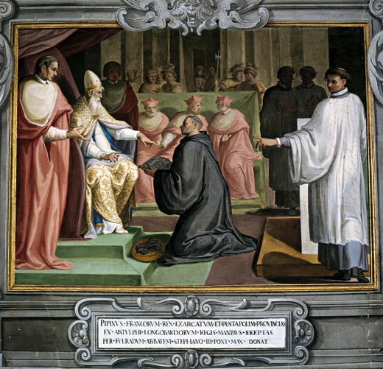
Donation of Pepin
751, Pope Zachary petitioned Pepin for aid against Lombards.
754 - Pepin was anointed King of the Franks by Pope Stephan II

Slide 27
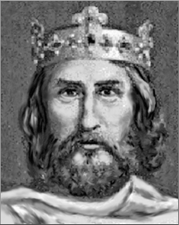
Charlemagne: 768-814
Defeats the Saxons, Lombards, Avars, and Saracens.
Builds a city and palace in Aachen.
Einhard - personal historian
Encourages scholarship - Alcuin

Slide 28
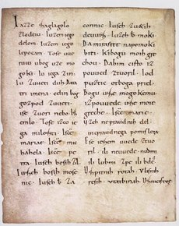
Carolingian Renaissance
Significant change in minuscule
More refined culture - Christian
Court & Estate System
Counts and Cities
Missi Dominici

Slide 29
The New Rome
726-787: Iconoclast Controversy sweeps through the Byzantine Empire.
797: Irene of Athens brutally kills her son Constantine VI and assumes the role of Emperor.
799-800: Internal factions in Rome attempted to depose Pope Leo III.

Slide 30
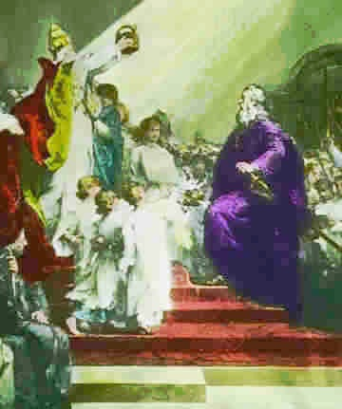
Holy Roman Empire
Christmas Day 800
Leo III crowns Charlemagne
Holy Roman Emperor
Church / State

Slide 31
Development of Western Europe
Henri Pirenne: Muhammad and Charlemagne.
"Without Islam, the Frankish Empire would have probably never existed, and Charlemagne, without Muhammad, would be inconceivable”.

Slide 32
The Father of Europe
Charlemagne’s nickname at court was David . Why is this significant?
According to Christopher Dawson why did Pope Leo III so willingly crown Charlemagne?
What event does Charlemagne’s rule allude to?

Slide 33
Next Week
Explain feudalism and how it contributed to the making of Europe during the Middle Ages.
Discuss the importance of theNorman Conquest of England.
Describe the power struggle between Pope Gregory VII and Emperor Henry IV of Germany.

