Slide 1
Byzantine, Muslim, and Frankish Kingdoms
Week 12

Slide 2
The Early Middle Ages
This period can be seen as an overlap of epochs.
1. Late Antiquity: 150-750 AD
2. Middle Ages: 476- 1500 AD
The development saw the Birth of Western European Society & Culture.

Slide 3
The Early Byzantine Empire
The Roman Empire continued in the East.
324 - 1453 AD
The crossroads between Asia & Europe. Constantinople became an epicenter of culture.

Slide 4
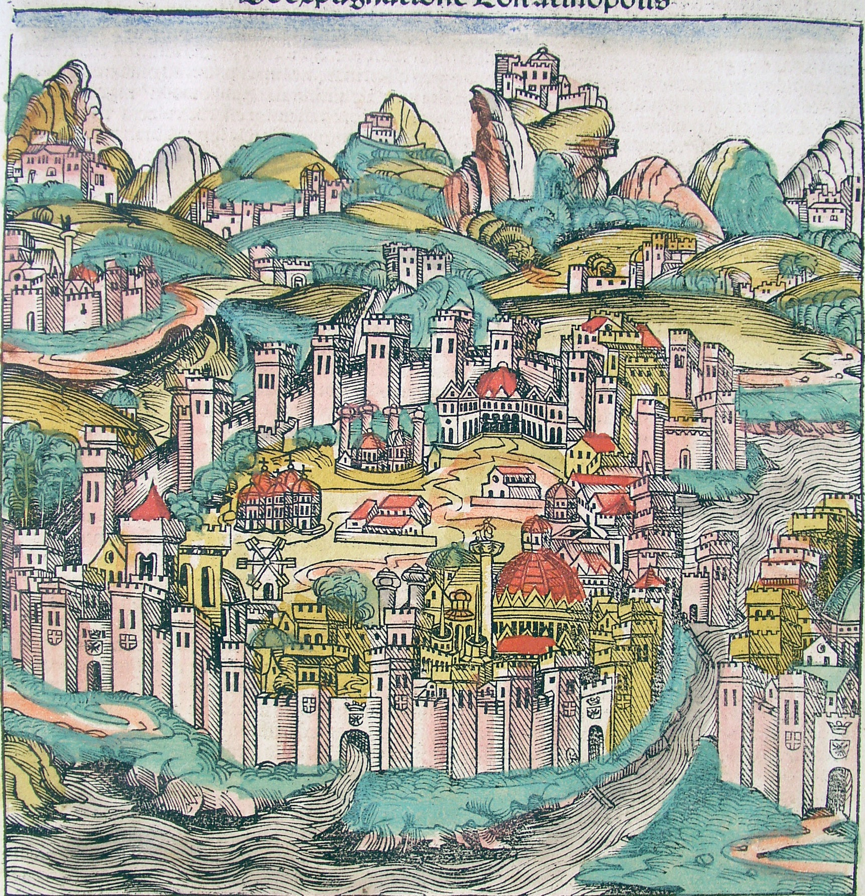

Slide 5
The Later Roman Empire
Roman infrastructure in place
Roads, institutional hierarchies
Challenges from strong Persian empire (Sassanid dynasty, 226-641 CE)
Invasions of Germanic peoples

Slide 6
Caesaropapism
Power centralized in figure of Emperor
Christian leader cannot claim divinity, rather divine authority
Political rule
Involved in Religious rule as well
Authority absolute

Slide 7
The Byzantine Court
Etiquette reinforces authority of Emperor
Royal purple
Prostration
Mechanical devices designed to inspire awe

Slide 8
Justinian (527-565 CE)
The “sleepless emperor”
Wife Theodora as advisor
Background: circus performer
Uses army to contain tax riots, ambitious construction program
Hagia Sophia
Law Code definitive for centuries

Slide 9
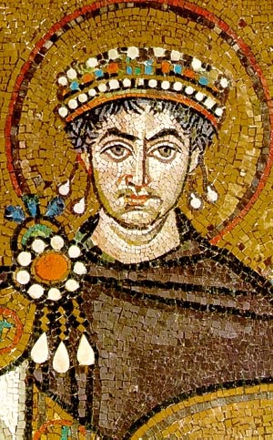

Slide 10
The Recruiter
Theodora: helped his career prosper immensely.
Tribonian: the great lawyer
Belisarius: the successful warrior
John the Cappadocian: the shrewd banker

Slide 11
Corpus Juris Civilis
Justinian’s platform to codify Roman Law in Byzantium
Body of Civil Law – Digest & Codex
Attacked Monophysites as a Heresy.
Procopius: Historian recording this era. Wrote the The Secret History

Slide 12
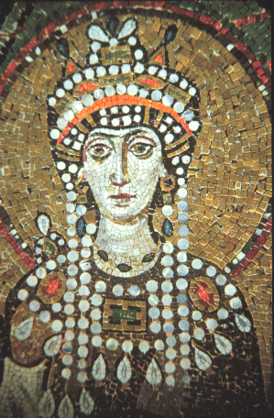
Theodora
Prostitute from the outskirts of the Empire.
Very powerful and persuasive woman
Died young, before Justinian

Slide 13
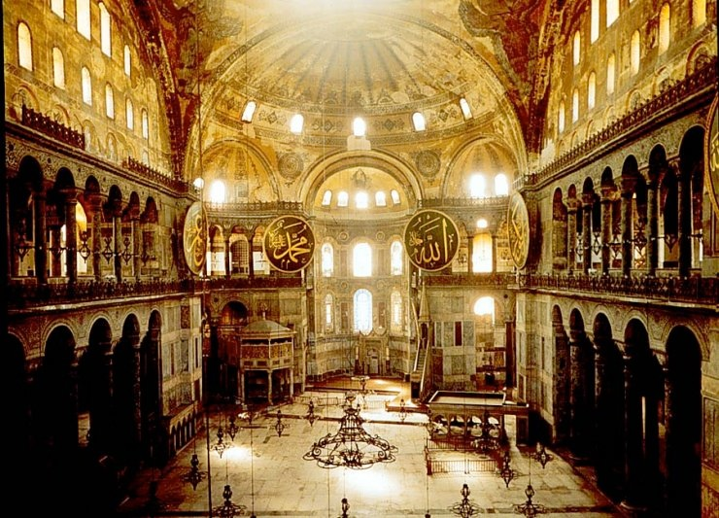
Orthodoxy
The Eastern Church was rooted in Orthodox Christianity.
Hagia Sophia

Slide 14
The Conquests
Justinian attempted to restore the Roman Empire to what it was in Antiquity.
Belisarius: Chief Soldier goes on a series of expeditions to re-conquer Roman territory.

Slide 15
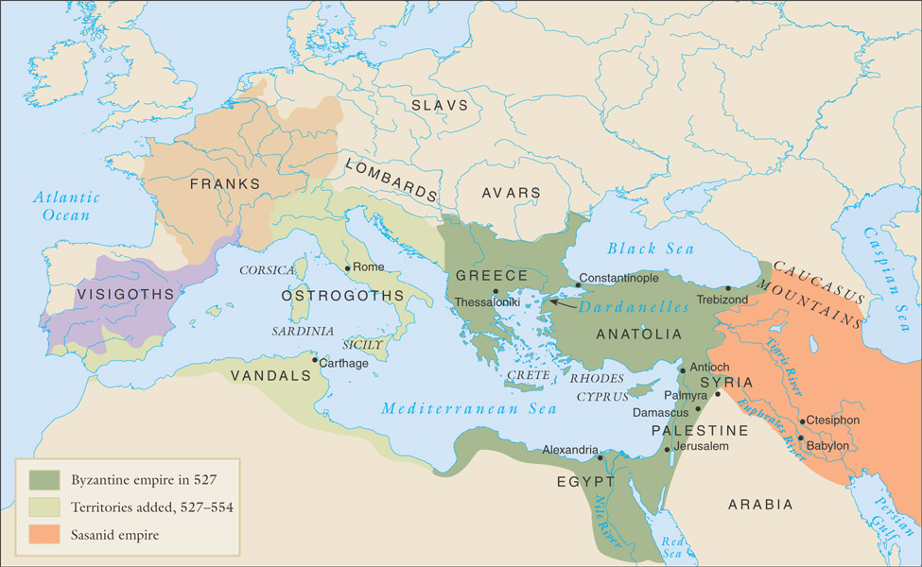
The Byzantine empire and its neighbors 527-554 C.E.

Slide 16
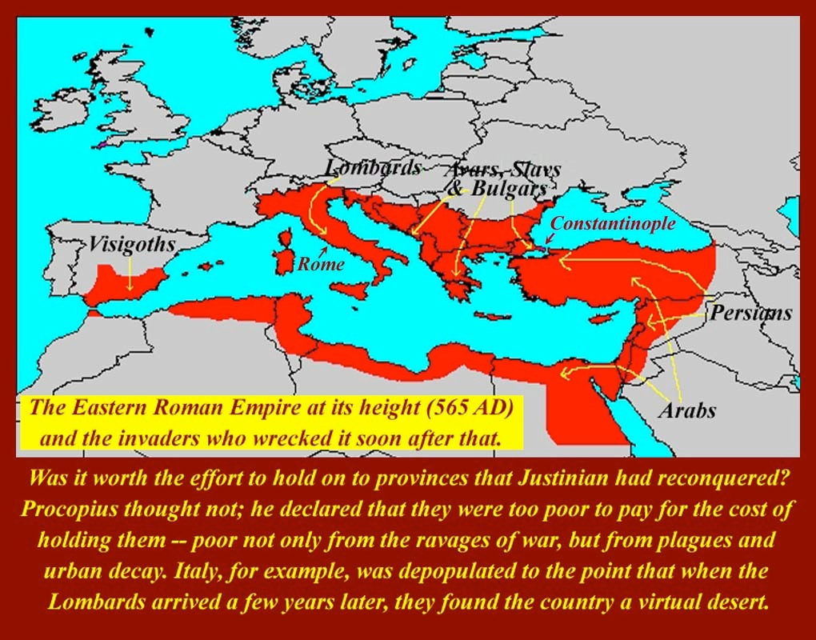

Slide 17
Imperial Organization
Themes (provinces) under control of generals
Military administration
Control from central imperial government
Soldiers from peasant class, rewarded with land grants

Slide 18
Tensions with Western Europe
Church
Byzantine: Greek; Roman: Latin
Conflicts over hierarchical control
Fealty of Germanic peoples
Roman pope crowns Charlemagne in 800, a challenge to Byzantine authority

Slide 19
Islamic Conquests and Byzantine Revival
7th century Arab Muslim expansion
Besieged Byzantium 674-678, 717-718
Defense made possible through use of “greek fire”

Slide 20
The Rise of Islam
The Prophet Muhammad 570-632
Received a calling in the desert in 610.
Islam: submission to Allah
Muslim: one who submits
Hegira - 622 Muhammad retreats to Medina

Slide 21
Conflict at Mecca
Muhammad’s monotheistic teachings offensive to polytheistic pagans
Economic threat to existing religious industry
Denunciation of greed affront to local aristocracy

Slide 22
Islam Expands
630 Muhammad returned to Mecca with 10,000 followers.
Muhammad quickly converted Arabia.
Islam unified Arab culture by force.

Slide 23
The “Seal of the Prophets”
Islam as culmination and correction of Judaism, Christianity
Inheritor of both Jewish and Christian texts

Slide 24
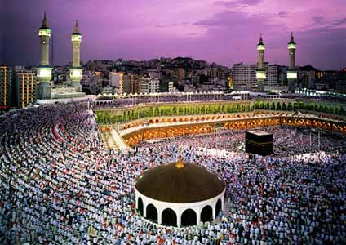
Mecca
The black stone or the Ka’aba
When Muhammad returned he destroyed the Bedouin idols and converted the city
Muhammad died in 632.

Slide 25
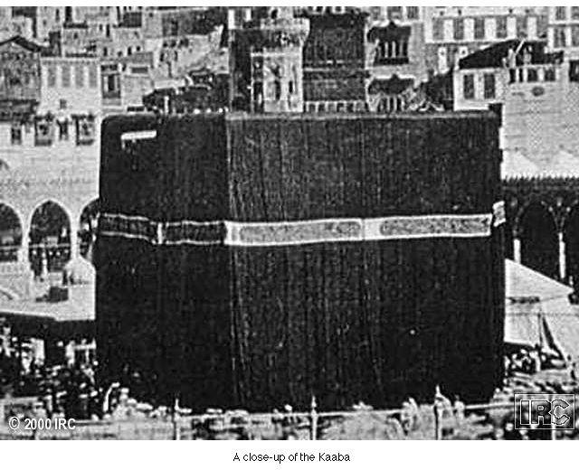
The Ka’aba

Slide 26
Five Pillars of Islam
Shahadah/Faith - There is no God but Allah
Salat/Prayer - Five times a day must face Mecca.
Zakat/Alms - Religious tax to protect the poor.
Sawm/Fasting - During the month of Ramadan fast between dawn and sunset.
Hajj/Pilgrimage- to Mecca once in their lifetime.

Slide 27
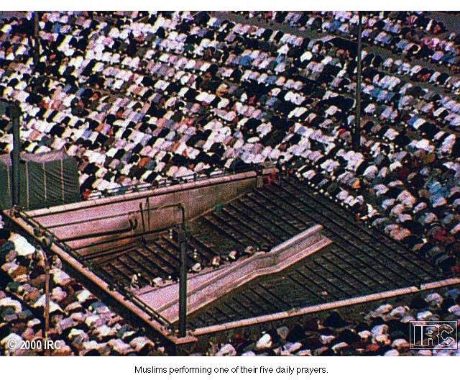
Muslims at Prayer

Slide 28
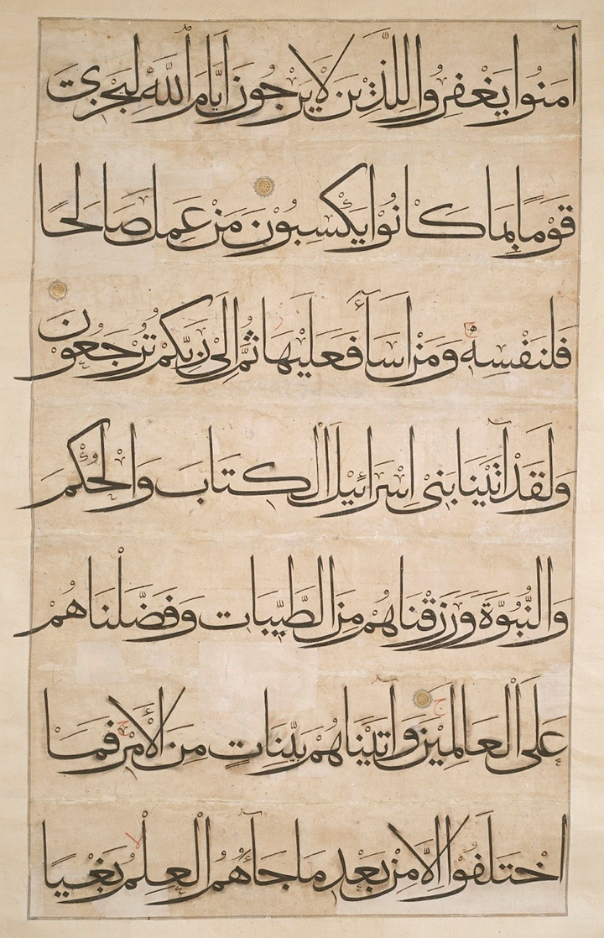
Muslim Civilization
Koran - Holy Word of Allah
Sunna - models of life based on Muhammad.
Hadith - sayings of the prophet Muhammad
Sharia - system of law that regulates family life, moral conduct, and community

Slide 29
Jihad
“struggle”
Against vice
Against ignorance of Islam
“holy war”

Slide 30
The Caliph
No clear successor to Muhammad identified
Abu Bakr chosen to lead as Caliph
Led war against villagers who abandoned Islam after death of Muhammad

Slide 31
The Expansion of Islam
Highly successful attacks on Byzantine, Sassanid territories
Difficulties governing rapidly expanding territory

Slide 32
The Shia
Disagreements over selection of caliphs
Ali passed over for Abu Bakr
Served as caliph 656-661 CE, then assassinated along with most of his followers
Remaining followers organize separate party called “Shia”
Traditionalists: Sunni

Slide 33
The Umayyad Dynasty (661-750 CE)
From Meccan merchant class
Capital: Damascus, Syria
Associated with Arab military aristocracy

Slide 34
Policy toward Conquered Peoples
Favoritism of Arab military rulers causes discontent
Limited social mobility for non-Arab Muslims
Head tax (jizya) on non-Muslims
Umayyad luxurious living causes further decline in moral authority

Slide 35
The Abbasid Dynasty (750-1258 CE)
Abu al-Abbas Sunni Arab, allied with Shia, non-Arab Muslims
Seizes control of Persia and Mesopotamia
Defeats Umayyad army in 750
Invited Umayyads to banquet, then massacred them

Slide 36
Caliph Harun al-Rashid (786-809 CE)
High point of Abbasid dynasty
Baghdad center of commerce
Great cultural activity

Slide 37
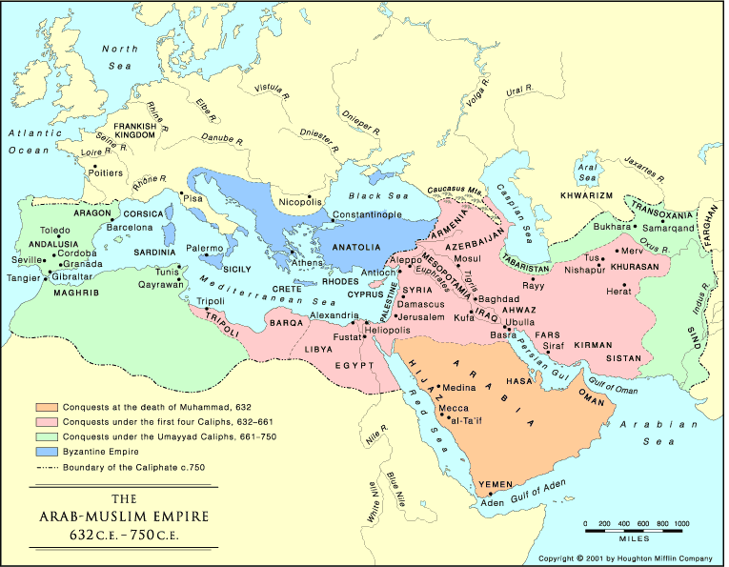

Slide 38
The Birth of Western Europe
Pirenne Thesis: Exams Egyptian papyri to see what was being imported and exported into the West
Islamic invasion differed from Barbarians…no mixing of culture
Marginalization of Western Europe

Slide 39
The Uniqueness of Gaul
400s AD - Franks take over Gaul
486 AD - United under Clovis I
486-751 AD - Merovingian Dynasty
Gregory of Tours - The History of the Franks

Slide 40
The Franks
Heavy influence on European development
Strong agricultural base
Shifts center of economic gravity to Europe
Firm alliance with western Christian church

Slide 41
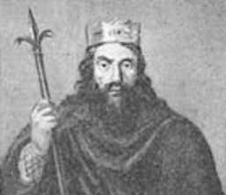
Merovingian Gaul
Clovis: 466-511
United the Franks - Battle of Tolbiac
Strength and Vitality.
Epic Quality
Civilization Process

Slide 42
Clovis’ Conversion to Christianity
Paganism, Arian Christianity popular among Franks
Clovis and army chooses Roman Catholicism
Influence of wife Clotilda
Political implications:
Alliance with western church

Slide 43
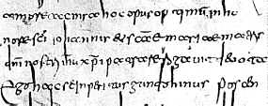
The Kingdom
Signs of Civilization
Develop a method of writing --Merovingian minuscule.
Salic Law
Cities - still small

Slide 44
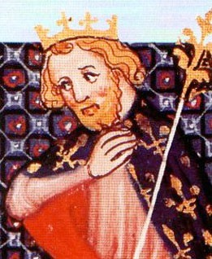
Charles Martel: 736-751
Mayor of the Palace
The “Hammer” defeats Muslims.
Battle of Tours 732
Pepin the Short - Charles’ son
Carolingian Dynasty

Slide 45
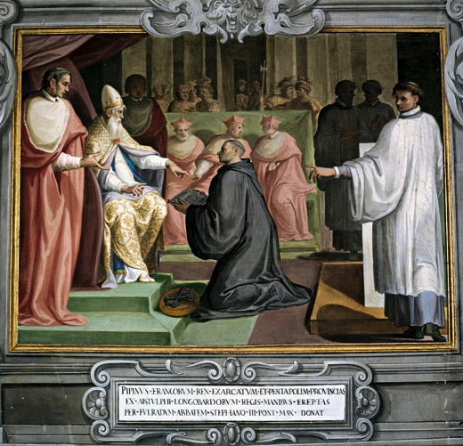
Donation of Pepin
751, Pope Zachary petitioned Pepin for aid against Lombards.
754 - Pepin was anointed King of the Franks by Pope Stephan II

Slide 46
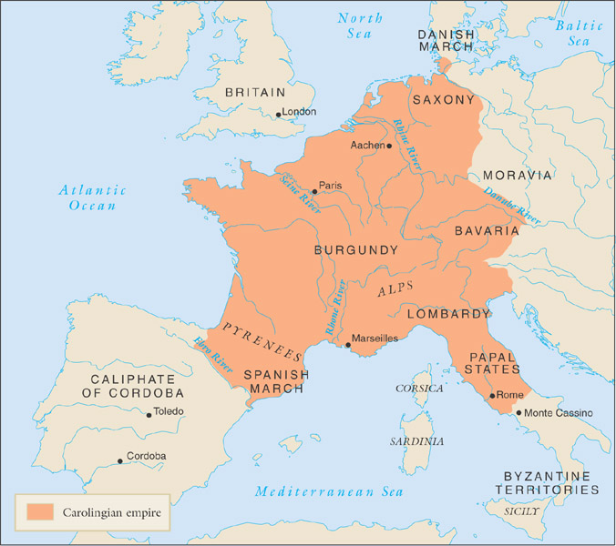
The Carolingian Empire

Slide 47
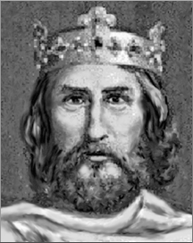
Charlemagne: 768-814
Defeats the Saxons, Lombards, Avars, and Saracens.
Builds a city and palace in Aachen.
Einhard - personal historian
Encourages scholarship - Alcuin

Slide 48
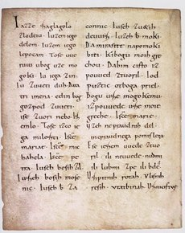
Carolingian Renaissance
Significant change in minuscule
More refined culture - Christian
Court & Estate System
Counts and Cities
Missi Dominici

Slide 49
The New Rome
726-787: Iconoclast Controversy sweeps through the Byzantine Empire.
797: Irene of Athens brutally kills her son Constantine VI and assumes the role of Emperor.
799-800: Internal factions in Rome attempted to depose Pope Leo III.

Slide 50
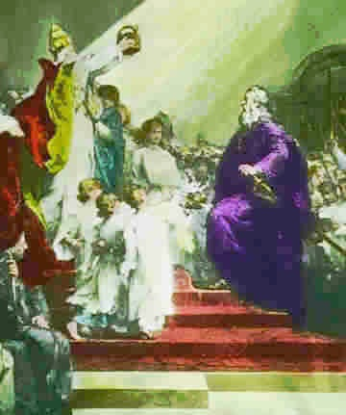
Holy Roman Empire
Christmas Day 800
Leo III crowns Charlemagne
Holy Roman Emperor
Church / State

Slide 51
Development of Western Europe
Henri Pirenne: Muhammad and Charlemagne.
"Without Islam, the Frankish Empire would have probably never existed, and Charlemagne, without Muhammad, would be inconceivable”.

Slide 52
The Father of Europe
Charlemagne’s nickname at court was David . Why is this significant?
According to Christopher Dawson why did Pope Leo III so willingly crown Charlemagne?
What event does Charlemagne’s rule allude to?

Slide 53
Next Week
Explain feudalism and how it contributed to the making of Europe during the Middle Ages. Be able to account for what Feudalism was and how it varied!

