Slide 1
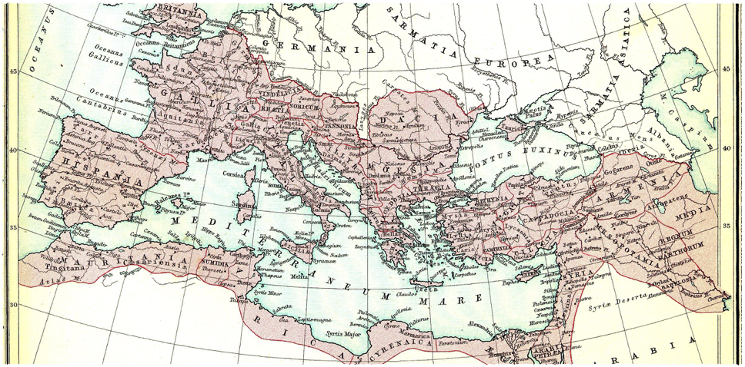
Week 8
The Decline and Fall of the Roman Empire

Slide 2

Why Did Rome Fall?
There are many theories as to why Rome fell…from social to economic or from political to cultural.
Did Rome get too big? Was it the poor leadership? What is ironic about the collapse of Rome? What was unique about the Roman World?

Slide 3
Causes for Decline
Lead Poisoning from lead based utensils.
Rome’s lack of morality.
Barbarian Attacks from the hinterland.
Political Decline within the Empire.
Economic factors due to the lack of agricultural.
In adequate use of man power.
The lack of civic ideals.

Slide 4
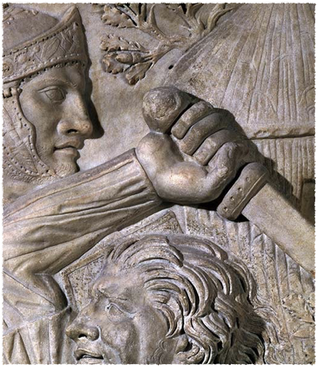
Decline and Fall
The Decline: period between 180 and 284.
The Divide: period between 284-476
The Fall: period after 476

Slide 5
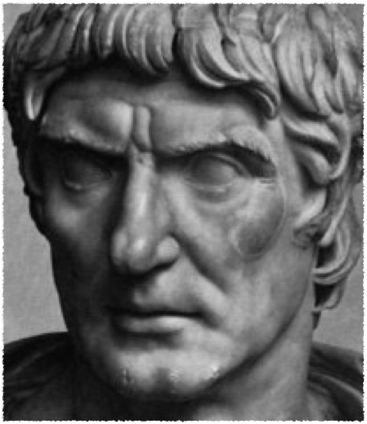
Bread and Circuses
The people that once bestowed commands, consulships, legions, and all else, now concerns itself no more, and longs eagerly for just two things - bread and circuses!
Juvenal, Satires

Slide 6
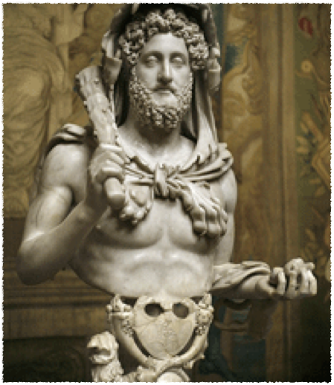
Commodus: 180-192
Marcus Aurelius
Died in 180 and Rome’s benevolence seemed to vanish.
Commodus focused on Gladiatorial Games.
Hercules Syndrome

Slide 7
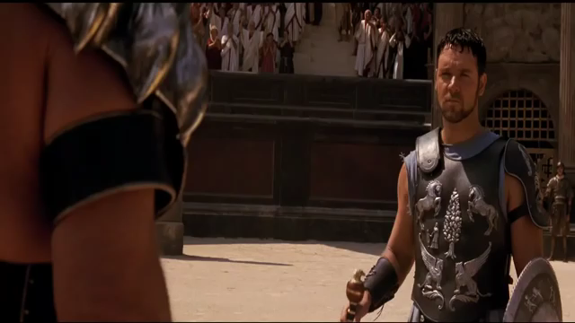

Slide 8
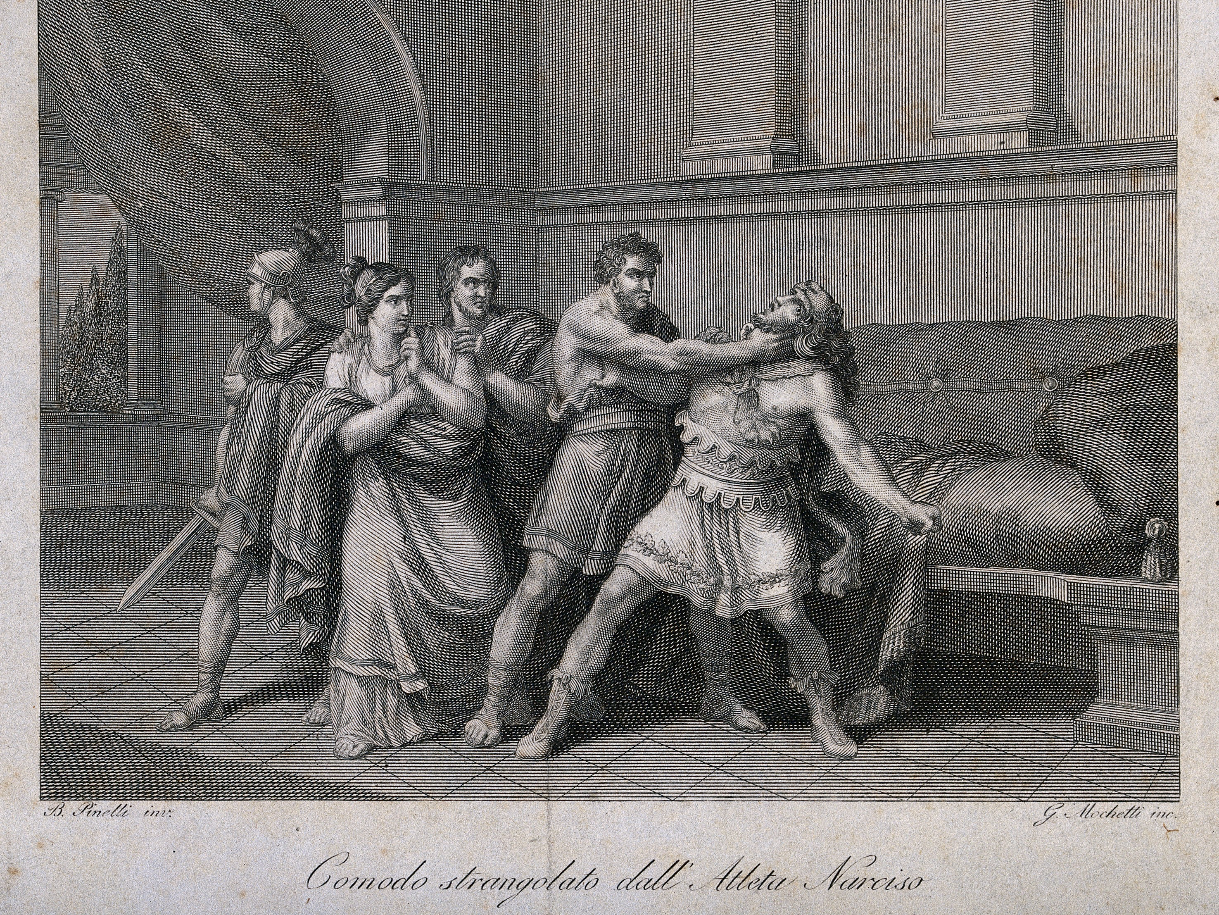

Slide 9
Man on the Mountain
After Commodus’ reign there was a progression on Emperors who were more militaristic than imperial.
Septimus Severus 193-211 AD emerged as the first of these military-dictators.
Between 235-284 AD there were 26 Barracks Emperors.

Slide 10
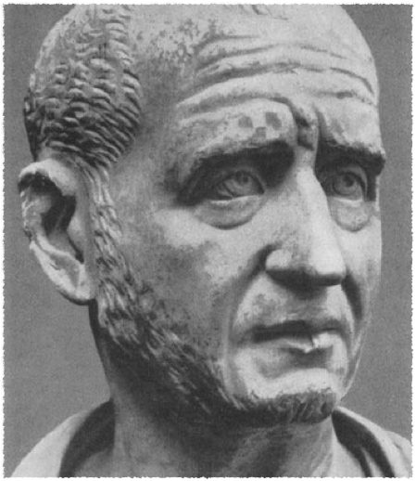
Civil War
The 3rd century was clearly rife with political and economic decline.
The hinterland simply was left alone which broke down the agricultural output.

Slide 11
Barbarian Europe
251 the Goths crossed the Danube and slew the Emperor Decius made their way to the Balkans
260 the Persians captured Emperor Valerian and made him a prisoner.

Slide 12
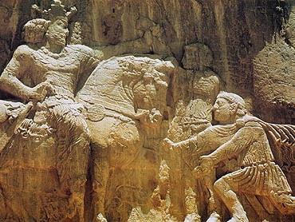

Slide 13
Age of Anxiety
Just as the Hellenistic period developed paths to embrace the anxiety of the age, so too did the period of chaos in Rome.
Neoplatonism - developed by Plotinus from Egypt around 204.
  spiritualism that focused on emanations that proceeded from the “World Soul”

Slide 14
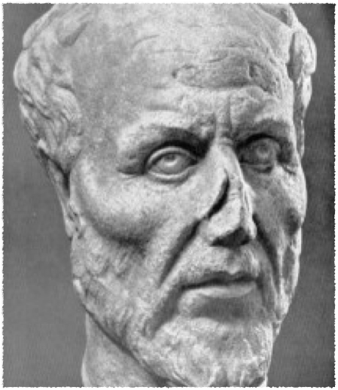
The World-Soul
Plato’s thought of extremes
Matter is Darkness
Mortify the flesh to elevate the soul
Early signs of monasticism and asceticism
  St. Anthony the Pillar Sitter

Slide 15
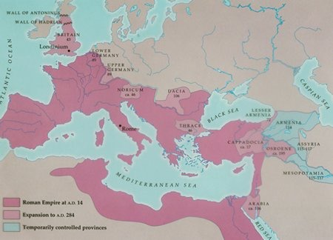

Slide 16
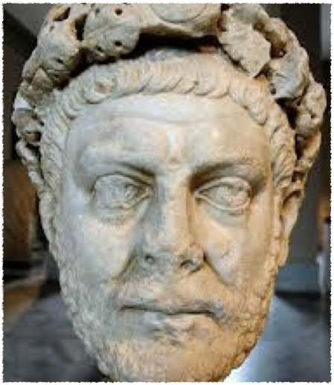
A Roman Revival
Rome declined after 180 but it did not collapse.
Diocletian saved the Empire in 284.
Transitional Period
  Antiquity - Medieval

Slide 17
Age of Late Antiquity
284 - 610 is usually attributed to the age of Late Antiquity.
While Rome was on the decline, Christianity was on the rise.
Ultimately the Roman World would end in a whimper, not a bang!

Slide 18
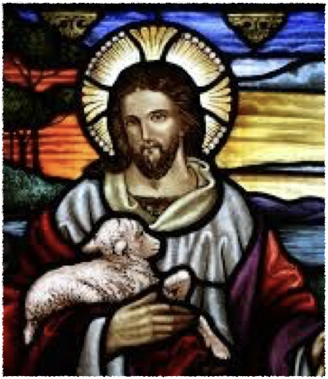
The Emergence of Christianity
Jesus Christ = fulfillment of the scriptures
“Therefore the Lord himself shall give you a sign; Behold, a virgin shall conceive, and bear a son, and shall call his name Emmanuel.”
        ~Isaiah 6:14

Slide 19
Birth of Christianity
Jesus of Nazareth - Jewish teacher from the line of King David
Moral Code, Reputation for miracle-working.
Romans fear instigation of rebellion and crucify Jesus.

Slide 20
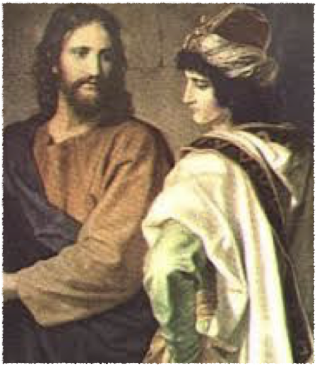
Jesus’ Early Follower
Belief in Jesus’ resurrection, and divine nature.
Christos = “Anointed One”
The New Testament
  Gospel
  Pauline Letters
  Apocalypse

Slide 21
Christianity and the West
Christ was born into the height of the Roman Empire 3 B.C. - 30 A.D.
Bible contains the Old Testament of Judaism and the New Testament containing the 4 Gospels and Letters of St. Paul.
The Trinity = Hypostatic Union

Slide 22
Jewish Culture
Romans respected Judaism because of the customary mos maiorum
70 Romans destroy the Temple of Solomon
  Second Diaspora
  Pharisees hope for a political messiah than a religious one.

Slide 23
Christ the Rabbi
Jesus began his mission around 30 years old with the intent to save the world from sin.
Principles taught by Christ:
  Fatherhood of God, Brotherhood of Humanity, Golden Rule, Forgiveness of Sins and of Enemies.

Slide 24
Jesus’ Early Followers
Belief in Jesus’ resurrection, divine nature
Title Christ: “Anointed One”
Teachings recorded in New Testament
Paul of Taurus
    Extends teachings far beyond Jewish circles
    Intensive travel, missionary activity

Slide 25
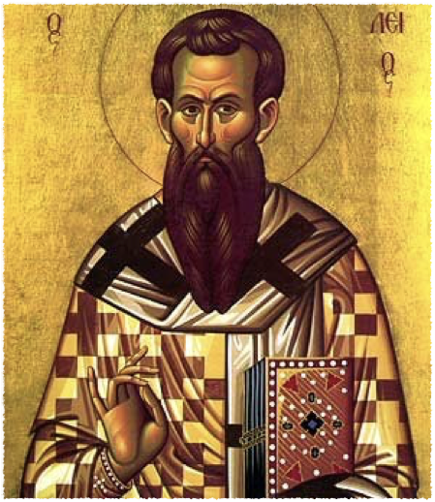
Christian Morality
Tertullian 160-240
What Has Jerusalem to do with Athens?
What exactly is Tertullian’s point in this excerpt?
How does this fit into Gibbon’s view on the Fall of Rome?

Slide 26
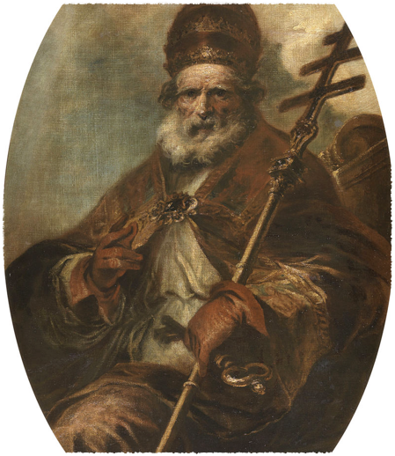
Papal Leadership
Connection to Rome - Petrine Doctrine
Matthew 16: 18-19 “Upon this rock I will build my church”
Pope Leo I “the Great” 400-61
  attacked the Monophysites
  strengthen Rome’s dominance over Emperors

Slide 27
Reforms of Diocletian
Diocletian 284-305 was an energetic solider who reorganized the declining Empire.
  Political and Economic Reform
  Military and Civilian Reform
  Divide and Conquer
    Tetrarchy to produced stability

Slide 28
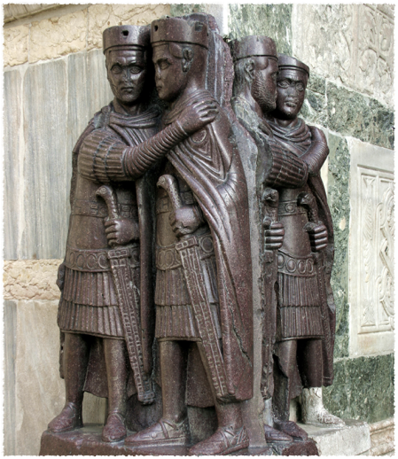
Tetrarchy
Co-Emperors
  Diocletian and Maximian
Caesars - Lieutenant Emperors
Able to leverage more support and reform policies.

Slide 29
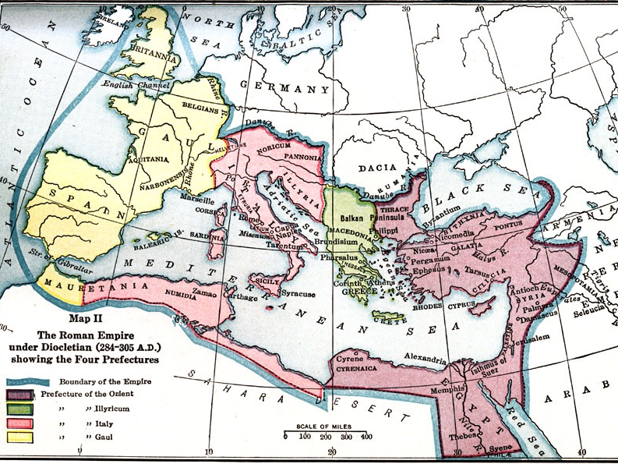

Slide 30
Orientalization of Rome
Diocletian quickly realized the wealth of the the East.
Moved his governance to Nicomedia in 285
Dominus “Lord” became an autocratic ruler.

Slide 31
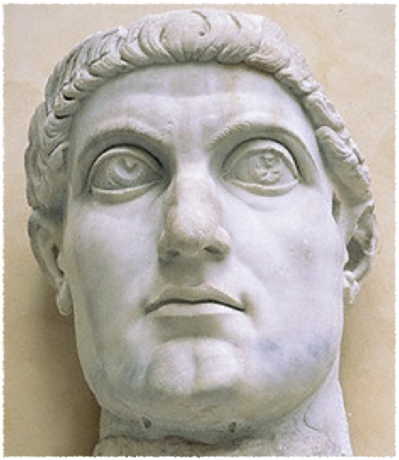
Death of the West
In 305, Diocletian retired to the Balkans.
Rome erupts into Civil War
312 at the Battle of Milvian Bridge, Constantine wins and becomes the sole Emperor.

Slide 32
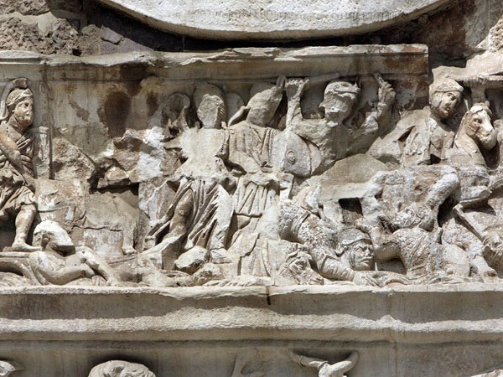

Slide 33
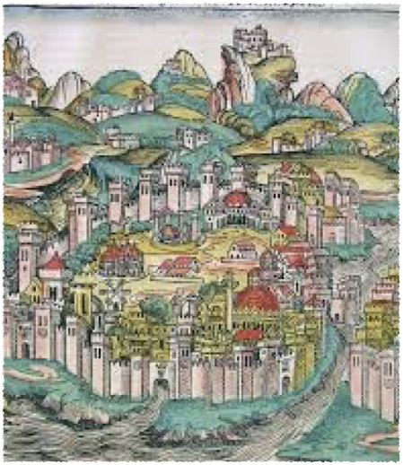
Points East
In 337 took over complete control and moved the capitol to the East.
Constantinople - the new City on a Hill.
Succession became hereditary, which weakens the West.

Slide 34
Early Christian Communities
Local leaders: Bishops - used the system set up by Diocletian …. hence Dioceses
Church develops in the 4th century - Catholicism
  Emperor Constantine - Edit of Milan 313
Regional variation in doctrine and ritual
  Nature of resurrection
  Role of women
Gradual acceptance of core texts
Ecumenical “Church” Councils
  Council of Nicaea - 325
  Council of Chalcedon - 451

Slide 35
Western Thought
Christianity helped to shape Western Thought in the Early Middle Ages.
Church Fathers are the source of intellectualism
  St. Jerome
  St. Ambrose
  St. Augustine
  Boethius

Slide 36
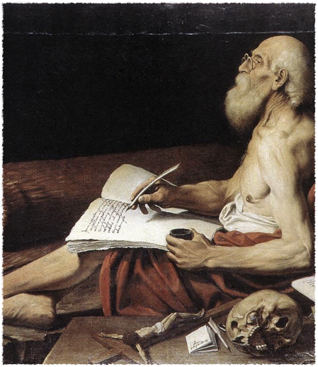
St. Jerome
340-430
Vulgate - Latin translation of the Bible
A big influence on the medieval Latin literature.

Slide 37
The First Father
As a result of contribution to the dissemination of the “good news” Jerome is deemed the first father of the Church.
Avidly supported the monastic community
Misogynistic views that looked to women as the fall of man.

Slide 38
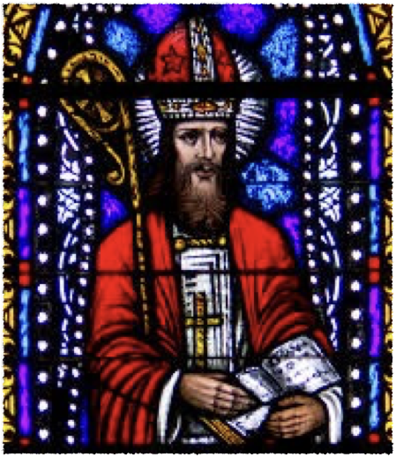
St. Ambrose
340-397
Archbishop of Milan
On the Duties of Ministers
Extremely Active in the concerns of the world

Slide 39
Stoic Christianity
Ambrose’s work on Christian Duty closely resembled Cicero’s work On Duties.
Reverence of God should supersede all human conduct.
Gift of Grace is something that God helps some Christians see but not all.
Emperor Theodosius and importance of morality
      Church and State Relations?

Slide 40
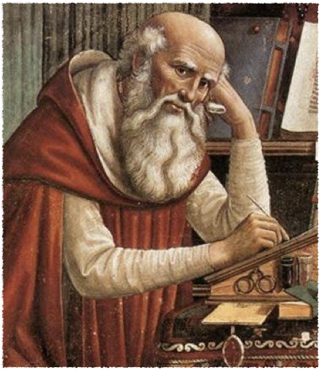
St. Augustine
354-430
Arguably the greatest of all the Church Fathers
Basis for Medieval Theology and Philosophy
Struggled with his Christianity

Slide 41
A wayward Christian
Although his mother was a devout Christian, Augustine did not get baptized until age 33.
Influenced by Manicheanism and Plotinus he struggled to find meaning in the world.
Confessions - explains how he discovered God
  Influenced by Ambrose in 387 who he traveled to hear preach the Good News.
  Converts and quickly ascends … became the Bishop of Hippo in 395

Slide 42
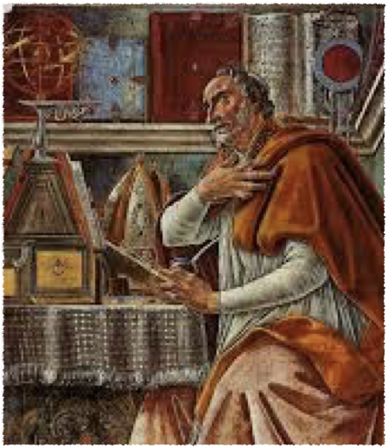
Augustinian Theology
The Sinfulness of Humanity
God’s Omnipotence and Human Corruption
Although one has the power to choose good over evil, only God chooses to save mankind.
  Doctrine of Predestination

Slide 43
City of God
Augustine believed people chose good in the hopes that they would be chosen by God (Grace).
  Doctrine of Charity (good works) and avoids a life of cupidity.
City of Earth - “live according to man” vs. City of God = “live according to God”

Slide 44
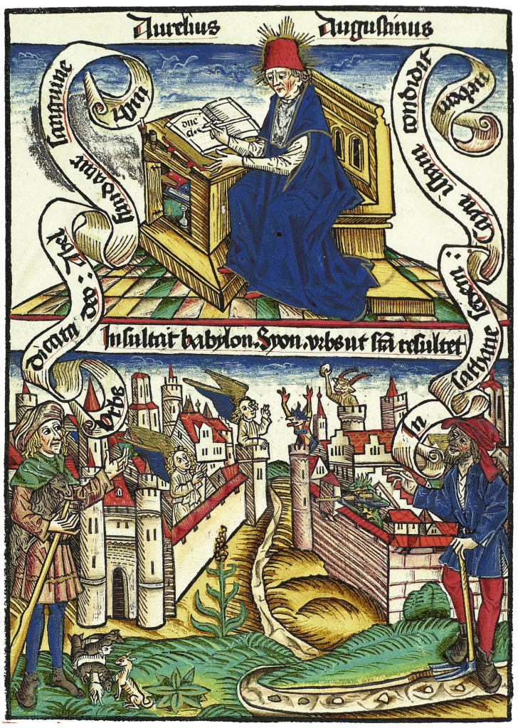

Slide 45
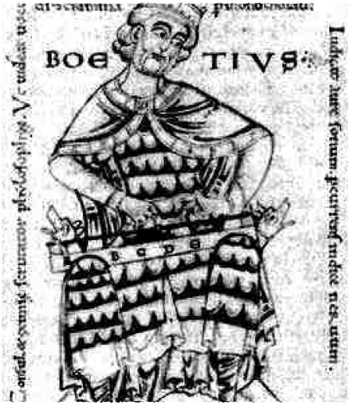
Boethius
480 - 524
A roman aristocrat who became a follower of Augustine
Ancient Learning at the end of Antiquity
Liberal Arts
More of a philosopher than a theologian

Slide 46
Liberal Arts
Boethius wanted to preserve the ancient ways of learning.
  grammar, rhetoric, logic, arithmetic, geometry, astronomy, and music
  Wrote handbooks on two … arithmetic and music

Slide 47
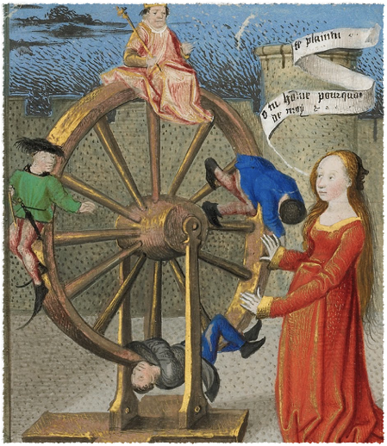
Consolation of Philosophy
Christian Theology = Augustinian as seen in the Consolation of Philosophy
Condemned to die by Theodoric asks the questions - What is human happiness?
Highest Good = pursuit of God

Slide 48
The Wheel of Fortune
Since Boethius was condemned to die, he equated his life to the downward fall of the Rota Fortunae
Myth of Orpheus - man chooses good or evil
“Happy is he who can look into the shining spring of good; happy is he who can break the heavy chains of earth”

Slide 49
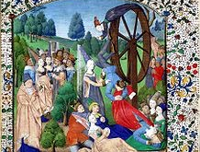

Slide 50
Why Did Rome Fall?
Historians have long debated the actual cause of Rome’s Fall.
Issues that we saw in the Decline of Rome, spill over.
  Social Structure?
  Economy?
  Cultural - Rise of Christianity?
  Barbarian Invasions?

Slide 51
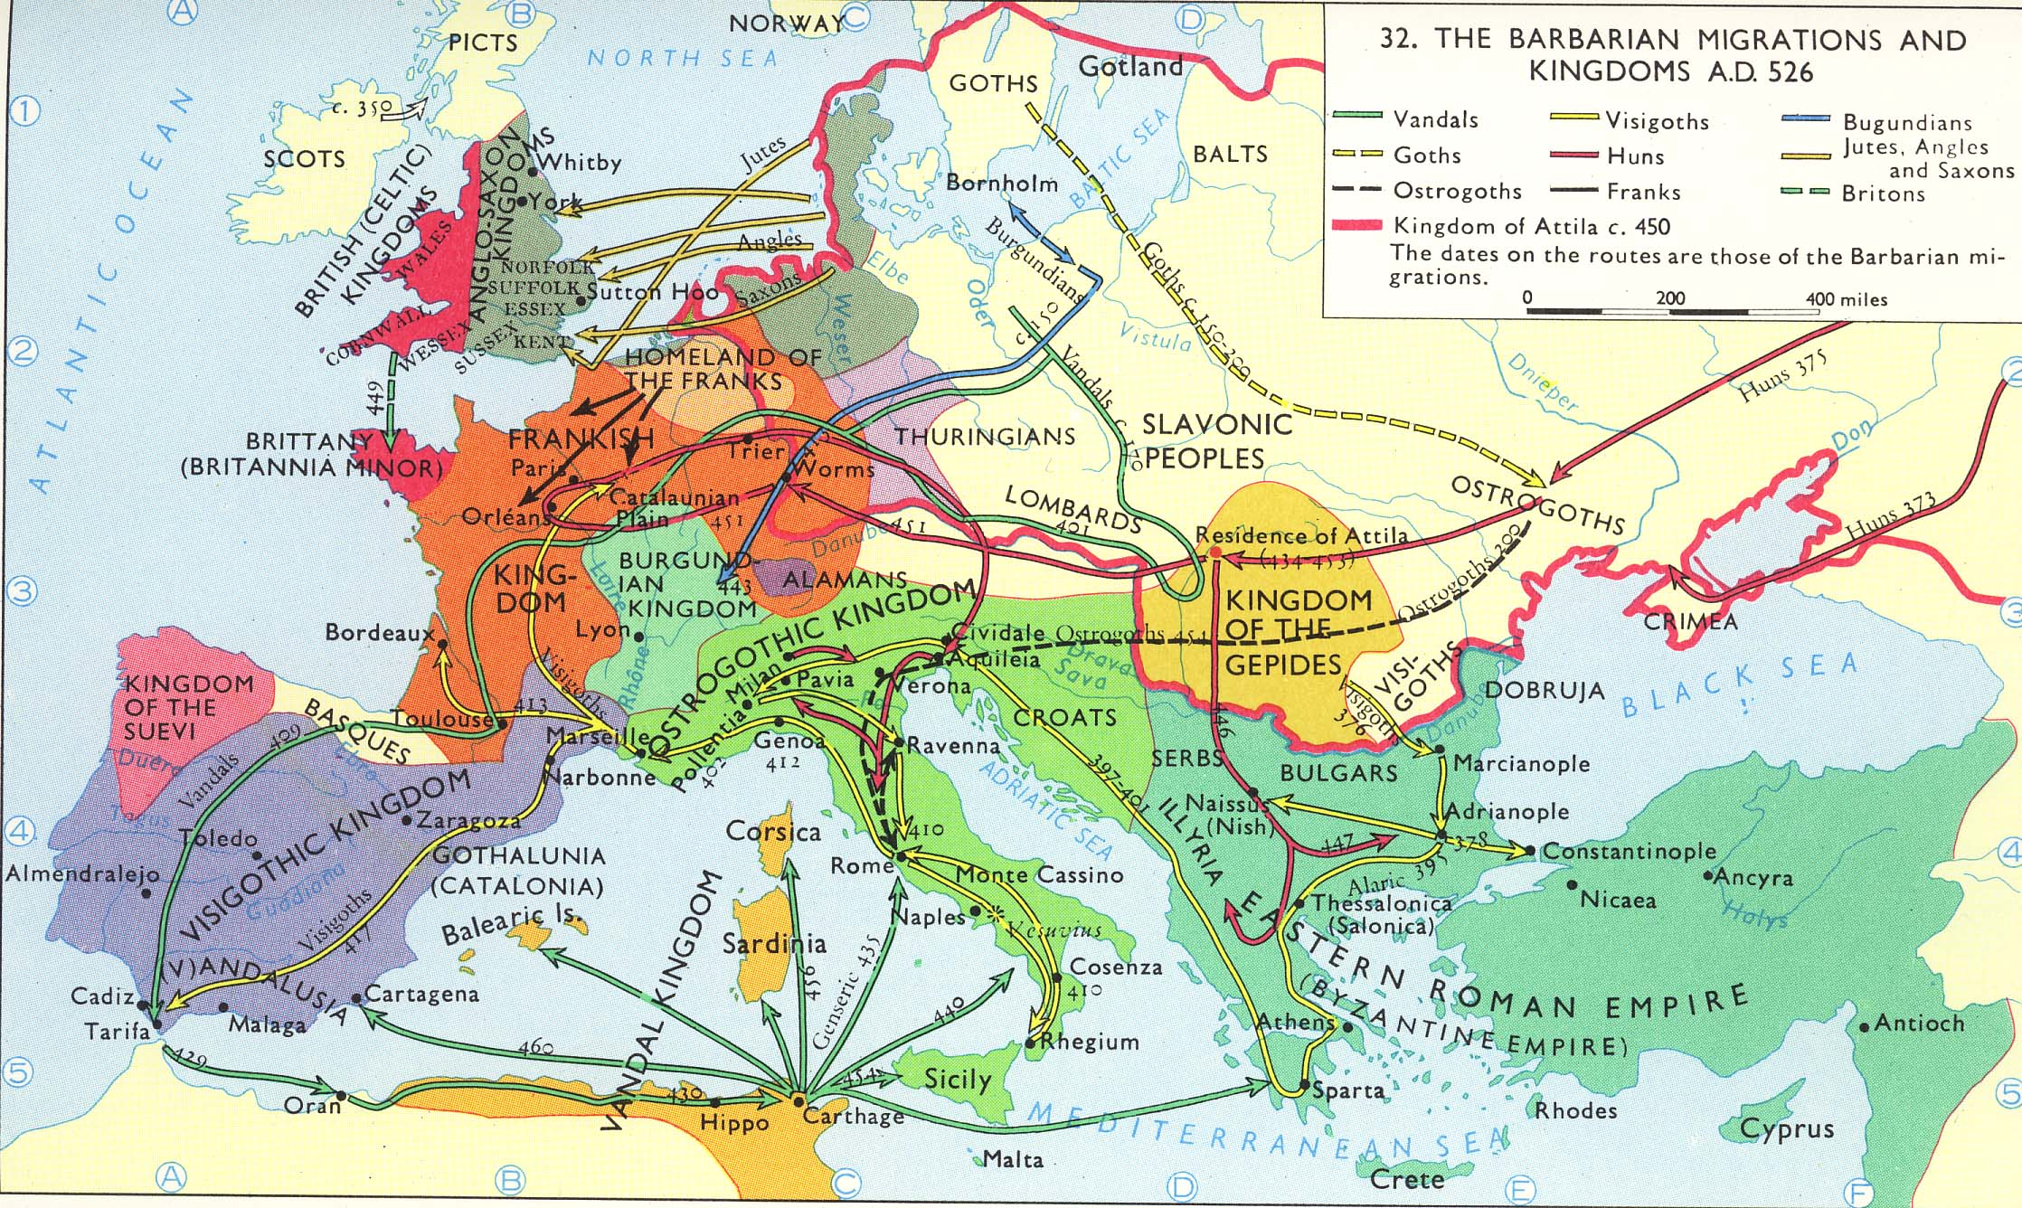

Slide 52
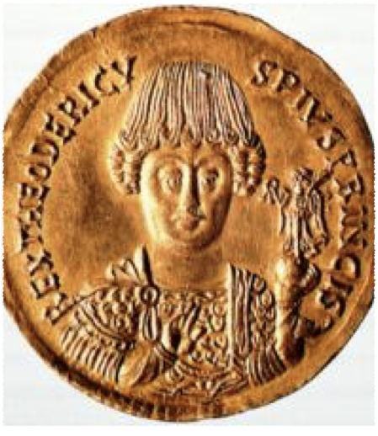
The Fall of the West
476 Romulus Augustulus the last Roman Emperor falls to Odoacer.
Theodoric the Ostrogoth
  493-526 stabilizes the West in Rome.
  Assimilated a lot of the Roman Culture but Christianized.

Slide 53
Next Week
Next week we will continue to look at the growth of Christianity and the Rise of Western Civilization.
Some scholars view Charlemagne as the “Father of Europe” while others argue he was simply in the right place at the right time. How do you view Charlemagne in the context of the Birth of Europe?

