Slide 1
Week 7
The Rise of Rome - from Kingdom to Empire

Slide 2
Establishment of Rome
Legend of Romulus and Remus
Rome Founded 753 BC
Indo-European migrants c. 2000 BC
Bronze c. 1800 BC, Iron c. 900 BC

Slide 3
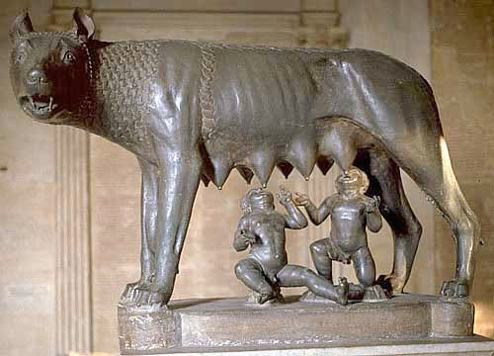
Mythology?
Romulus & Remus twins of the god Mars & Rhea Silvia.
Abandoned at birth, on the Tiber found and nursed by a she-wolf.

Slide 4
The City on a Hill
When the twins were about 10 years old, they were found by a shepherd, Faustulus, who raised the boys.
In 753 BC, the twins decided to build a city where the she-wolf nurtured them.

Slide 5
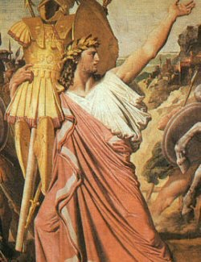
Kleptocracy
The twins argued over location.
Romulus killed Remus and became king.
A refuge for criminals.

Slide 9
The First Romans
Etruscans = Originally from Anatolia, who colonized the northern regions of Italy.
Society declines late 6th c. BCE
Greek maritime attacks
Celtic invasions from north
Latins - built the original settlement in Rome around the Palatine Hill.
Greeks = established colonies in the south between 750 - 600 BC.
Romans inherit alphabet, religious concepts, art, and mythology

Slide 10
The Early Kingdom
Monarchy through 7th-6th c. BCE
Streets, temples, public buildings
Major center of trade routes

Slide 11
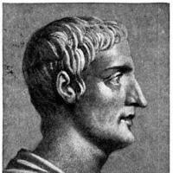
The Seven Kings of Rome
Romulus: 753-715 BC
Numa: 715-673 BC
Tullus Hostilius: 673-642 BC
Ancus Marcius: 642-616 BC
Tarquin the Elder: 616-579 BC
Servius Tullius: 579-534 BC
Tarquin the Proud: 534-510 BC

Slide 12
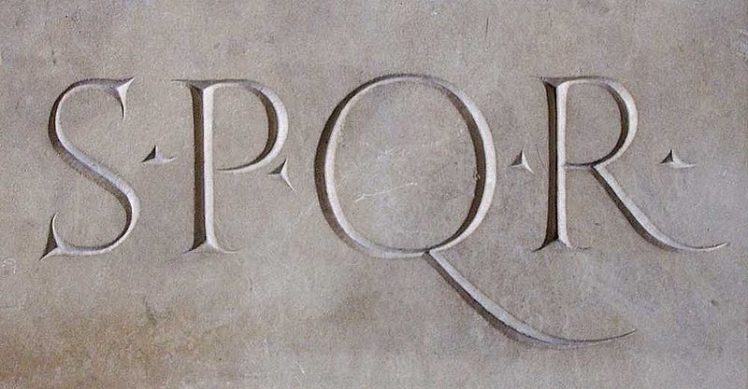
In 510 BC, a revolution broke out, spearheaded by Rome’s elite.
Established Senatorial Rule headed by aristocrats living in Rome.
Senex = Old wise men.

Slide 14
Establishment of the Republic
509 BCE Romans overthrow Tarquin and vowed never to have a government ruled by a King
Roman forum built = res publica or “public affairs”
Republican Constitution - the citizens have the right to vote for leader
Executive: 2 consuls
Senate
Voting Rights to all free-born male citizens

Slide 15
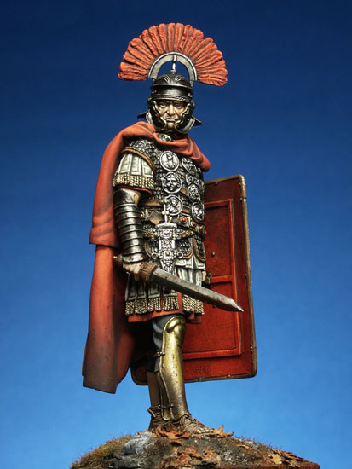
Social Conflict
Patricians (aristocrats)
Plebeians (commoners)
Major class conflict 5th c. BC
Plebeians allowed to elect tribunes for representation
Twelve Tables - Roman Law
Yet 6-month appointments of dictators

Slide 16
Roman Law
Twelve Tables, c. 450 BCE
Adapted to diverse populations under Roman Rule
Innocent until proven guilty
Right to challenge accusers in court

Slide 18
Rome spread its power
Long series of conflicts reinforced the agrarian and military character of Rome.
Agricultural based no need to expand commercial pursuits
Steely Military Ideal: Horatio and Cincinnatus

Slide 19
Expansion of the Republic
Dominated Etruscans
Took over iron industry 5th-4th c. BC
Expansion via military threat and incentives
Legions - 5,000 soliders broke up into infantry and cavalry
Tax exemptions
Trade privileges
Citizenship
By 265 BC had conquered all of the Italian peninsula

Slide 20
Roman Deities
Polytheistic
Major gods
Tutelary deities
Absorption of gods from other cultures

Slide 21
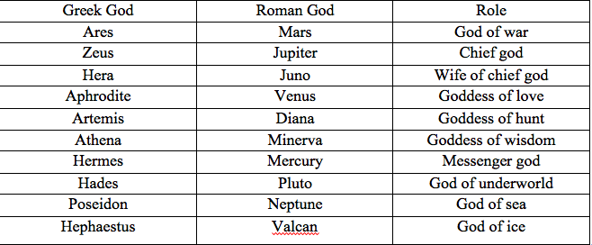
Roman Religion

Slide 23
The Punic Wars
Conflict with Carthage, 264-164 BCE
Romans called Carthage Poeni for Phoenicians
Three major wars over Sicilian grain supply
Later conflict with declining Hellenistic Empires
Rome dominates Mediterranean by middle of 2nd C. BC

Slide 24
Stages of War
First Punic War: 264-241 BC - began over the presence of Carthage in Sicily
Second Punic War: 218-202 BC - Rome was not happy about Carthage’s entrance into Spain
Hannibal crosses the Alps biggest threat but meets Fabius the Delayer
Scipio Africanus attacks Carthage in 202 BC
Third Punic War: 149-146 BC
Cato the Elder “Carthage must be destroyed!”

Slide 25
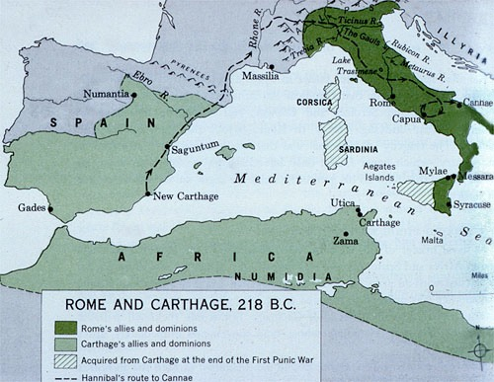

Slide 26
the Spoils of War
Rome successful defeated Carthage in all three Punic Wars.
Incorporates the conquered peoples as Romans.
By 140 BC, Rome expanded further to Greece & Egypt.

Slide 27
Commercial Agriculture and Trade
Latifundia: production for export
Regional specialization increases
Integration of Empire-wide economy
Mediterranean Sea: Mare Nostrum, “our sea”

Slide 28
Imperial Expansion and Domestic Problems
Land distribution
Perennial problem
Development of large latifundia
Unfair competition for smaller landholders
Slavery - introduction of the plantation system
By 100 BC one-third of Rome’s population
Growing discontent among the lower classes of society and break down in military order

Slide 29
Slavery
Estimated at one-third of Empire population = commercialized product
Customary manumission at age 30
Agricultural work, quarries, mines
Chain labor
Revolt under Spartacus, 73 BCE

Slide 30
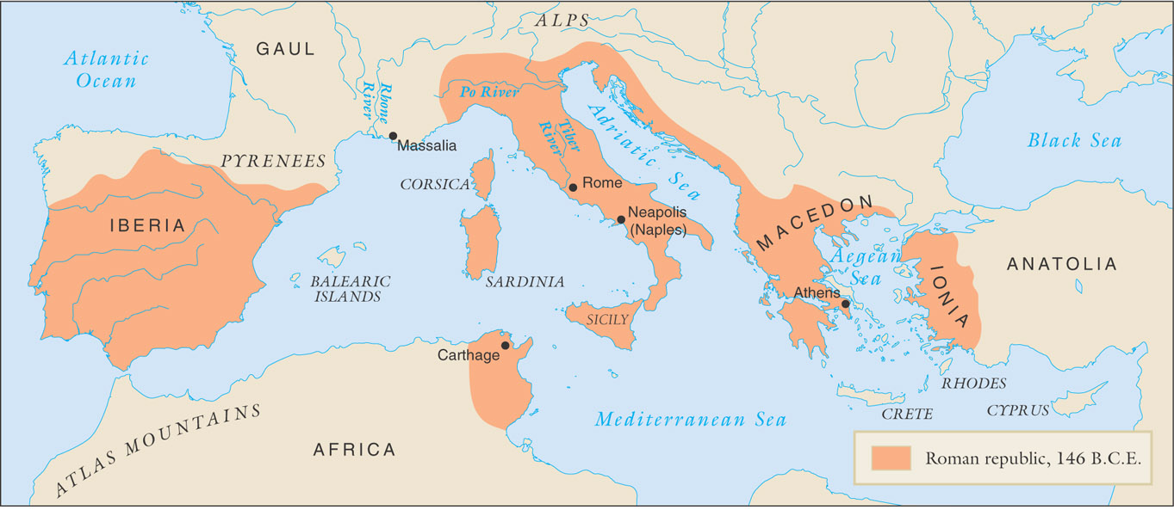
The Roman Empire to 146 BCE

Slide 31
The Gracchi Brothers
Tiberius and Gaius
133 BC - Tiberius suggested to limit land holdings of aristocrats and redistribute the land
Assassinated by a mob of conservative senators

Slide 32
Freedom Fighter
Gaius Gracchus, Tiberius’ brother renewed the struggle nine years later.
Stabilizing the grain price in Rome to help the poor.
122 BC - he was executed and charged as an outlaw by the Senate.

Slide 33
Civil War
The Gracchan turbulence indicated that Rome outgrew its constitution.
Development of private armies made up of landless peasants
Gaius Marius (with reformers) in 107-87 BC he takes Rome
Lucius Cornelius Sulla (with aristocrats) drives Marius out of Rome and takes command of in 82 BC - Dictatorship
Reign of terror follows until 60 BC when the first triumvirate formed.

Slide 34
Cicero and Stoicism
Marcus Tullius Cicero (106-46 BCE)
Major orator, writer
Influenced by Greek thought
Proponent of Stoicism

Slide 36
What makes a Good Leader?
Which is more important in measuring leadership—results or integrity?
Does a leader have to be likable in order to succeed?

Slide 37
A trio of Hope
Triumvirate consisted of military partnerships among:
Caesar(north), Crassus(central) and Pompey(south).
59-49 BC power transfers to the military and generals
Consul - elected by people

Slide 38
Julius Caesar
Nephew of Marius
Escapes Sulla’s terror
Relatively young, well-timed trip abroad
Rises to popularity
Public spectacles, victories in Gaul
Loyal legionaries

Slide 39
The Conqueror
In 49 BC crosses the Rubicon River and marched on to Rome
Defeats Pompey in 48 BC and moves onto Egypt
Veni, Vidi, Vici - leveraged Roman Hegemony on the boarded of old Hellenistic Empire
Names self Dictator for life in 46 BC

Slide 40
Caesar’s Policies
Centralized military, governance under personal control
Redistribution of land to war veterans, other allies
Major building projects reduce urban unemployment
Extended citizenship to provinces
Aristocrats threatened, assassinate Caesar on March 15, 44 BC
Brutus and Cassius - been vilified by Shakespeare’s play

Slide 42
Beginning of the Empire
Civil conflict follows death of Caesar
The Second Triumvirate forms in 43 BC and rules for 10 years
Octavian (Caesar’s nephew) and generals Mark Anthony and a politician named Lepidus.

Slide 43
Jealousy and violence
33 BC Octavian forces Lepidus to retire.
Then Octavian fights with Mark Antony & Cleopatra
Accuses Mark Antony of treason and conspiracy
Battle of Actium - 31 BC Octavian defeats the duo

Slide 45
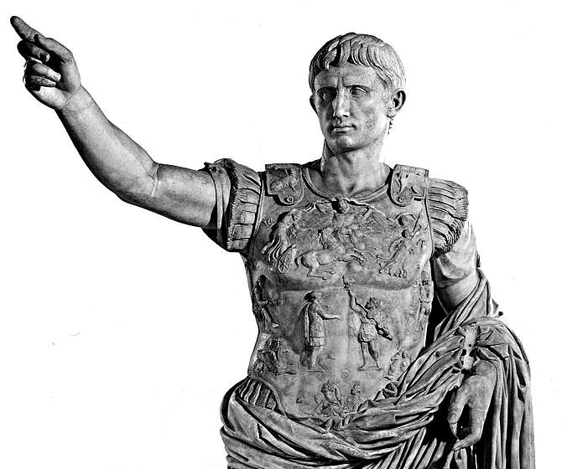
Augustus’ Administration
Monarchy disguised as a republic
Takes title Augustus 27 BC
Increasing centralization of political, military power
Civil Service
Princeps
Stabilized empire through the Pax Romana
Death in 14 CE

Slide 46
Expansion and Integration of Empire
Roman occupation of increasingly remote areas
Gaul, Germany, Britain, Spain
Coordination of crop production, transport of natural resources
Developed infrastructure, cities emerge

Slide 47
Pax Romana: “Roman Peace”
27-250 CE
Facilitated trade, communication
Stable Coinage and leveraged a systematic tax collection system
Roadwork
Curbs, drainage, milestones
Postal service

Slide 48
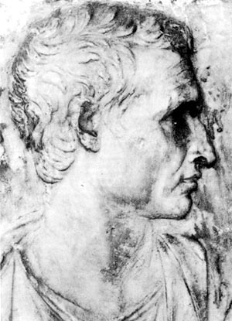
Virgil
70 - 19 BC
Golden Age of Latin Literature
Wrote the Eclogues
Pastoral Poetry
Mirrors the Homeric Epics

Slide 49
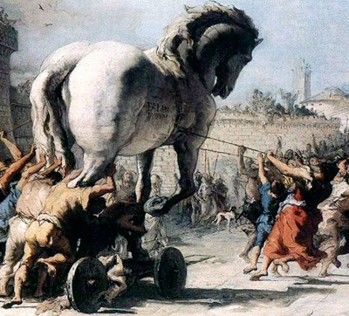
Fall of Troy
Troy’s Walls
The Wooden Horse.
Odysseus’ plan worked and the Greeks seized Troy.
Achilles shot in the heel by Paris and dies.
Odysseus chosen as the next great warrior.

Slide 50
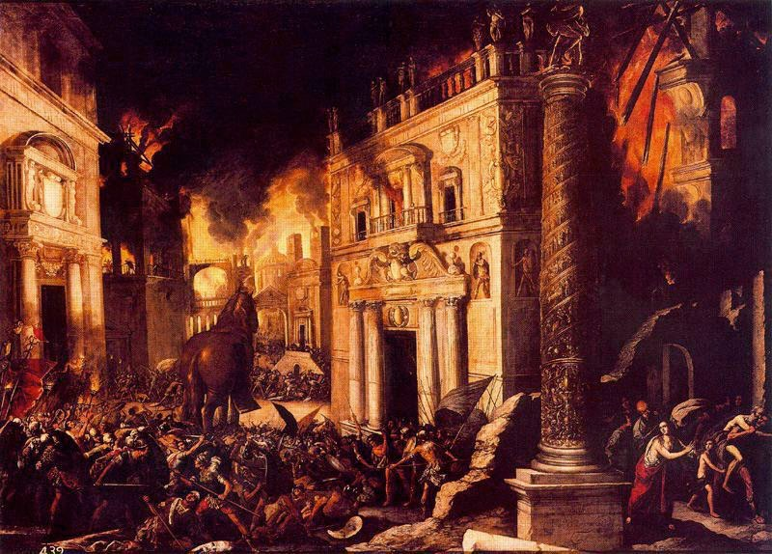
Burning down the House

Slide 51
The Aeneid
The “Legendary” story of Rome
Aeneas was the Seed of Troy
Book I - lands in Carthage meets Dido (Tragic Queen)
Book II - Aeneas tells Dido his story - Epic Journey

Slide 52
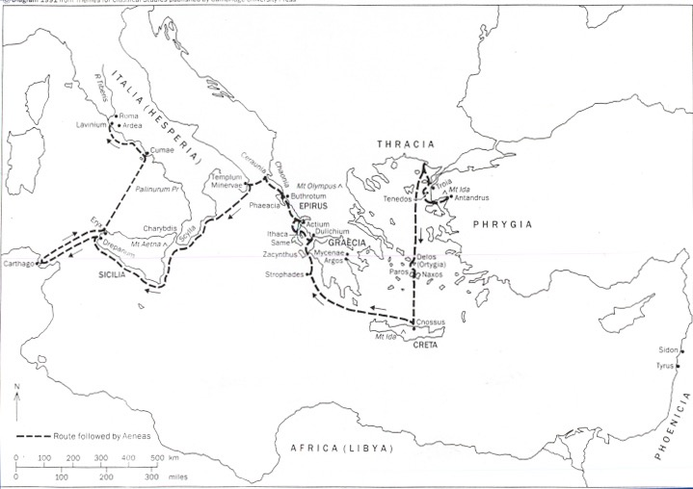

Slide 54
Agriculture and Trade
Agriculture was the most important industry in the empire.
90 percent of the people were engaged in farming
As Empire expanded so did the trade

Slide 56
Family and Society
Pater Familias: “father of the family”
Right to arrange marriages, sell children into slavery
Women not allowed to inherit property
Rarely enforced

Slide 57
Roman Attractions
The Empire Flourished into a Golden Age under Augustus
Underground sewage
Circus Maximus
250,000 spectators
Colosseum
Gladiatorial Games

Slide 58
Wealth and Social Change
Newly rich challenge aristocracy
To distract and control the masses of Romans, the government provided free games, mock battles, and gladiatorial contests.
Poor class increasing in size
Distraction: “Bread and Circuses”

Slide 60
Mithraism
From Zoroastrian myth: god of Sun, light
Roman version emphasizes strength, courage, discipline
Women not admitted into cult
Appealed to military
Cult of Isis also popular

Slide 61
Judaism in Early Rome
Jewish monotheism at odds with most ancient cultures
Refusal to recognize state gods
Repeated Jewish rebellions
Romans finally crush Jewish self-governance in Jewish Wars (66-70 CE)

Slide 62
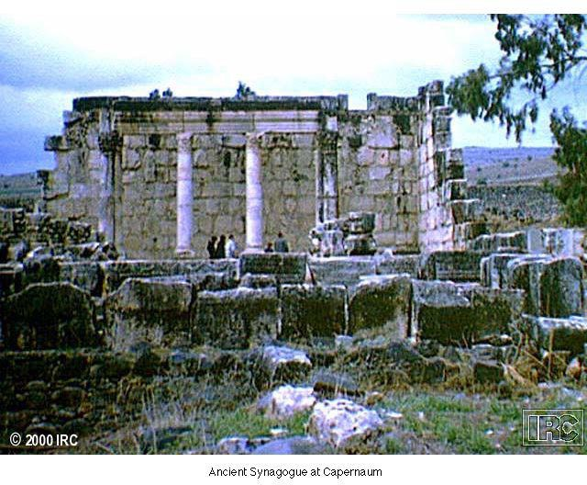
Synagogue at Capernaum

Slide 63
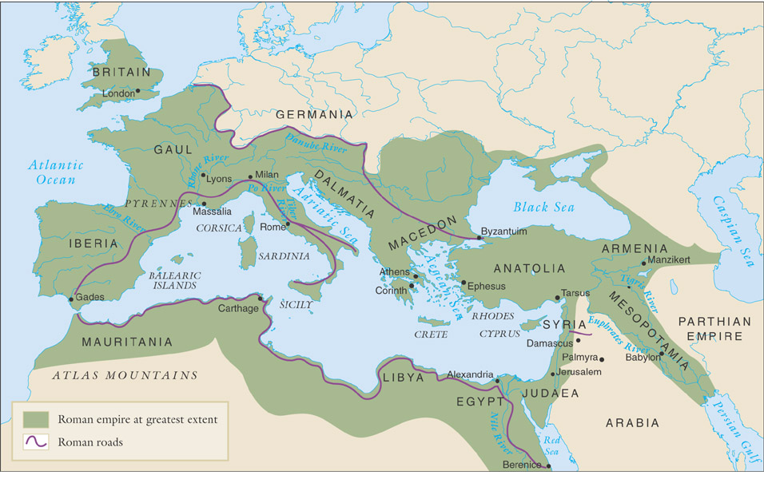
The Roman Empire, c. 117 CE

Slide 64
Augustus’ Successors
At first no real capable rulers
Caligula 37-41AD
Claudius 41-54 AD
Nero 54-68 AD

Slide 65
Five Good Emperors
Nerva 96-98 AD
Trajan 98-117 AD
Hadrian 117-138 AD
Antoninus Pius 138-161 AD
Marcus Aurelius 161-180 AD

Slide 66
Next Week
How did Christianity arise in the wake of the collapse of Rome? Consider Gibbon again or discuss the success of Christianity on its own after 476

