Slide 1
Week 8
Hellenistic Civilization

Slide 2
Aftermath of the Peloponnesian War
Weakened Greek City-States
Rapid decline in military and economic power.
Macedonia Emerges

Slide 3
Kingdom of Macedonia
Frontier region to north of Peloponnesus
King Philip II (r. 359-336 BCE) builds massive military
350 BCE encroaches on Greek poleis to the south, controls region by 338 BCE

Slide 4
Philip and Macedon Hegemony
Machiavellian type of politician
Unscrupulous leader who mixed the best of the barbaric with that of Greek culture
Siege of Methone
Deonsthenes of Athens
Battle of Chaerona

Slide 5
Alexander the Great
356-323 BC
Tutored by Aristotle
became king in 336 at the age of 20. Philip was assassinated by a Macedonian nobleman.
Builds a massive army of 40,000 soldiers
Attacks Persia 336-35 BC
Darius III

Slide 6
The Conqueror
“Alexander wept when he heard from Anaxarchus that there was an infinite number of worlds. When his friends asked if any accident had befallen him, he answered: ‘ Do you not think it a matter worthy of lamentation that when there is such a vast multitude of them, we have not yet conquered one?’”
Plutarch, On the Tranquility of the Mind

Slide 7
the Cosmopolitan Ruler
After Persia makes rapid expansion throughout Mediterranean basin … rejected Darius offer to accept the lands to the west of the Euphrates River
332 BC enters Egypt where he was welcomed by the Egyptians.
332-326 BC the Battle of Gaugamela crushes Darius again whose army was over 250,000 men.
Forges the first unified Greek Civilization and establishes the concept of cosmopolitanism
Moves onto India and reaches the Indus Valley in 326 BC

Slide 9
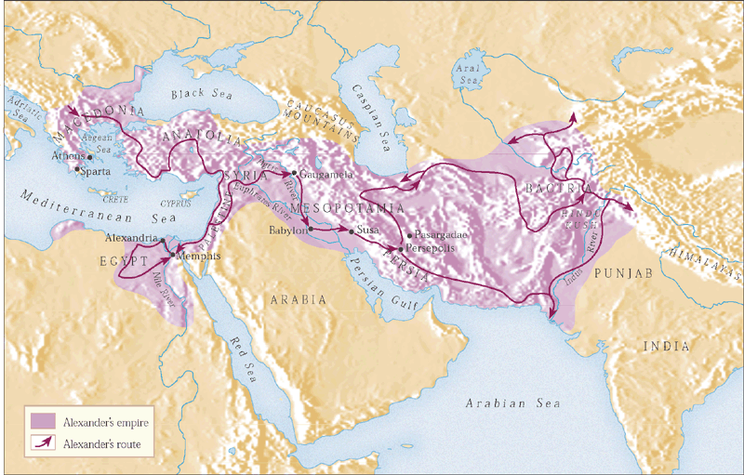

Slide 10
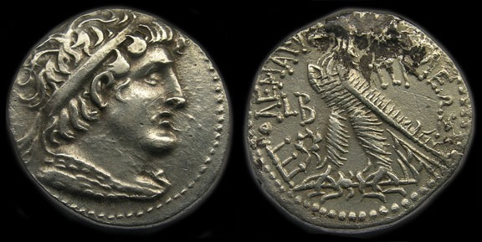
Cosmopolitan
Universal Empire - Hellenistic society characterized by mingling and exchange of cultures.
Greek, Mesopotamian, Egyptian, Hebrew, and Persian traditions interact.
Alexandria, Egypt

Slide 11
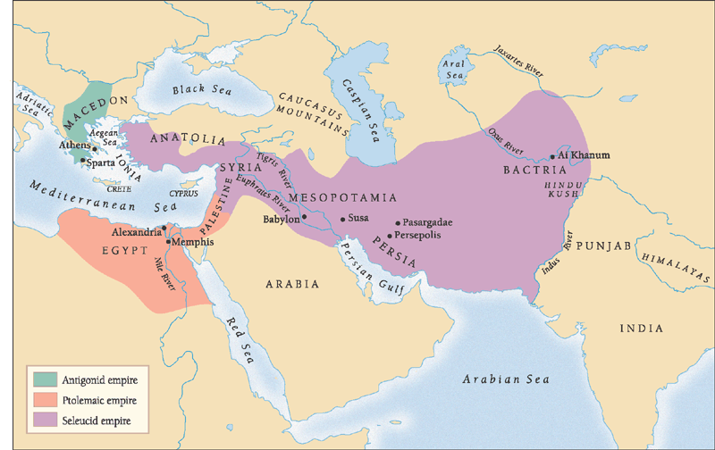
The Hellenistic Empires
After Alexander’s death in 323 BC competition for empire
Divided by generals
Antigonus: Greece and Macedon
Ptolemy: Egypt
Seleucus: Persian Achaemenid Empire
Economic integration, Intellectual cross-fertilization

Slide 12
The Antigonid Empire
Smallest of Hellenistic Empires
Local dissent
Issue of land distribution
Heavy colonizing activity

Slide 13
The Ptolemaic Empire
Wealthiest of the Hellenistic empires
Established state monopolies
Textiles
Salt
Beer
Capital: Alexandria
Important port city
Major museum, library

Slide 14
The Seleucid Empire
Massive colonization of Greeks
Export of Greek culture, values as far east as India
Bactria
Ashoka legislates in Greek and Aramaic

Slide 15
Hellenistic Culture
Literature, History, and Art
Callimachus (305-240 BC) urged poets to write short poems.
Theocritus (315-250 BC) wrote pastoral poetry
Polybius (200-118 BC) leading Hellenistic historian
Language - Greek Koine - literally “shared”

Slide 22
Developments of Science
Alexander brought surveyors, engineers, and architects to Asia Minor to collect data.
Knowledge through the rational collection of data. The birth of analysis and research.
Astronomy and Mathematics prevailed during the Hellenistic Age.

Slide 23
Eureka
Euclid (c.300 BC) applied reason to geometry
The Golden Ratio 1.618
Archimedes of Syracuse (287-212 BC)
Density - Water Placement

Slide 24
Hellenistic Philosophies
Hellenistic thinkers reflected the general anxiety pervading their society. Does this provide comfort?
The View of Happiness
Epicureans
Pleasure, distinct from Hedonists
Stoics
Duty, virtue
Emphasis on inner peace
Skeptics
Doubted possibility of certainty in anything

Slide 25
Happiness as Pleasure
Hedonism = delight or gaining happiness from pleasure
Aristippus 435-356 BC
Happiness is the sum total of pleasures experienced during one’s lifetime.

Slide 26
Hedonist Assumptions
Everyone deserves as much pleasure as possible
Pleasure is automatically good.
No amount of pleasure is ever too much.
Absence of pleasure is a misfortune for which compensation is due

Slide 27
Happiness Is Avoiding Pain
Epicureanism is the happiness of not being in pain.
Epicurus (341-270 B.C.)
Man only needs bread and water. Why?

Slide 28
Epicurean Assumptions
If we buy into Hedonism, then we are in constant need of pleasure.
No one can sustain pleasure for prolonged periods of time.
Avoid excess and seek out non-physical pleasures.

Slide 29
Happiness as Strategy for Survival
“When you come to the end of your rope, tie a knot”
Stoicism teaches that pain is intrinsic to living.
Don’t avoid the pain, cope with it.

Slide 30
Stoic Assumptions
Each of us can control our responses to external events.
“Life is what happens while we are out making plans.”
True happiness is not a matter of circumstance, or good fortune but how we respond to what happens to us.

Slide 31
Stoic Minds
Zeno: (335-264 B.C.)
Epictetus: (50-130 A.D.)
Happiness like sorrow is an idea or an attitude not an object or an event.

Slide 32
Skepticism
Cyrene (213-129 BC)
All ideas are only hypotheses
Essential no beliefs are true and there is no way to truly be happy
Suspended judgement calms the mind and brings contentment

Slide 33
Cynicism
Diogenes (c.330 BC) met Alexander the Great
Cultivate apathy, disdain, and discomfort
Society is that which restrains us from our true freedom.
Role of the Individual - Solipsism

Slide 34
The Hellenistic Legacy
Greek civilization spread both east and west because of Alexander and his successor kings
Cosmopolitanism emerged and was adapted by future civilizations
Rome embodied it in law, institutions, and art
Christianity will also resonate with Stoic ideas of human equality, the notion of natural rights and the concept of universalism.

Slide 35
Next Week
Something Old, Something New … so much of what Rome did to emerge as a powerful Empire was predicated in the adaptation of past societies and civilizations. Be able to account for what Rome borrowed and what they created that was new.
Consider Virgil’s great work the Aeneid as a prime example of this phenomenon.

