Slide 1
Week 5
Golden Age of Greek Civilization

Slide 2
Classical Greek Civilization
750 - 550 BC - The Age of Expansion
550 - 400 BC - The Age of Democracy
500- 479 BC - The Persian War
431- 404 BC - Peloponnesian War
400 - 300 BC - The Age of Philosophy

Slide 3
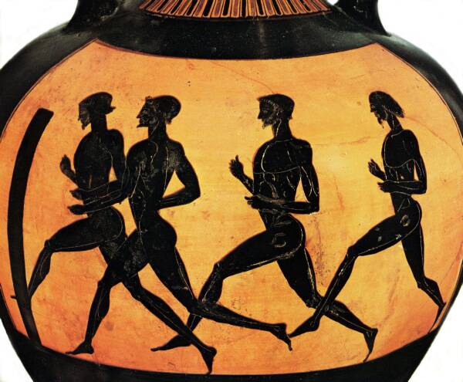
Olympics
776 BCE - festival to honor the gods.
Showed off strength and vitality
long-distance race, wrestling, the long jump, javelin, and discus throw.

Slide 4
Character of Civilization
Around 750 BCE the character of Greek or Hellenic Civilization emerged.
Most notable developments were in the political realm.
Spartan vs. Athenian government

Slide 5
The Polis
City-state
Urban center, dominating surrounding rural areas
Highly independent character
Monarchies
“Tyrannies”, not necessarily oppressive
Early Democracies

Slide 6
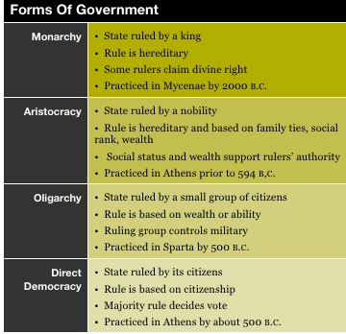

Slide 8
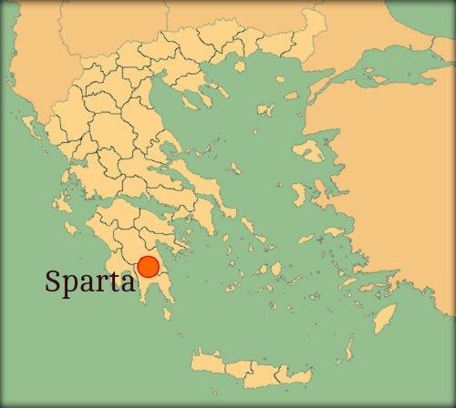

Slide 9
Sparta
Cut off from the rest of Greece. Protected by the Gulf of Corinth
In 725 BCE - Sparta conquered the region of Messenia.
Enslaved the peoples

Slide 10
Military Might
Highly militarized society
Subjugated peoples of Messenia: helots
Serfs, tied to land
Outnumbered Spartans 10:1 so they revolted in 650 BCE, but it was put down
Military society developed to control threat of rebellion > Oligarchy

Slide 11
Spartan Government
Assembly - included all Spartan citizens.
Elected officials and voted on major issues.
Council of Elders - included 30 older citizens
Proposed laws on which the assembly voted.
Council of Five - 5 elected officials - Executives
Controlled education, prosecuted court cases, and carried out the passed laws from the assembly.

Slide 12
Spartan Society
Austerity the norm
Boys removed from families at age seven
Received military training in barracks
Active military service follows
Marriage, but no home life until age 30
Some relaxation of discipline by 4th c. CE

Slide 13
Athens
Development of early democracy
Free, adult males only
Women, slaves excluded
Yet contrast Athenian style of government with Spartan militarism …. what is the difference?

Slide 14
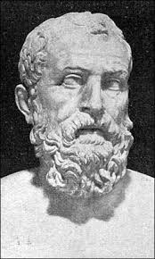
Building Democracy
621 BCE Draco developed a legal code.
All Athenians, rich and poor, were equal under the law.
Extremely harsh code for criminals and debtors.
Civil War looming in the background

Slide 15
Athenian Society
Maritime trade brings increasing prosperity beginning 7th c. BCE
Aristocrats dominate smaller landholders
Areopagus Council
Increasing socio-economic tensions
Class conflict

Slide 16
Solon and Athenian Democracy
Aristocrat Solon mediates crisis in 594 BCE
No citizen should own another citizen
Aristocrats to keep large landholdings
But forgive debts, ban debt slavery
Removed family restrictions against participating in public life
Instituted paid civil service

Slide 17
Cleisthenes
Around 500 BCE - instituted further reforms.
Broke up the power of the nobility by organizing citizens in to ten groups based on where they lived.
Allowed citizens to submit laws for debate and passage.
Council of Five Hundred - chosen by lot or at random > Direct Democracy — what’s the problem with mob rule?

Slide 18
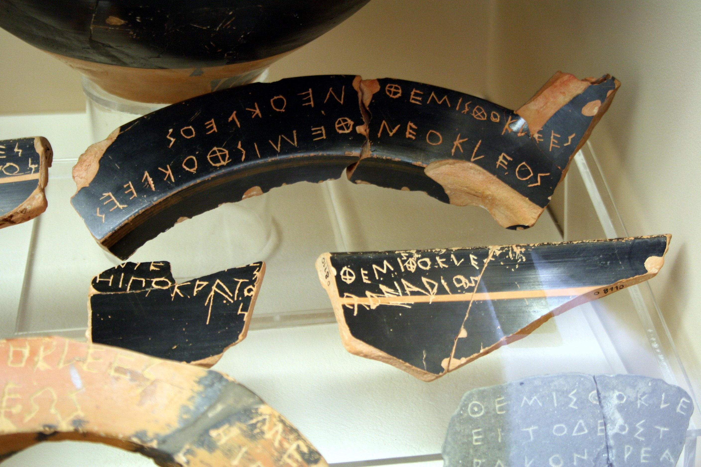
Ostracism
Greek Ostraka were pots.
Democracy - take old potsherds and write the names of unpopular citizens.
Banned from the polis - ostracized

Slide 19
Athenian Education
Sons of wealthy families received formal education > mostly boys starting at 7 years old.
General Studies: Reading, Grammar, Poetry, History, Mathematics, and Music.
Logic and Public Speaking most important … why?
demagogues - public figures
Duty of Citizenship - Military school at the age of 16 to 18.

Slide 20
The Polis
Polis - “City-State” expands the length of the Mediterranean World.
Originally aristocratic republics
Government and Politics
Athens and Sparta - What were the chief differences between these two states?

Slide 21
Greek Colonization
Following the development of Athens and Sparta, the Greeks began to colonize.
Population expansion drives colonization
Coastal Mediterranean, Black sea
Sicily (Naples: “nea polis,” new city)
Southern France (Massalia: Marseilles)
Anatolia
Southern Ukraine

Slide 22
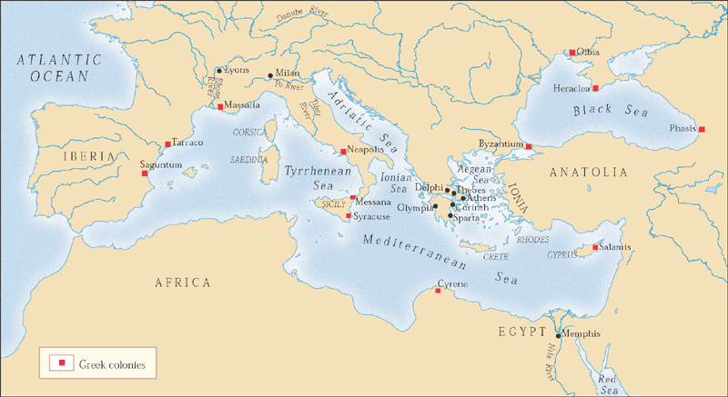
Classical Greece and the Mediterranean basin, 800-500 B.C.E.

Slide 23
Persian Wars (500-479 BCE)
Revolt against Persian Empire 500 BCE in Ionia
Athens supports with ships
Yet Greek rebellion crushed by Darius 493 BCE; routed in 490 to Greece’s mainland.
25,000 Persians were no match for the Greeks mighty phalanxes.

Slide 24
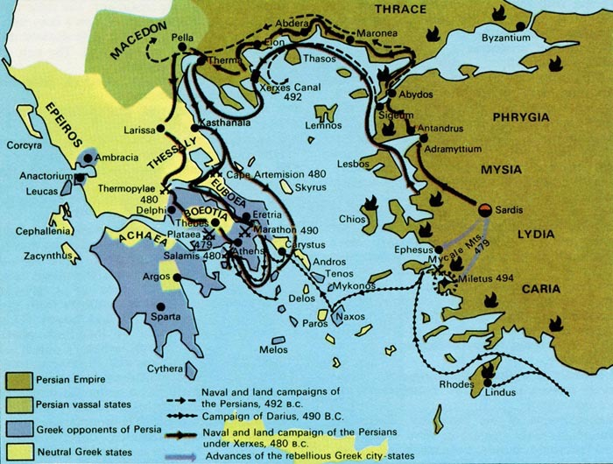

Slide 25
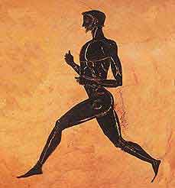
Marathon Man
490 BC - Battle of Marathon
Pheidippides, a young runner, ran from Marathon to Athens to inform the council of their victory

Slide 27
Second Phase of War
In 480 BC, Xerxes set out to crush Athens. Some Greek city-states fought on the Persian side.
Battle of Thermopylae - 7,000 Greeks along with 300 Spartans block Xerxes path to Athens.
A traitor helps Xerxes defeat the Greeks and he burns Athens.

Slide 28
To the Sea
Themistocles, an Athenian leader, convinces the army to flee the city and attack Xerxes by sea.
Smaller Greek ships defeat the Persians at two battles.
Salamis and Plataea
Herodotus - The Histories: How does he depict the war?

Slide 29
The Delian League
Poleis create Delian League to forestall more Persian attacks
Led by Athens
Massive payments to Athens fuels Periclean expansion
Resented by other poleis … Especially Sparta why?

Slide 32
Pericles
Ruled 461-429 BCE
High point of Athenian democracy
Aristocratic but popular
Massive public works
Encouraged cultural development

Slide 33
Age of Pericles
The Age of Pericles is the considered the Golden Age of Democracy.
Three Major Goals:
strengthen Athenian democracy
hold and strengthen the empire
glorify Athens

Slide 34
Greek Drama
Evolution from public presentations of cultic rituals
Religious ceremonies that showcased civic pride and a tribute to the gods.
Major playwrights (5th c. BC)
Aeschylus - Oresteia
Sophocles - Oedipus Trilogy*
Euripides - Medea
Comedy: Aristophanes - Lysistrata

Slide 35
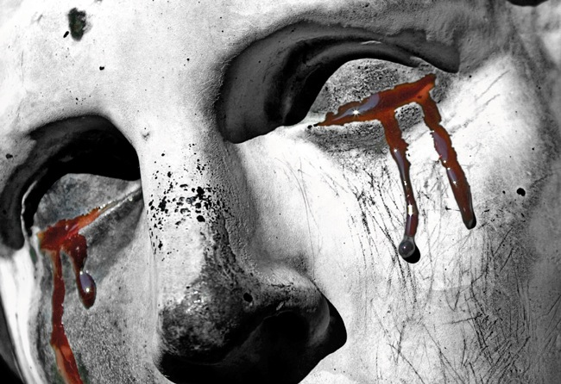
Oedipus Rex

Slide 36
The Story of Oedipus
Son of Laius and Jocasta the King and Queen of Thebes.
FATE - Kill your father and marry your mother!
Oedipus = Swollen Foot

Slide 37
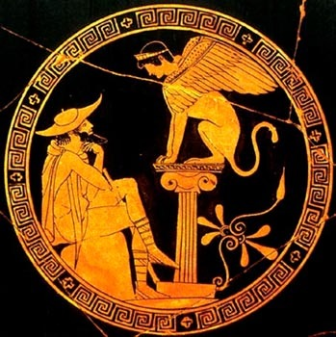

Slide 38
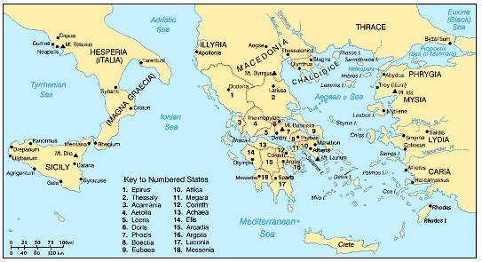

Slide 39
The Tragic Lesson
“Let every man in mankind’s frailty consider his last day; and let none presume on his good fortune until he find life, at this death a memory without pain.”

Slide 40
The Peloponnesian War
Civil war in Greece, 431-404 BCE
Poleis allied with either Athens or Sparta
Athens forced to surrender to the might of Sparta
But conflict continued between Sparta and other poleis
Thucydides - History of the Peloponnesian War.
Pericles’ Funeral Oration - What did he address in this excerpt?

Slide 41
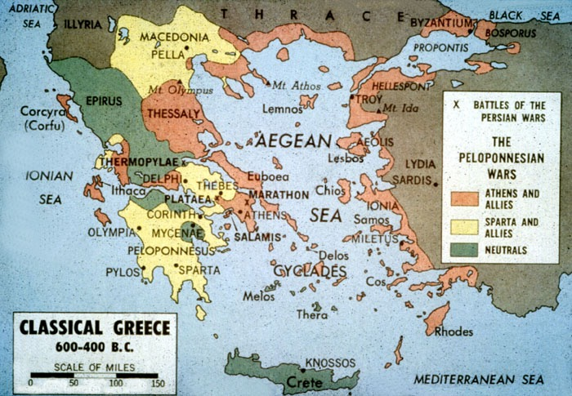

Slide 42
Plague and War
Athens had a superior navy, but no match for the Spartan army.
In 430 BC, a plague swept through Greece killing thousands, including Pericles.
The Truce between 421 - 415 BC. Athens regrouped and aimed to destroy Sicily.
Athens lost the battle and hung on to 414 before losing the entire war, empire, and power.

Slide 43
The Greek Language
Borrowed Phoenician alphabet. The Greek language which included a “middle voice” allowed for communication of abstract idea, such as philosophy.
Athenians during the war lost confidence in the democratic government as well as the uncertainty of life.
Universal Truths, Law, and Logic

Slide 44
Socrates (470-399 BC)
The Socratic Method
Student: Plato
Public gadfly, condemned on charges of immorality
The Socratic Method - Posing Questions
“The unexamined life is not worth living”
The Death of Socrates - Forced to drink hemlock

Slide 45
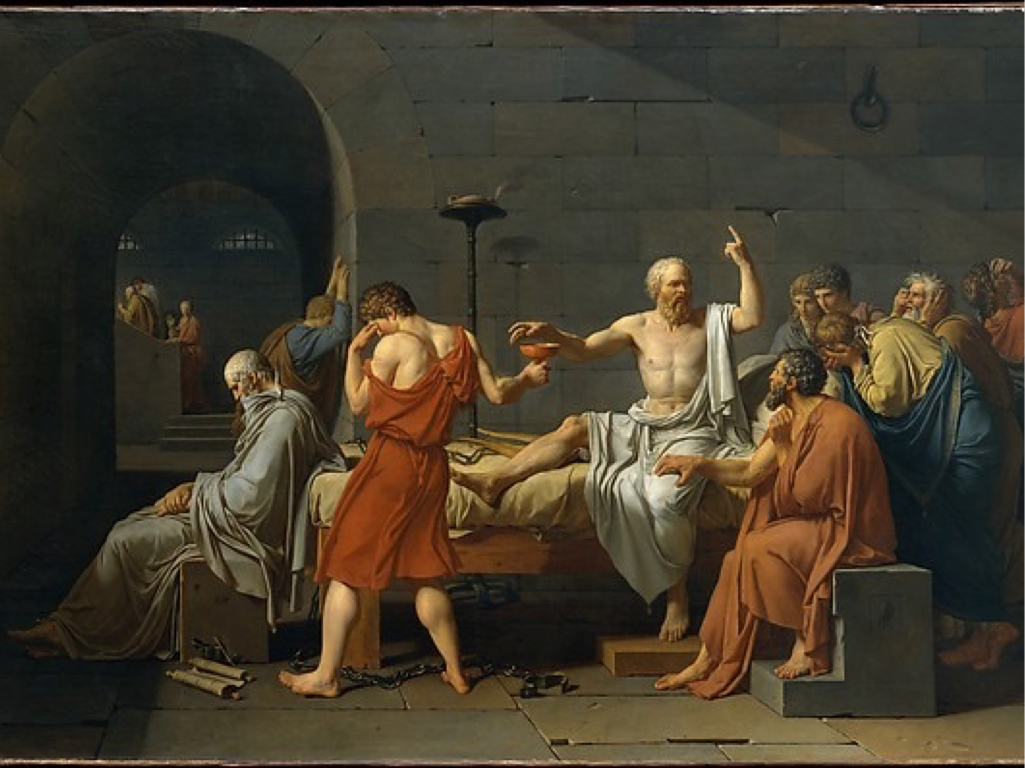

Slide 46
Plato (430-347 BC)
Systematized Socratic thought
The Republic
Parable of the Cave
Theory of Forms/Ideas
Ring of Gyges - Morality

Slide 47
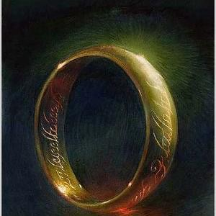
Self-Interest
Is acting out of self-interest always a bad thing?
Are we doing good out of virtue or to get noticed?
The Ring of Gyges - “To know the good is to do the good”

Slide 48
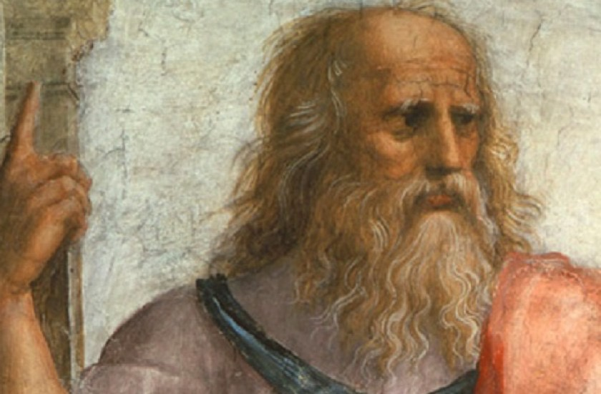
The Philosopher King
Philosopher Kings = men guided by reason
According to Plato, these men would balance out the democracy in society, and prevent any vicious self-interested individual from taking over.

Slide 49
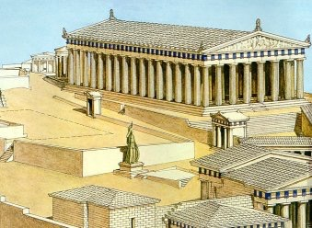
Government & Self-Interest
Plato’s concept of the Philosopher King helps explain the birth and development of Western Civilization.
What is the “right” form of government? morally guided?
“Government is best which governs the least”

Slide 50
Aristotle (389-322 BC)
Student of Plato
Broke with Theory of Forms/Ideas
Emphasis on empirical findings, reason
Massive impact on western thought
Metaphysics - Logic -> teleological
Nicomachean Ethics - Self Realization
golden mean

Slide 51
Aristotle’s View on Happiness
There will always be limitations to happiness.
Many people live in unimaginable conditions that are anything but happy.
Social and Cultural Reform

Slide 52
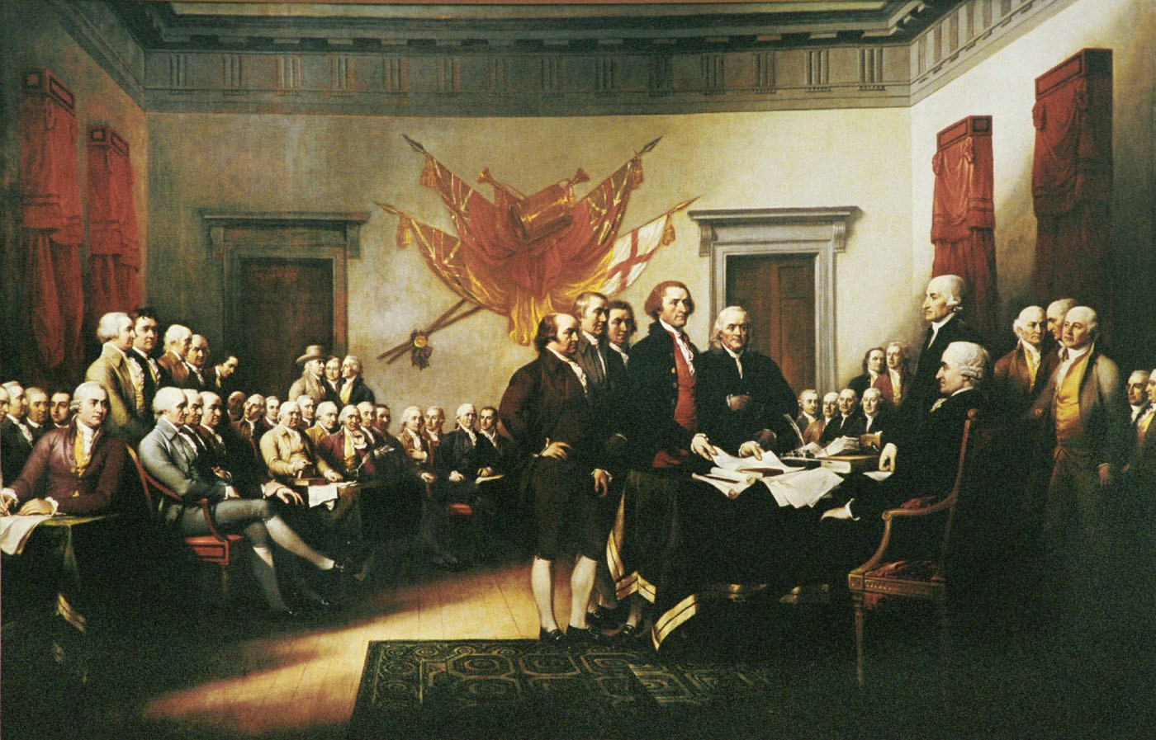
The Government’s Role
If morality is crucial to the concept of good government, then so too is the idea of happiness.
The basic function of government is to provide happiness for each citizen
American Revolution began with this concept.

Slide 53
Greek Achievement
Undesirable and Unique features of Greek Life
Democracy - Role of Freedom
Value of Life - Philosophy
The Art of the Humanities

Slide 54
Next Week
How did Alexander embody the best of the Greek concept of civilization? Consider all the empires we have discussed that mentioned Alexander.

