Slide 1
Week 4
The Orient - Ancient Indian and Chinese Civilizations

Slide 2
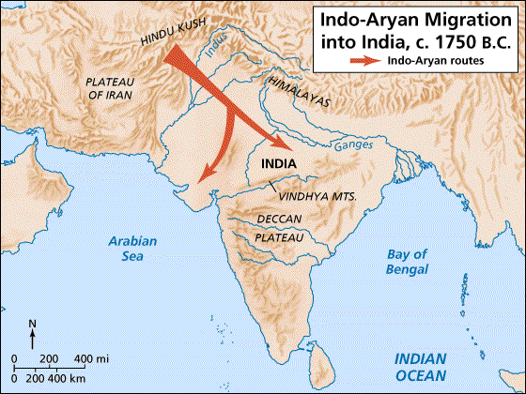
Early days of civilization
The pillars of Civilization were built upon:
Language
Written Law
City-States
Religion has also served as an important aspect to shaping civilization - Why?

Slide 3
Modes of Progress
The notion of progression as a sign of civilization was clearly a Western notion. What about the East?
The Ancient Orient - Indian and Chinese Civilization seems to look on different roots.
The Theme of Enlightenment

Slide 4
Indian Civilization
Vast and archaic culture
Evidence found in the 20th century suggests that Indian Civilization began as early as 4,000 BCE.
Religious society that developed a caste system.
Aryan Society

Slide 5
India begins to rise
520 BCE Persian Emperor Darius conquers north-west India
Introduces Persian ruling pattern
327 Alexander of Macedon destroys Persian Empire in India
Troops mutiny, departs after 2 years
Political power vacuum

Slide 6
Kingdom of Magadha
Most significant remaining kingdom after Alexander’s departure
Central Ganges plain
Economic strength
Agriculture
Trade in Ganges valley, Bay of Bengal
Dominated surrounding regions in north-eastern India

Slide 7
Chandragupta Maurya
322 - 298 BCE
Took advantage of power vacuum left by Alexander
Overthrew Magadha rulers
Expanded kingdom to create 1st unified Indian empire
Mauryan Dynasty

Slide 8
Chandragupta’s Government
Advisor Kautalya
Recorded in Arthashastra, manual of political statecraft
the ends justify the means
Foreign policies, economics
Domestic policies
Network of spies
Legend: Chandragupta retires to become a monk, starves himself to death

Slide 9
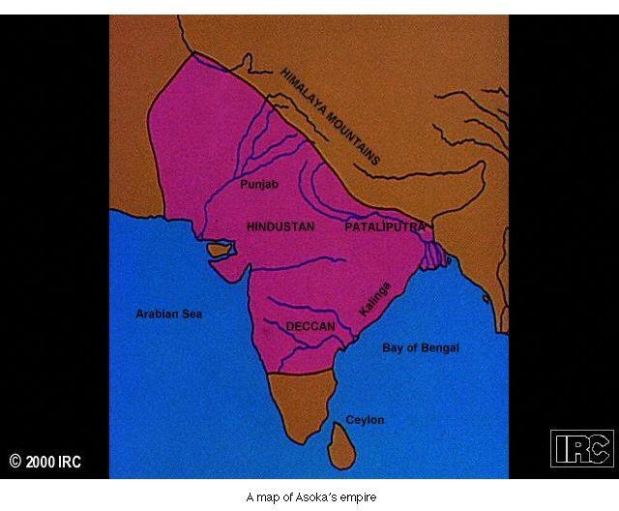
Ashoka Maurya
Grandson of Chandragupta
Represents high point of Mauryan Empire, r. 268-232 BCE
Expanded empire to include all of Indian subcontinent except for south
Positive rulership integrated Indian society

Slide 10
Decline of the Mauryan Empire
Economic crisis follows death of Ashoka
High costs of bureaucracy, military not supported by tax revenue
Frequent devaluations of currency to pay salaries
Regions begin to abandon Mauryan Empire
Disappears by 185 BCE

Slide 11
The Gupta Dynasty
Based in Magadha
Founded by Chandra Gupta (no relation to Chandragupta Maurya), c. 320 CE
Slightly smaller than Mauryan Empire
Highly decentralized leadership

Slide 12
Gupta Decline
Frequent invasions of White Huns, 5th c. CE
Gupta Dynasty disintegrates along regional fault lines
Smaller local kingdoms dominate until Mughal Empire founded in 16th c.

Slide 13
Economy: Towns and Manufacturing
Manufactured goods in big demand
Developed in dense network of small workshops
Trade intense, capitalizes on trade routes across India

Slide 14
Long-Distance Trade
Persian connection since Cyrus, Darius
Massive road-building projects under Persian rule
Alexander extends trade west to Macedon
Trade routes through Kush mountains, the silk roads

Slide 15
Trade in the Indian Ocean Basin
Seasonal sea trade expands
Spring/winter winds blow from south-west, fall/winter winds blow from north-west
Trade from Asia to Persian Gulf and Red Sea, Mediterranean

Slide 16
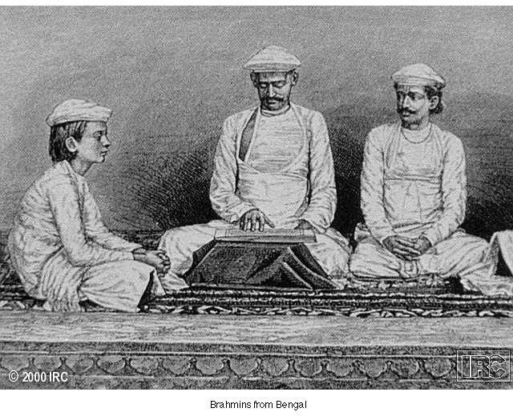
Social Order
Caste system from Aryan times
Brahmins (priests)
Kshatriyas (warriors, aristocrats)
Vaishyas (Peasants, merchants)
Shudras (serfs)

Slide 17
Castes and Guilds
Increasing economic diversification challenges simplistic caste system
Jatis formed: guilds that acted as sub-castes
Enforced social order
“outcastes” forced into low-status employment

Slide 18
Wealth and the Social Order
Upward social mobility possible for Vaishyas, Shudras
Wealth challenges varna for status

Slide 19
Religions of Salvation in Classical India
Social change generated resentment of caste privilege
e.g. Brahmins free from taxation
6th-5th c. BCE new religions and philosophies challenge status quo
Charvakas: atheists
Jainists, Buddhists

Slide 20
Jainism
Vardhamana Mahavira, 540-468 BCE
Abandoned privileged family to lead ascetic life
Promotes 7th c. movement based on Upanishads
Emphasis on selfless living, concern for all beings

Slide 21
Ahimsa
Principle of extreme non-violence
Jainists sweep earth, strain water, use slow movements to avoid killing insects
Ahimsa continues to inspire modern movements (Ghandi, Martin Luther King Jr.)

Slide 22
Appeal of Jainism
Rejected caste, jati distinctions
Obvious appeal to underprivileged groups
But asceticism too extreme to become a mass movement

Slide 23
Early Buddhism
Siddhartha Gautama, c. 563-483 BCE
Encountered age, sickness, death, then monastic life
Abandoned comfortable life to become a monk

Slide 24
Gautama’s Search for Enlightenment
Intense meditation, extreme asceticism
49 days of meditation under bo tree to finally achieve enlightenment
Attained title Buddha: “the enlightened one”

Slide 25
The Buddha and his Followers
Begins teaching new doctrine c. 528 BCE
Followers owned only robes, food bowls
Life of wandering, begging, meditation
Establishment of monastic communities

Slide 26
Buddha and his Disciples

Slide 27
Buddhist Doctrine: The Dharma
The Four Noble Truths
all life is suffering
there is an end to suffering
removing desire removes suffering
this may be done through the eight-fold path
(right views, intention, speech, action, livelihood, effort, mindfulness, concentration)

Slide 28
Appeal of Buddhism
Less dependence on Brahmins for ritual activities
No recognition of caste, jati status
Philosophy of moderate consumption
Public service through lay teaching
Use of vernacular, not Sanskrit

Slide 29
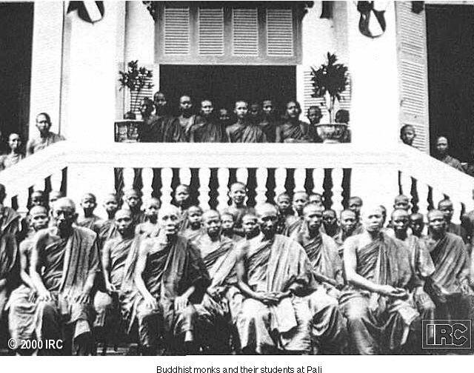
A Buddhist Monastery

Slide 30
Spread of Mahayana Buddhism
Mahayana (“greater vehicle”), newer development
India, China, Japan, Korea, central Asia
Hinayana (“lesser vehicle,” also Theravada), earlier version
Ceylon, Burma, Thailand

Slide 31
Emergence of Popular Hinduism
Composition of epics from older oral traditions
Mahabharata
Ramayana
Emphasis on god Vishnu and his incarnations
What did you think of the Hundred Questions?

Slide 32
The Bhagavad Gita
“Song of the Lord”
Centuries of revisions, final form c. 400 CE
Dialogue between Arjuna and Krishna during civil war

Slide 33
Hindu Ethics
Emphasis on meeting class obligations (dharma)
Pursuit of economic well-being and honesty (artha)
Enjoyment of social, physical and sexual pleasure (kama)
Salvation of the soul (moksha)

Slide 34
Go East - Chinese Civilization
Chinese Civilization one of the oldest in recorded time.
Predates many of the Western movements but isolated for years.
24 majestic dynasties
Xia- 2200 BCE

Slide 35
China in the dawn of civilization
Chinese culture much like Indian was focused on religious movements that emphasized the notion of Enlightenment.
Prominent developments during the dawn of civilization - bronze, metallurgy, silk, and spices.

Slide 36
Confucius
Kong Fuzi (551-479 BCE)
Master Philosopher Kong
Aristocratic roots
Unwilling to compromise principle
Decade of unemployment, wandering
Returned home a failure, died soon thereafter
Teachings: Analects
In the Analects what did the maxims relate to? What were some of the more important qualities presented in the reading?

Slide 37
Confucian Ideas
Ethics and politics
Avoided religion, metaphysics
Junzi: “superior individuals”
Role in government service
Emphasis on Zhou Dynasty texts
later formed core texts of Chinese education

Slide 38
Confucian Values
Ren
kindness, benevolence
Li
Propriety
Xiao
Filial piety
Traits lead to development of junzi
Ideal leaders

Slide 39
Mencius (372-289 BCE)
Principal Confucian scholar
Optimist, belief in power of ren
Not influential during lifetime
Considered prime exponent of Confucian thought since 10th century

Slide 40
Xunzi (298-238 BCE)
Career as government administrator
Belief in fundamental selfishness of humanity
Compare with Mencius
Emphasis on li, rigid propriety
discipline

Slide 41
Daoism
Critics of Confucianism
Passivism, rejection of active attempts to change the course of events
Founder: Laozi, 6th c. BCE
The Daodejing (Classic of Way and of Virtue)
Zhuangzi (named for author, 369-236 BCE)

Slide 42
The Dao
“The Way” (of nature, of the cosmos)
Water: soft and yielding, but capable of eroding rock
Cavity of pots, wheels: nonexistent, but essential

Slide 43
Doctrine of Wu wei
Attempt to control universe results in chaos
Restore order by disengagement
No advanced education
No ambition
Simple living in harmony with nature
Cultivate self-knowledge

Slide 44
Political Implications of Daoism
Confucianism as public doctrine
Daoism as private pursuit
Ironic combination allowed intellectuals to pursue both

Slide 45
Legalism
Emphasis on development of the state
Ruthless, end justifies the means
Role of Law
Strict punishment for violators
Principle of collective responsibility
Shang Yang (390-338 BCE), The Book of the Lord Shang
Han Feizi (280-233 BCE)
Forced to commit suicide by political enemies

Slide 46
Legalist Doctrine
Two strengths of the state
Agriculture
Military
Emphasized development of peasant, soldier classes
Distrust of pure intellectual, cultural pursuits
Historically, often imitated but rarely praised

Slide 48
Unification of China
Qin dynasty develops, 4th-3rd centuries BCE
Generous land grants under Shang Yang
Private farmers decrease power of large landholders
Increasing centralization of power
Improved military technology

Slide 49
The First Emperor
Qin Shi huangdi (r. 221-210 BCE) founds new dynasty as “First Emperor”
Dynasty ends in 207, but sets dramatic precedent
Basis of rule: centralized bureaucracy - autocracy
Massive public works begun
Incl. precursor to Great Wall

Slide 51
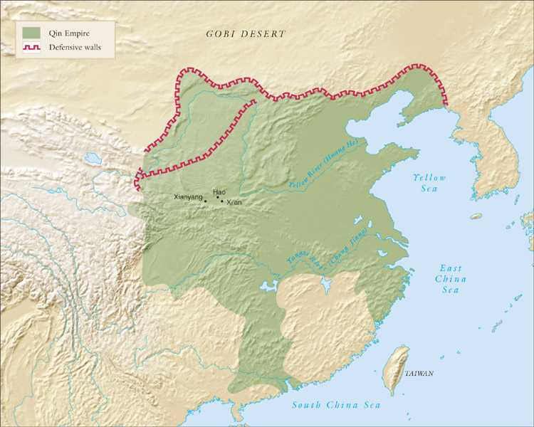
China under the Qin dynasty, 221-207 B.C.E.

Slide 52
Resistance to Qin Policies
Emperor orders execution of all critics
Orders burning of all ideological works
Some 460 scholars buried alive
Others exiled
Massive cultural losses

Slide 53
Qin Centralization
Standardized:
Laws
Currencies
Weights and measures
Script
Previously: single language written in distinct scripts
Building of roads, bridges

Slide 54
Massive Tomb Projects
Built by 700,000 workers
Slaves, concubines, and craftsmen sacrificed and buried
Excavated in 1974, 15,000 terra cotta soldiers unearthed

Slide 55
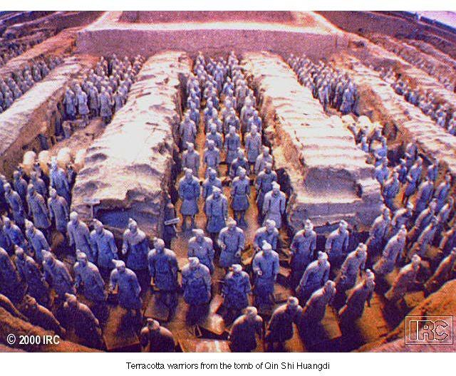
Tomb of the First Emperor

Slide 58
The Han Dynasty
Civil disorder brings down Qin dynasty 207 BCE
Liu Bang forms new dynasty: the Han (206 BCE-220 CE)
Former Han (206 BCE-9 CE)
Interruption 9-23 CE
Later Han (25-220 CE)

Slide 59
Early Han Policies
Relaxed Qin tyranny without returning to Zhou anarchy
Created large landholdings
But maintained control over administrative regions
After failed rebellion, took more central control

Slide 60
The Legacy of the East
The occidental notion of progress not stressed in the orient.
Centralization of government and development through a variety of religions.
The notion and theme of Enlightenment
cyclical rather than linear concept of history

Slide 61
Next Week
What were the chief differences between the Persian War and Peloponnesian War? How did these wars create a rise and fall in Greek Civilization?

