Slide 1
People, Land and Gods
Week 3:
Cities Around Water

Slide 2
The Phoenicians
City-states along Mediterranean coast after 3000 BCE
Extensive maritime trade
Dominated Mediterranean trade, 1200-800 BCE
Development of alphabet symbols
Simpler alternative to cuneiform
Spread of literacy
“Phonics” derives from this culture.

Slide 3
Indo-European Migrations
Common roots of many languages of Europe, southwest Asia, India
Implies influence of a single Indo-European people
Probable original homeland: contemporary Ukraine and Russia, 4500-2500 BCE
Domestication of horses, use of Sumerian weaponry allowed them to spread widely

Slide 4
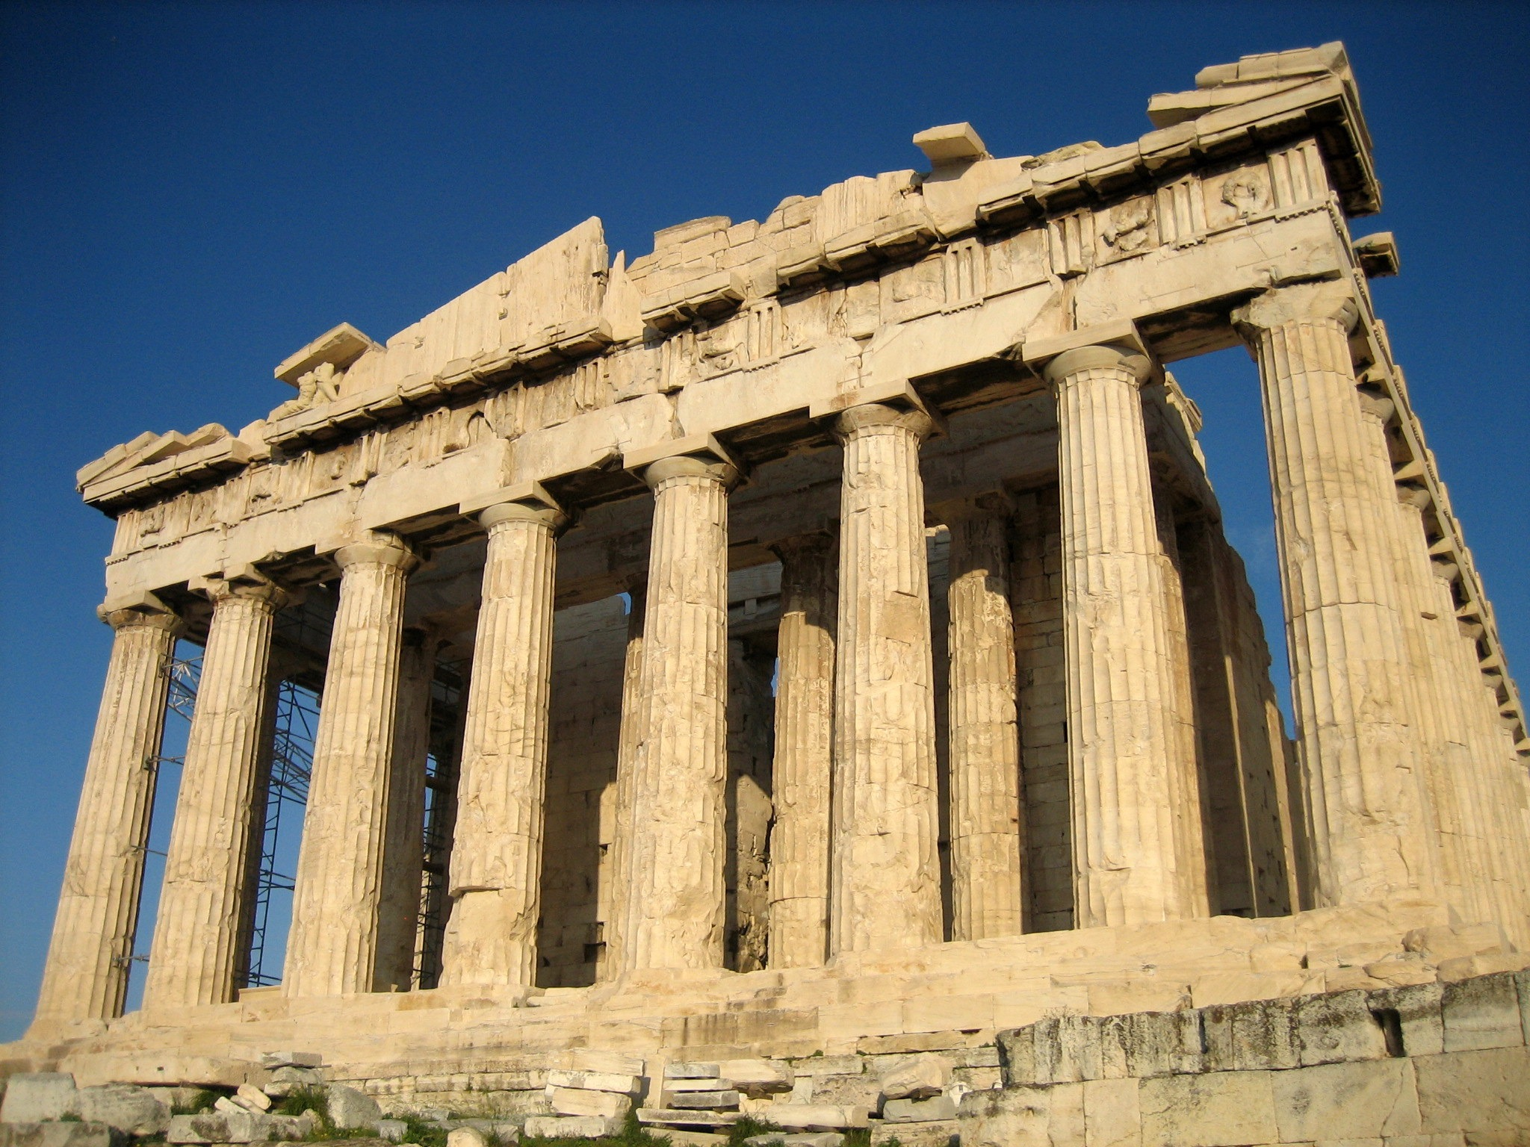
Ancient Greece
Some believe to be the foundation for Classical Civilization.
Discoveries were made, however, tracing the roots of Greece back much farther.
Minoan and Mycenaean

Slide 6
Early Development of Greek Society
Minoan Society
Island of Crete
Major city: Knossos
C. 2200 BCE center of maritime trade
Undeciphered syllabic alphabet (Linear A)

Slide 7
Notable Development
Prosperous community with little degrees of difference.
Bureaucratic Kings
Elaborate culture which include sports, theatre, and engineering.
Earth Goddess - Matriarchal society

Slide 13
Decline of Minoan Society
Series of natural disasters after 1700 BCE
Earthquakes, volcanic eruptions, tidal waves
Foreign invasions
Foreign domination by 1100 BCE

Slide 14
Mycenaean Society
Indo-european invaders descend through Balkans into Peloponnesus, c. 2200 BCE
Influenced by Minoan culture
Major settlement: Mycenae
Military expansion throughout region

Slide 15
Chaos in the Eastern Mediterranean
Trojan war, c. 1200 BCE
Homer’s The Iliad
Sequel: The Odyssey
Political turmoil, chaos from 1100 to 800 BCE
Mycenaean civilization disappears

Slide 16
The Iliad
What were the ideals of heroism as seen in the selections from the Iliad?
Why would these ideals be so important?
Arete - personal excellence

Slide 17
Dark Ages
The end of the Mycenaean civilization ushered in a period called the Dark Ages 1150-800 or the Dorian Period.
Significant for the development of religion and mythology.
Hierarchy much different than the previous civilizations studied > these stories helped explain the mysteries of humanity.

Slide 21
Hatshepsut 1472-1458 BCE
Prominent female Pharaoh of the New Kingdom
Took over because her stepson was too young to rule.
Encouraged trade more than waging war
Gold, Ivory, and unusual plants and animals

Slide 22
Development of Organized Religious Traditions
Principal gods Amon and Re
Religious tumult under Amenhotep (Akhenaton) (r. 1364-1347 BCE)
Amenhotep - Amon rests
Akhenaton - Aton is satisfied
Introduces sole worship of sun god Aton

Slide 23
King Tut
Tutankhamon restores old system of growing faith in ritualism and magic
Tutankhaton - ruler of Aton
Tutankhamen - ruler of Amon
Preservation of Life

Slide 24
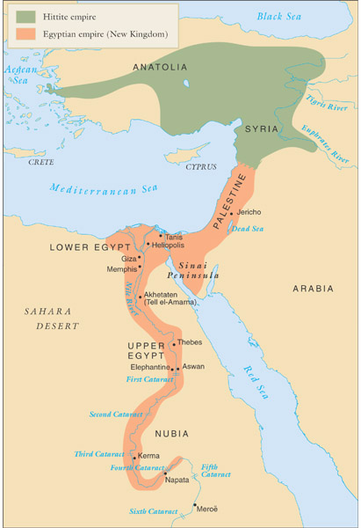
The New Kingdom
Fewer pyramids, but major monumental architectural projects
Engaged in empire-building to protect against foreign invasion
Local resistance drives Egypt out of Nubia
Kingdom of Kush revives c. 1100 BCE
Invasions of Kushites, Assyrians destroy Egypt mid 6th century BCE

Slide 25
Kassite and Hittite Interlude
Decline of the Old Babylonian Empire
Learned how to combat salinization of the soil
But the lack of governing skills and fighting techniques led to decline.
The Light-Chariot Warfare
Fighting on horse back would prove to be efficient.
Hittites Emerge circa 1600 BCE
Refer to in the Bible; probably from the Steppe regions
Efficient means of strength but not very intellectual.

Slide 26
The Early Hebrews
Patriarchs and Matriarchs from Babylon, c. 1850 BCE
Parallels between early biblical texts, Code of Hammurabi
Early settlement of Canaan (Israel), c. 1300 BCE
Biblical text: slavery in Egypt, divine redemption

Slide 27
Origins
The Hebrews were a semitic group who originated in Mesopotamia and migrated West
Canaan
Egypt
Significant for their belief in one God.

Slide 28
History of the Hebrews
1900 - 1500 BCE
Abram (father) from the Sumerian city of Ur was brought by God to the Holy Land, Canaan where he entered into a covenant with God takes the name Abraham (father of nations).
Covenant - pact with God establishes the notion of the ‘chosen people’

Slide 30
Father Abraham
Endurance of Abraham’s faith resides in the commitment to God.
Isaac - a son he waited for a long time to have was asked by God to be sacrificed.
Abraham’s willingness to sacrifice his son as Lamb on the alter proved his faith.

Slide 32
Soldiers of God
Jacob the son of Isaac wrestled with faith and received the name “Israel” which means “solider of God” - Jacob’s sons make up the 12 Tribes of Israel.
Hebrews migrate to Egypt and eventually are put into slavery, (Ramses II)
Around 1250 BCE, Moses led the Hebrews out of Egypt to reunite in Canaan. Took the name Israelites, as Moses declared they were the saved by Yahweh the god of Abraham.

Slide 34
The Great Ramses
Ramses II: 1290 - 1224 BCE
Apex of power in the New Kingdom
Valley of the Kings in Thebes
Temple of Amon-Re
What do these works show and prove?

Slide 37
Keys to Civilization
Government - As seen in the development of civilizations - government and politics are paramount to the success of city-state growth
The New Kingdom resembled the Old Kingdom but was even more absolute in power.
Ramses III 1182-1151 BCE - the last of the great pharaohs.

Slide 38
Moses and Monotheism
Hebrews shared polytheistic beliefs of other Mesopotamian civilizations
Moses introduces monotheism, belief in single god
Denies existence of competing parallel deities
Personal god: reward and punishment for conformity with revealed law
The Torah (“the teaching”)

Slide 39
Ten Commandments

Slide 40
The Israelite Kingdom
Wandering Israelites returned to Canaan after 40 years and joined other Hebrew Tribes.
Israelites were loosely organized into a confederation of 12 tribes under Yahweh
Philistines invade around 1050 BCE and dominate the Israelite territory.
The judges form a united kingdom

Slide 41
Forging a Kingdom
Samuel, a tribal judge selected Saul to unite the Israelites in 1025 BCE.
1005 BCE, Saul grew weak and Samuel began to support David.
David succeeded as unifying the Israelites
Star of David

Slide 42
David’s Legacy
Instituted a basis for collecting taxes
Began the building an imperial city at Jerusalem
The Book of Psalms - Hymns to God

Slide 44
Solomon the Great
David was succeeded by his son, Solomon who ruled from 973-933 BCE.
Trade and construction flourished
Ark of the Covenant - Temple of Solomon
Houses the tablets of Moses
Hebrew Law and Culture

Slide 47
Jerusalem: City of God
Jerusalem became the epicenter of trade and religion.
But tax policies and territorial rivalries will divide the kingdom in 922 BCE.
Kingdom of Judah (South)
Kingdom of Israel (North)

Slide 48
Conquest and Captivity
722 BCE, Israel fell to the mighty Assyrians
Assyrians deported Hebrews to other parts of the empire, where they merged and assimilated (10 lost tribes).
Why is moving the Hebrews significant?

Slide 49
Might of the Assyrians
Assyrian Supremacy
1300 - 612 BCE
Following the Kassite “dark age”
Semitic group who settled on the Tigris.
Notable Nobles - Sennacherib
705 - 681 BCE advanced the Assyrian rule
Built a stupendous city - Nineveh
Assyrian Frightfulness
Virtues of brutal masculinity - machismo
“I tore out the tongues of many who plotted against me and then had them murdered.”

Slide 50
Later Mesopotamian Empires
Weakening of central rule an invitation to foreign invaders
Assyrians use new iron weaponry
Beginning 1300 BCE, by 8th-7th centuries BCE control Mesopotamia, Syria, Palestine, most of Egypt
Nebuchadnezzar of Babylon (r. 605-562) takes advantage of internal dissent to create Chaldean (New Babylonian) Empire
Famously luxurious capital
Notes:
Nebuchadnezzar by William Blake

Slide 51
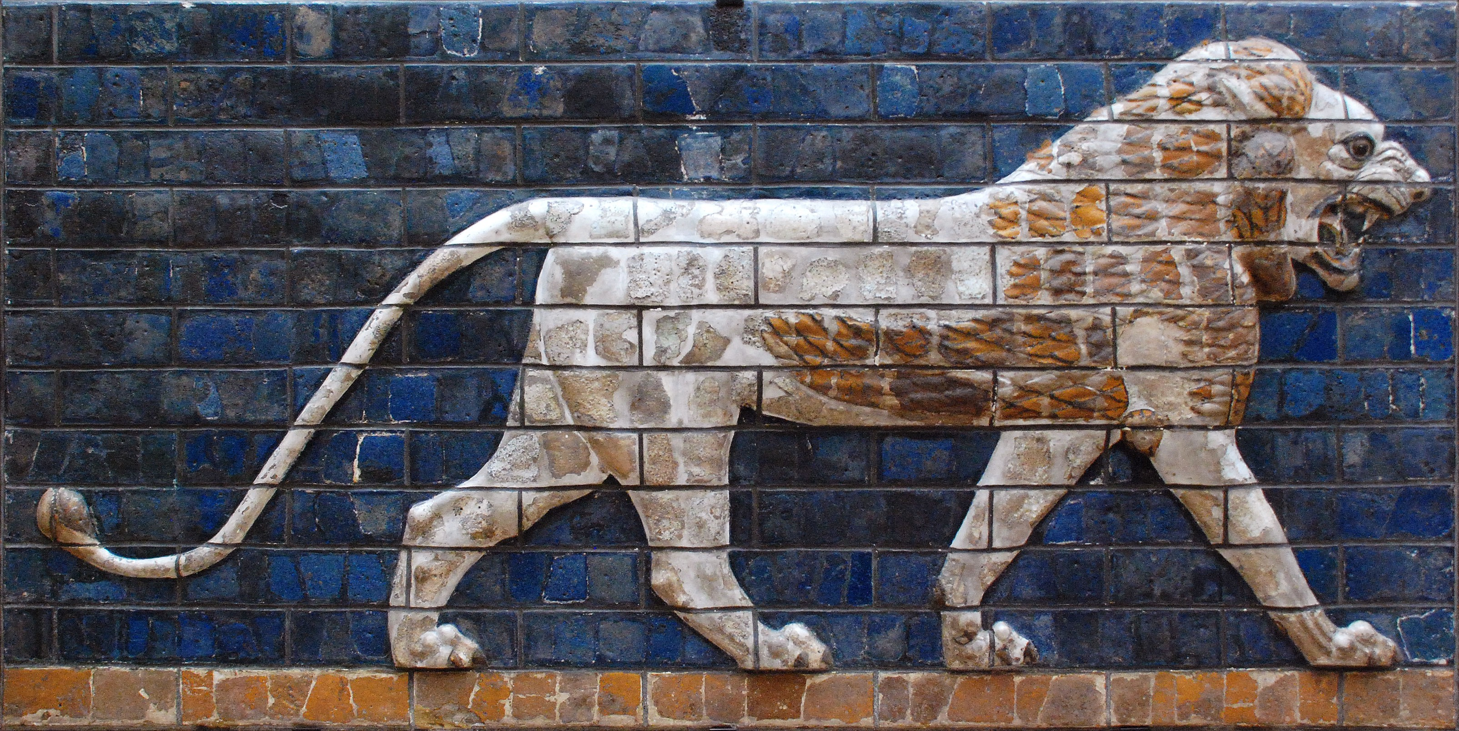
Babylonian Revival
Chaldeans succeeded the Assyrians in 612 BCE and made their capital at Babylon.
539 BCE - King Nebuchadnezzar increased the size of the kingdom.
2,100 acres

Slide 52
Jewish Diaspora
Diaspora = displacement of the Hebrews.
586 BCE Chaldeans (Babylonians), conquered Judah, destroyed Solomon’s temple, and deported the Hebrews
Nebuchadnezzar
Babylonian Captivity - because the Hebrews disobeyed God, broke the covenant.

Slide 53
The Book of Ruth
Set in the early part of the Hebrew Civilization but significant during Babylonian Captivity.
What did you think of this story?
What is the historical importance?
Why important to the theme of tonight’s class?

Slide 54
Restoration
Some Hebrews do not assimilate in Babylon, keep to Yahweh and the Law of Moses.
Priests create the Torah (teachings) by codifying the laws to prevent the erosion of faith
538 BCE the Persian king Cyrus permitted the exiled Hebrews to return to Judah and rebuild the temple.
515 BCE - the Jewish Community forms in Jerusalem.

Slide 55
Scriptures
Faith seems to be difference of the Hebrew Civilization.
Scriptures contain oral and written traditions from 1250 - 150 BCE.
Emphasis on human qualities and relationship to God crucial.

Slide 56
Monotheism
God: One, Sovereign, Transcendent, and Good
Hebrews view of the one God marked clear break with Near Eastern religious thought.
Hebrews de-mythicized nature in a revolutionary way, but did not view it as a system governed by natural law.

Slide 57
Next Week
We will begin to explore the Ancient Orient and look at the civilization of India. How did these civilization form differently than those of the West?

