Slide 1
Early Civilizations
Week 2:
Mesopotamia and Egypt

Slide 2
Birth of History
“History begins in Sumer” but WHY????
What distinguished history in this period from the previous week?
What does it mean to be civilized?

Slide 3
Civilization Defined
Urban
Political/military system
Social stratification
Economic specialization
Religion
Communications
“Higher Culture”

Slide 4
Civilization and the Means of Production
Essential element: concentration of wealth
Agriculture
Control over natural resources
Development of ancient civilization
not hunter-gatherer economics

Slide 5
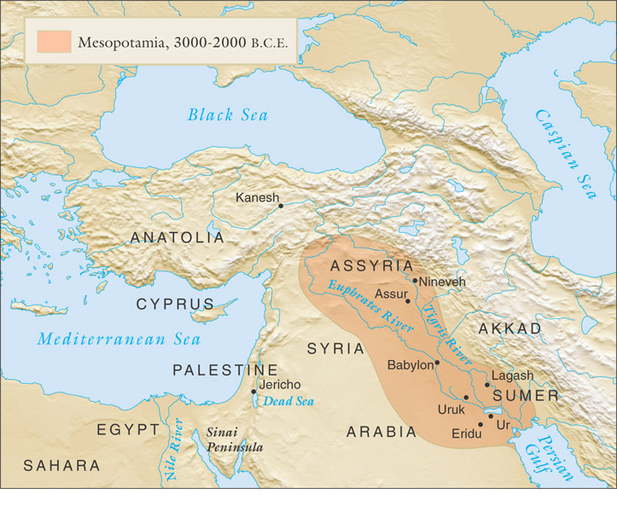
Mesopotamia
“Between the Rivers”
Tigris and Euphrates
Contemporary Iran, Iraq
Cultural continuum of “fertile crescent”

Slide 6
The Wealth of the Rivers
Nutrient-rich silt
Key: irrigation
Necessity of coordinated efforts
Promoted development of local governments
City-states
Sumer begins small-scale irrigation 6000 BCE
By 5000 BCE, complex irrigation networks
Population reaches 100,000 by 3000 BCE
Attracts Semitic migrants, influences culture

Slide 7
Sumerian City-States
Cities appear 4000 BCE
Dominate region from 3200-2350 BCE
Ur (home of Abraham, see Genesis 11:28), Nineveh (see Jonah)
Ziggurat home of the god
Divine mandate to Kings
Regulation of Trade
Defense from nomadic marauders

Slide 8
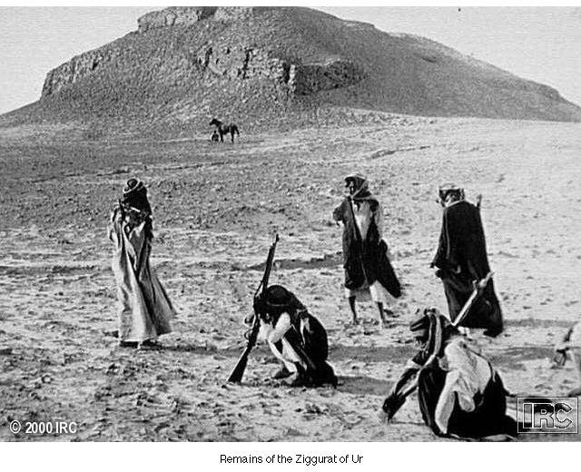
The Ziggurat of Ur

Slide 9
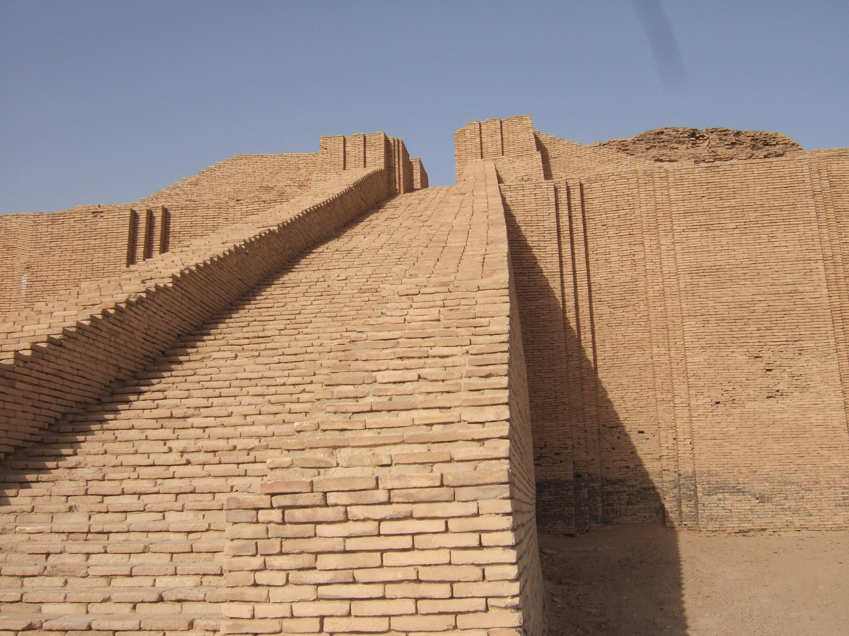

Slide 10
Political Decline of Sumer
Semitic peoples from northern Mesopotamia overshadow Sumer
Sargon of Akkad (2370-2315 BCE)
Destroyed Sumerian city-states one by one, created empire based in Akkad
Empire unable to maintain chronic rebellions
Hammurabi of Babylon (1792-1750 BCE)
Improved taxation, legislation
Used local governors to maintain control of city-states
Babylonian Empire later destroyed by Hittites from Anatolia, c. 1595 BCE

Slide 11
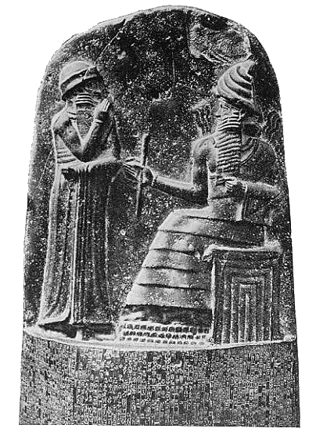
Legal System
The Code of Hammurabi (18th c. BCE)
282 items
lex talionis (item 196: “eye for an eye”)
Social status and punishment
women as property, but some rights

Slide 12
Exploring the Code
The Code seems to be mostly about preventing disputes, so how does that connect to the idea of a civilization process?
What did you think of the code? Is there any positives qualities of the code?

Slide 13
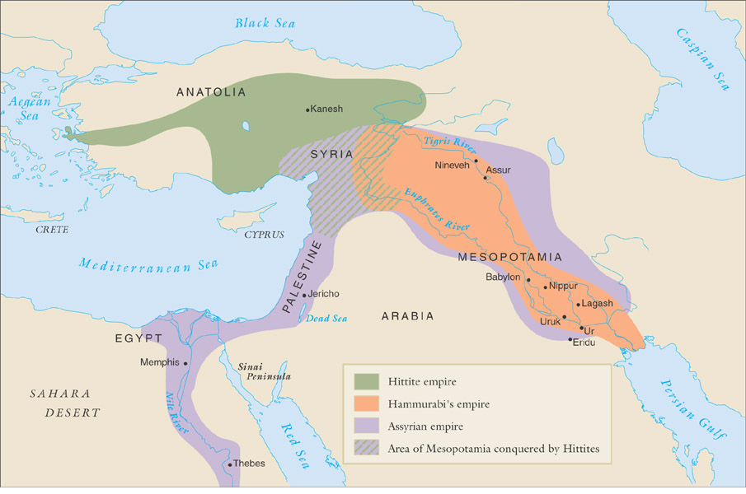
Mesopotamian Empires 1800-600 BCE

Slide 14
Technological Development in Mesopotamia
Bronze (copper with tin), c. 4000 BCE
Military, agricultural applications
Iron, c. 1000 BCE
Cheaper than bronze
Wheel, boats, c. 3500 BCE
Shipbuilding increases trade networks

Slide 15
Social Classes
Ruling classes based often on military prowess
Originally elected, later hereditary
Perceived as offspring of gods
Religious classes
Role: intervention with gods to ensure fertility, safety
Considerable landholdings, other economic activities
Free commoners
Peasant cultivators
Some urban professionals
Slaves
Prisoners of war, convicted criminals, debtors

Slide 16
Patriarchal Society
Men as landowners, relationship to status
Patriarchy: “rule of the father”
Right to sell wives, children
Double standard of sexual morality
Women drowned for adultery
Relaxed sexual mores for men
Yet some possibilities of social mobility for women
Court advisers, temple priestesses, economic activity
Introduction of the veil at least c. 1500 BCE

Slide 17
Development of Writing
Sumerian writing systems form 3500 BCE
Pictographs
Cuneiform: “wedge-shaped”
Preservation of documents on clay
Declines from 400 BCE with spread of Greek alphabetic script

Slide 18
Uses for Writing
Trade
Astronomy
Mathematics
Agricultural applications
Calculation of time
12-month year
24-hour day, 60-minute hour

Slide 19
Mesopotamian Literature
Epic of Gilgamesh, compiled after 2000 BCE
Heroic saga
Search for meaning, esp. afterlife
This-worldly emphasis

Slide 20
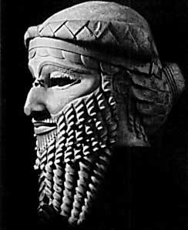

Slide 21
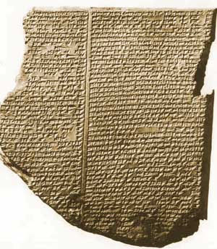

Slide 22
The Legend
One and the same fate befalls every man. ~Ecclesiastes 9
For Sumerians, there was NO JOY in the afterlife !!!
A Quest for Immortality
- Does this seem far-fetched?

Slide 23
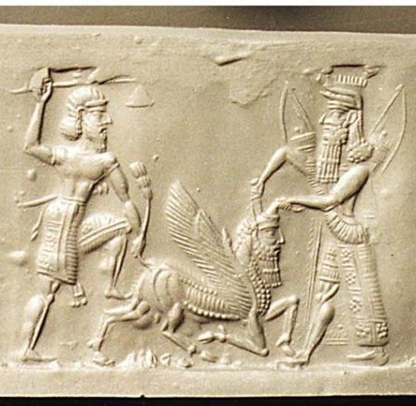

Slide 24
Foreign conquests of Israel
Civil war
Northern tribes: Israel
Southern: Judah
Assyrian conquest, 722 BCE
Exiles Israel: ten lost tribes
Babylonian conquest, 586 BCE
Additional exile of many residents of Judah
Returned later than century

Slide 25
Kassite and Hittite Interlude
Decline of the Old Babylonian Empire
Learned how to combat salinization of the soil
But the lack of governing skills and fighting techniques led to decline.
The Light-Chariot Warfare
Fighting on horse back would prove to be efficient.
Hittites Emerge circa 1600 BCE
Refer to in the Bible; probably from the Steppe regions
Efficient means of strength but not very intellectual.

Slide 26
Might of the Assyrians
Assyrian Supremacy
1300 - 612 BCE
Following the Kassite “dark age”
Semitic group who settled on the Tigris.
Notable Nobles - Sennacherib
705 - 681 BCE advanced the Assyrian rule
Built a stupendous city - Nineveh
Assyrian Frightfulness
Virtues of brutal masculinity - machismo
“I tore out the tongues of many who plotted against me and then had them murdered.”

Slide 27
Africa: Geography
5,000 miles north-south, east-west
North:
mountainous coastline
Sahara desert
West:
interior grasslands, tropical jungle on coast
East (on Indian ocean):
snowy mountains, upland plateaus
Central: Jungles
South: hills, plateaus, deserts

Slide 28
The Valley of the Nile
Egypt in many ways was more significant than Mesopotamia.
Two Major Difference:
Environment
Peaceful

Slide 29
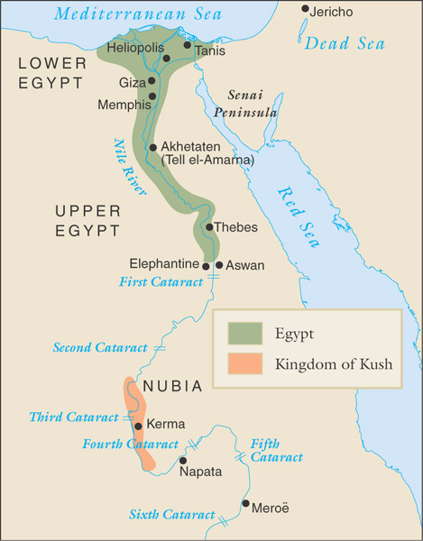
The Gift of the Nile
Gradual, predictable flooding
Inundation (July-October)
Sprouting
Summer
Communication:
Nubia-Egypt
Current: north
Winds: south
Sub-Saharan Africa-Mesopotamia
Increased in importance w/dessication of Sahara

Slide 30
Early Agriculture in Nile Valley
10,000 BCE migrants from Red Sea hills (northern Ethiopia)
Introduce collection of wild grains, language roots of Coptic
5000 BCE Sudanese cultivators, herders migrate to Nile river valley
Adaption to seasonal flooding of Nile through construction of dikes, waterways
Villages dot Nile by 4000 BCE

Slide 31
Impact on Political Organization
Mesopotamia: grand public works to control flash floods
Egypt: simple, local irrigation projects
Rural rather than heavily urban development
Trade networks develop

Slide 32
The Span of Egyptian History
Early Nubian domination
Manetho, Egyptian priest/historian
Archaic Period: 3100-2660 BCE
Old Kingdom, 2660-2160 BCE
pyramids
Middle Kingdom, 2160-1640 BCE
Hyksos invasion
New Kingdom, 1550-1075 BCE

Slide 33
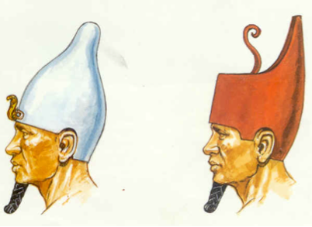
The Two Kingdoms of Egypt
Early on Egypt was two separate kingdoms
Upper Kingdom (Southern Egypt)
Lower Kingdom (Northern Egypt)

Slide 34
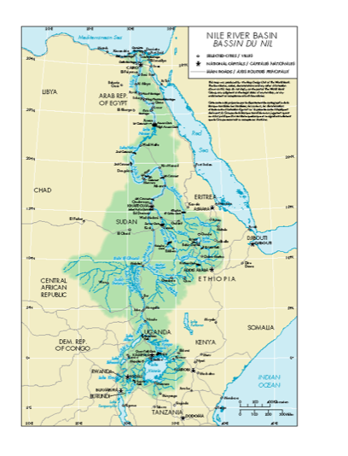

Slide 35
Unification of Egypt
Legendary conqueror Menes, c. 3100 unifies the Egyptian kingdom
Sometimes identified with Narmer
Tradition: founder of Memphis, cultural and political center of ancient Egypt
Instituted the rule of the Pharaoh
Claimed descent from the gods
Absolute rulers, had slaves buried with them from 2600 BCE
Most powerful during Archaic Period (3100-2660 BCE) and Old Kingdom (2660-2160 BCE)

Slide 36
The Pharaohs
The Pharaohs were chief priests and therefore considered to be gods.
ka = the mind and was believed to be immortal. Does preservation of life lead in the development of civilization?
Government = Theocracy

Slide 37
Social Hierarchy
Pharaoh
Royal Advisor
Priests
Traders/Merchants
Ordinary Citizens
Slaves

Slide 38
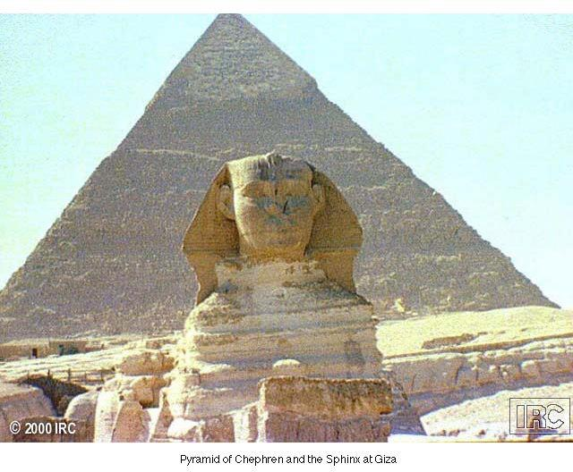
The Pyramids
Early architecture from Old Kingdom
Tallest buildings in the world until 19th century
2M Blocks, some 60 tons each
Role: burial chambers for Pharaohs
How were the pyramids built?
Video - Pyramids of Giza
Notes:
Show construction of Temple here from Ancient Egypt VH 5431

Slide 39
Egyptian Urban Culture
Major cities along Nile river, especially at delta
Memphis c. 3100 BCE, Heliopolis c. 2900 BCE
Nubian cities include Kerma, Napata, Meroë
Located at cataracts of the Nile
Well-defined social classes
Pharaohs to slaves
Archaeological discoveries in Nubia also support class-based society
Patriarchal societies, notable exceptions: female Pharaoh Hatshepsut (r. 1472-1458 BCE)

Slide 40
Relations with Nubia
Competition over Nile trade
Military conflict between 3100-2600 BCE
Drives Nubians to the south
Established Kingdom of Kush, c. 2500 BCE
Trade, cultural influences continue despite military conflict
What have we noticed about civilizations as they grow?

Slide 41
Turmoil and Empire
Increasing agricultural productivity at end of Old Kingdom leads to rise of regional powers and decline of central state (2160-2040 BCE)
Beginning of Middle Kingdom (2040-1640 BCE)
Invasion of Hyksos from southwest Asia, c. 1674 BCE
Semitic people, horse riders with bronze weaponry
Driven out by local military efforts, creation of New Kingdom (1550-1070 BCE)
Ahmose 1560 BCE - hero of the Egyptian struggle

Slide 42
Egyptian Religion
Polytheistic = over 2,000 gods and goddesses
Built huge temples to honor the gods. Why is that significant?
Believed in the afterlife.

Slide 43
Osiris and Isis
“Behold the Lord of all things is born!”
What is the purpose of this legend? What do you take away from the story?
What seems to be the moral?

Slide 44
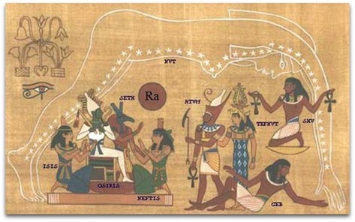
The Ennead
The Nine Gods of Heliopolis (Sun City)
Ra-Atum
Shu = Tefenet
Geb = Nut
Osiris = Isis
Seth = Nephthys

Slide 45
Social importance
Egyptian Civilization varied greatly from Mesopotamian city-states.
Egypt’s United Kingdom allowed for:
High degree of unity
Stability
Cultural Continuity

Slide 46
Hieroglyphs
“Sacred Writings”
Preserved on papyrus, made from reeds
Simplified form: hieratic script, 2600 BCE-600 CE
Rosetta Stone, discovered 1799
Hieroglyphs
Demotic (“popular”)
Greek
Pictographs
Meroitic language recorded in alphabet after 5th century BCE

Slide 48
Intellectual Advancements
Developed written numbers for recording taxes
Addition and Subtraction
Ratio of a Circle 360 degree
Calendar - Sirius Solar alignment
12 month calendar so accurate only 6 hours off the current record.
Medicine - Natural versus Supernatural
Listened to heartbeat, used natural sources like castor oil to alleviate pain

Slide 49
Agriculture and Industry
The “gift of the Nile” resulted in most of Egypt’s splendor.
Nutritious soil that yielded excellent crops
Wheat, Barley, Millet, Vegetables, Fruits, Flax, and Cotton
Economic Collectivism

Slide 50
Economic Specialization
Bronze metallurgy introduced late, with Hyksos invasion
Development of iron early, c. 900 BCE
Trade along Nile river
More difficult in Nubia due to cataracts
Sea trade in Mediterranean

Slide 51
Egyptian Achievement
Peace and Self-Sufficiency
Legacy
Musical Instruments
Agricultural Techniques
Pharmacy - Medicine
Pyramids

Slide 52
Next Week
What are the enduring qualities of civilization? How do the cornerstones of civilization fit into the mold of society?

