Slide 1
Week 10
Feudalism - The Making of Europe

Slide 2
The Great Leap Forward
Between 9th and 14th centuries Western Europe experienced a “great leap forward.”
Agricultural Revolution
Impact of Feudalism and Manorialism
Rise of Towns/Cities
Political, Economic, Religious, and Intellectual developments.

Slide 3
Global Warming?
A warming period occurred in the 9th century.
As a result, there is an agricultural revolution.
Estates and Manors spring up in Europe.

Slide 4
Growth of the Agricultural Economy
Increasing development of arable lands
Minimized threat of invading nomads
Clearing of swamps, forests
Improved agricultural techniques
Crop rotation
New crops, esp. beans
Horseshoes, horse collars (horses faster than oxen)

Slide 5
European Population Growth, 800-1300 CE

Slide 6
Revival of Towns and Trade
Urbanization follows increase in food supply
Specialization of labor
Textile production
Mediterranean Trade
Italy well-positioned for sea trade
Italian colonies established in major ports of Mediterranean, Black seas

Slide 7
Chivalry
Code of conduct for nobles
Sponsored by Church to minimize fighting among Christians
Technically, knight to dedicate his efforts to promotion of Christianity
Protection of women

Slide 8
Bonds of Society
Charlemagne dies and Europe forms out of division.
Divisions: upper, middle, and lower sort, but not classes.
Feudal distinctions = Hugh Capet (987-996) “elected” king.

Slide 9
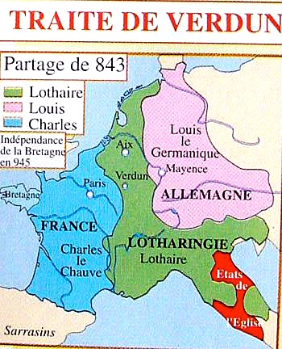

Slide 10
Manorialism vs. Feudalism
Manorialism: an economic system in which large agricultural estates were worked by serfs.
Feudalism: a political system with a decentralized government and two chief institutions—Vassalage and Fiefdom

Slide 11
Rise of Towns
Western Europe experienced little international trade between 500-1000, hence the use of the “Dark Ages”
Rise of Agricultural Estates, as a result of Charlemagne’s Europe and the Revolution.
What was left intact following the collapse of the Roman Empire in 476???

Slide 12
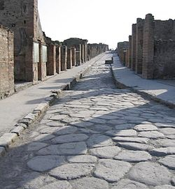
The “road” to the future
The old Roman Roads helped merchants develop towns and cites.
Bourgeoisie /Burghers promoted a banking culture
Medieval Guilds form

Slide 13
Feudal Development
There is much controversy over the term and the meaning of feudalism.
Organized system of Government
Mostly a political “system” that fostered progress and growth.
Significant in France and England - Post 1066
Also seen in Church development

Slide 14
Regional Monarchies: France and England
Capetian France
Hugh Capet succeeds last Carolingian Emperor, 987 CE
Slowly expands authority out from Paris
Normans in England
Descendants of Vikings, settled in France
Invade England in 1066 under William the Conqueror
Dominate Angles, Saxons, and other Germanic groups

Slide 15
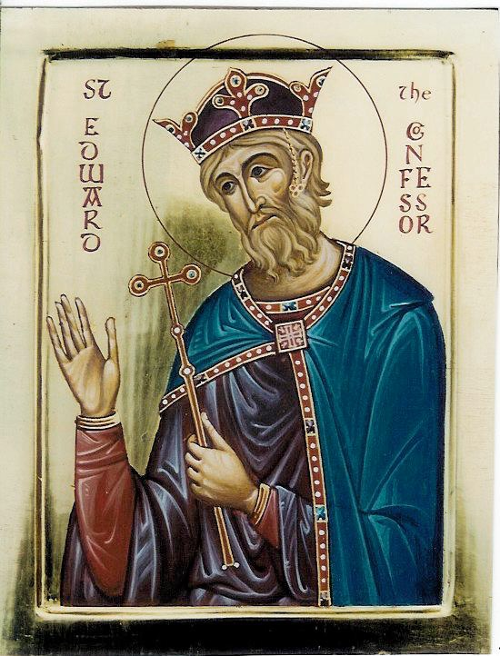
Edward the Confessor
King of England 1042-1066 A.D.
Died without an heir to the throne.
Claimed by Harold of Wessex and William of Normandy

Slide 16
Norman Conquest
Apparently, Edward had named Harold, the son of the Earl of Wessex, to the throne. He ruled for nine months.
William of Normandy heard of Edward’s death and Harold’s appointment, and set sail to England.

Slide 18
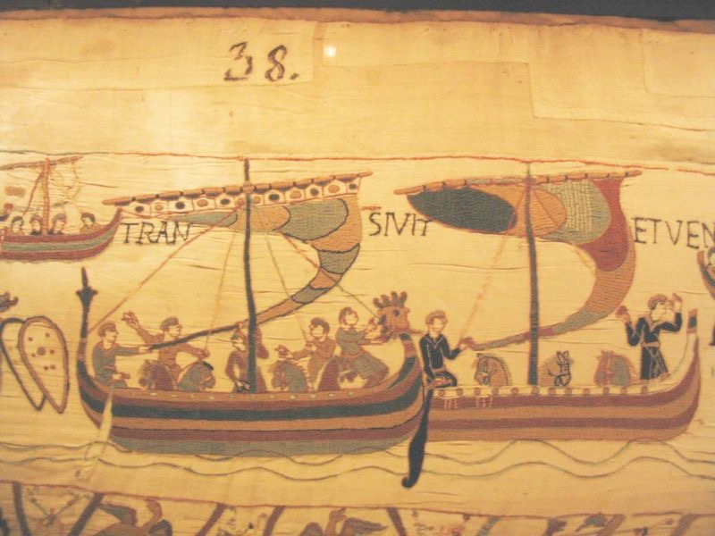

Slide 19
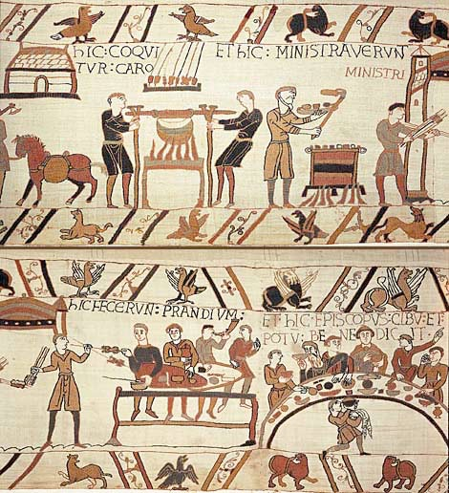

Slide 20
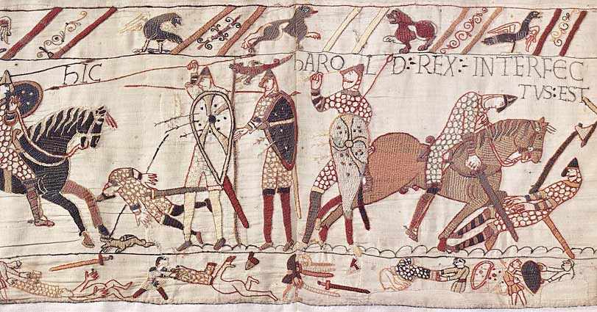

Slide 21
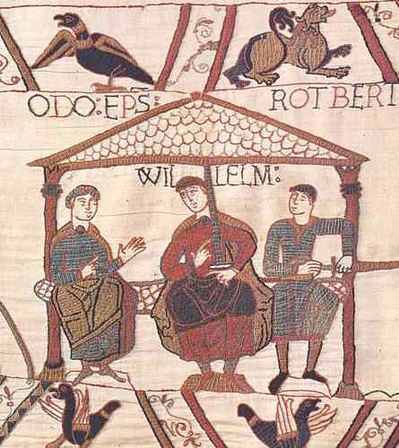

Slide 22
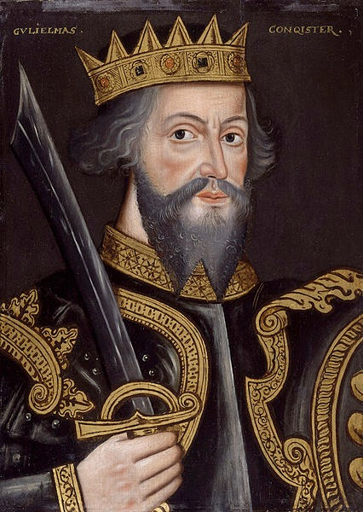
The Conqueror
William defeated Harold at the Battle of Hastings and became the King of England.
Domesday Book 1086: Introduced feudal customs to rule his government.

Slide 23
The Feudal “System”
While relationships existed between lords and their men, the feudal “system” was anything but systematic.
Jurisdiction possessed by a vassal and particular services owed to the lord, varied from fief to fief.

Slide 24
The Construct
Despite the differences of the “feudal system” there are many similar customs:
Counsel
Aid
Inheritance
Ward-ship & Marriage
Fidelity & Homage
Courts & Law
Taxes

Slide 25
Breakdown of Feudal Society
Feudal Society was basically hierarchical
Those who:
Ruled
Prayed
Fought
Worked

Slide 26
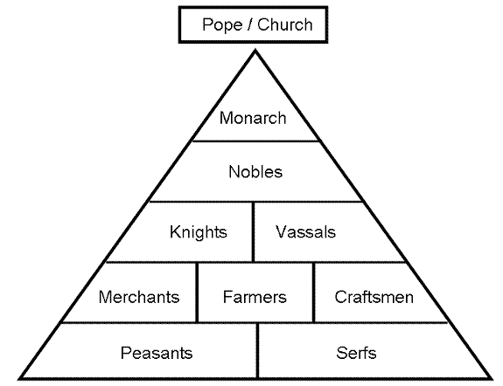

Slide 27
Post 1066
Following William the Conqueror the kings of England tried to push their authority more boldly.
These kings met strong opposition in two groups:
Church and Nobility

Slide 28
Norman & Plantagenet Kings
William I: 1066-1087
William II: 1087-1100
Henry I: 1100-1135
Stephen I: 1135-1154
Henry II: 1154-1189
Richard I: 1189-1199

Slide 29
The Great Charter
John I “the Soft-Sword”: 1199-1216
In 1215, a further development in feudalism came with the signing of the Magna Carta.
Contract between the barons and the monarch.

Slide 30
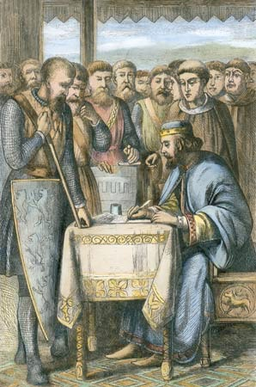

Slide 31
French National Unity
The Norman Conquest of England also helped establish national unity in France
The Duke of Normandy, who was also the English King, remained a Vassal under the French King
The Capetian Dynasty rose to the occasion and built a strong national monarchy.

Slide 32
Capetian Kings
Louis VI: 1108-1137
Louis VII: 1137-1180
Philip II “Augustus”: 1180-1223
Louis VIII: 1223-1226
Louis IX “St. Louis”: 1226-1270

Slide 33
Crisis in the Church
1046 - Bruno of Toul appointed as Pope Leo IX by Emperor Henry III
Council of Reims: REFORM
1. Against Simony & Nicolaitism
2. The College of Cardinals

Slide 34
East-West Schism
The power of the Pope in Rome, led to the first major schism of the Church.
1054 – East and West fought over three issues:
Use of leaven vs. unleavened bread at Mass
Filioque (And the Son)
Icons

Slide 35
Papal Power
Peter Damien - ascetic, advocate for the reform of clergy
Hildebrand - reviews Canon Law
Humbert - Papal Legate, issued the bull of excommunication to Constantinople.

Slide 36
Church Reform
Strengthen the Church.
Italy & Germany
Cardinals
- Direct Election of the Pope.

Slide 37
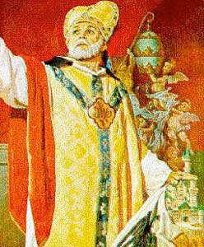
Gregory VII: 1073-85
1075 - bans Lay Investiture.
Henry IV did not listen.
Dictatus Papae
- Wish List

Slide 38
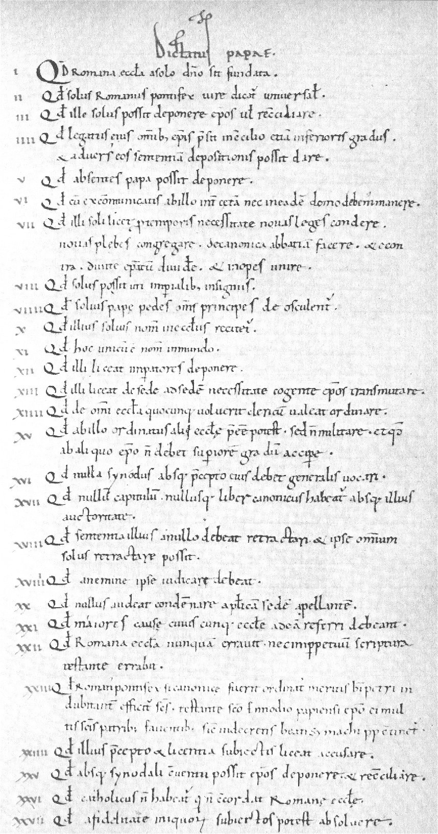

Slide 39
Caput Orbis
Gregory VII excommunicated Henry IV.
German Nobles support Henry
German Bishops support Gregory
Castle Canossa - Henry begs for forgiveness

Slide 40
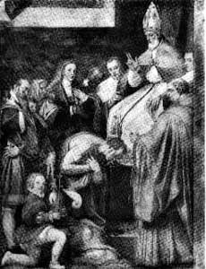
Division
Absolved
Civil War in Germany
1080 - excommunicated again

Slide 41
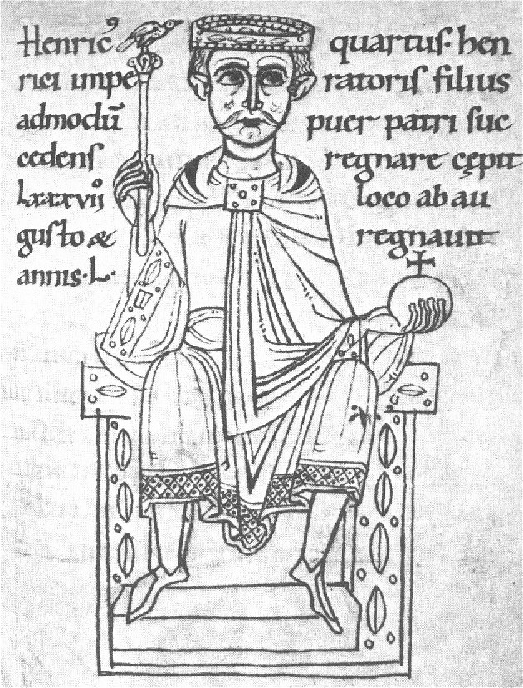

Slide 42
Canon Law
The Church mixed the Roman Law of CJC with the law of ecumenical councils.
Canon Law first cited in 1076 in Tuscany.
Burchard of Worms c.1000 - but too long (1785 chapters!)

Slide 43
Formation of Canon Law
Investiture Contests stimulated Canon Law Study
Increased Papal advances
What exactly were the Popes rights?

Slide 44
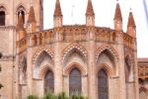
University of Bologna
Canon Law School
Intellectual Effort in materials
- collection
- arrangement
- interpretation

Slide 45
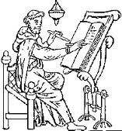
Papal Government
Development of a Court System
Feudal Structure
Papal Chancery - creating documents

Slide 46
Crisis of Church & State
Investiture Controversy gave the popes power.
Innocent III - Church reached its zenith.
Is this a Theocracy?

Slide 47
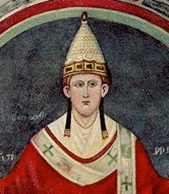
Innocent III: 1198-1216
Lothario di Segni
Doctrine of Plenitude of Power
Creation of the mendicant orders
Huge influence over powerful monarchs.

Slide 48
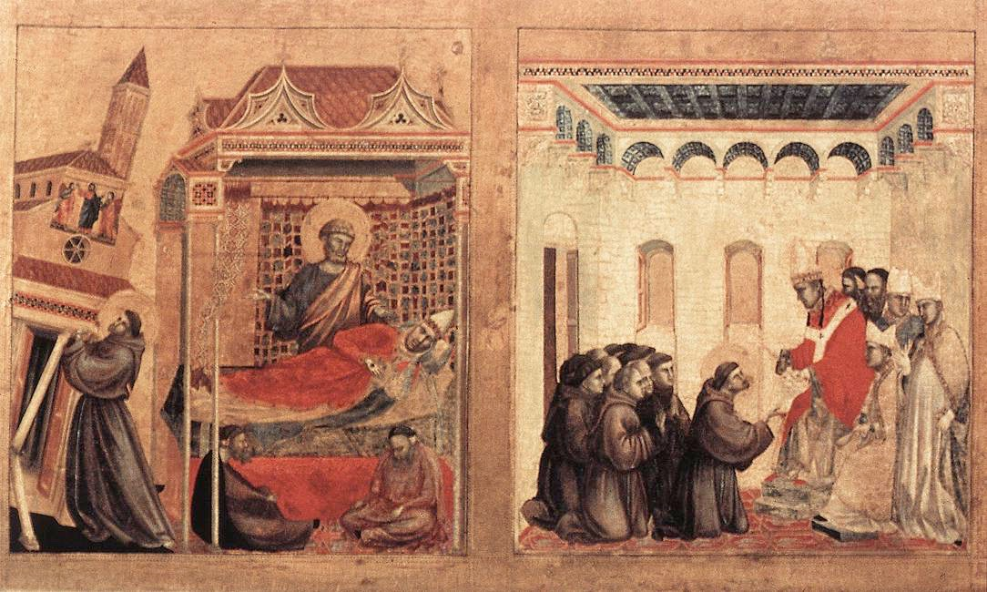
Papal Monarchy

Slide 49
Political Problems
Rome as well as Italy became dominated by powerful merchant families.
Ghibelline (pro-imperial) Guelf (pro-papal)
13th century two mighty Roman noble families … Orisini and Colonna

Slide 50
Papal Overkill
Rome received a lot of money during the era of the crusades.
Money equals power – Indulgences and the Inquisition.
Celestine V abdicated the papal throne in 1294 – Benedict Gaetani became pope.

Slide 51
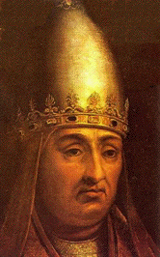
Boniface VIII
1294-1303
Excellent Canon lawyer, but haughty, overbearing and vain.
Conflict with England and France

Slide 52
England and France
England and France flourished in the 12th and 13th centuries.
In 1295, Edward I and Philip IV were preparing to go to war over Gascony.
To raise funds for the war, both Edward and Philip decided to tax the clergy.

Slide 53
Ecclesiastical Opposition
Boniface VIII issued Clericis Laicos forbidding lay taxation of clergy.
Edward I - cut off the protection of the clergy by the state
Philip IV – cut off the flow of gold and silver to Rome.

Slide 54
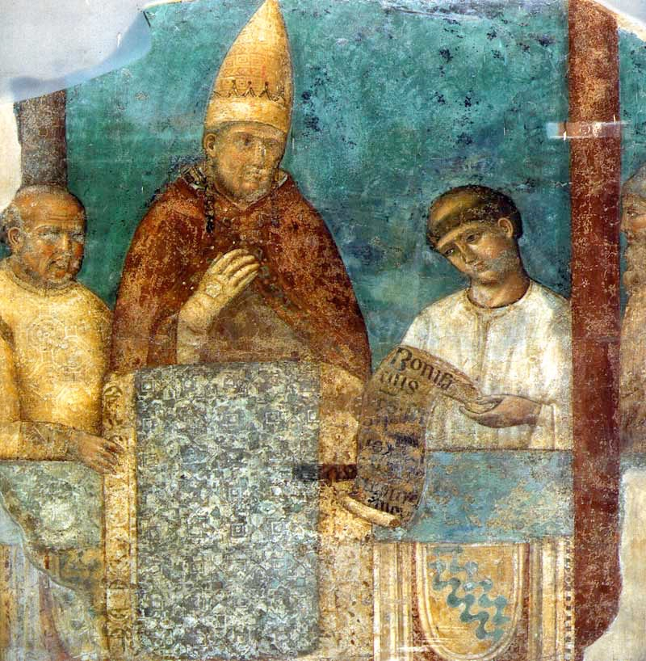
Ausculta Fili
Philip IV arrested the Bishop of Pamiers, Bernard Saisset.
Boniface demanded his release and scolded him: “God has set popes over kings and kingdoms.”

Slide 55
Unam Sanctam
Boniface VIII traced papal rule over temporal power back to the Bible.
One Holy Catholic Apostolic Church
Philip IV sends Wm. of Noraget to arrest and beat up Boniface.
Subsequently, Boniface dies a month later.

Slide 56
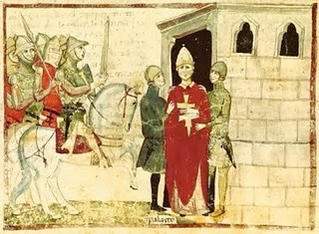
Boniface VIII arrested

Slide 57
French Papacy
Benedict XI 1303-1305 short reign as pope allowed for Philip IV to directly influence the papacy.
In 1305, Philip’s childhood friend, Bertrand de Got was elected Clement V.
Thus, begins the French domination of the College of Cardinals, and Avignon Papacy.

Slide 58
Next Week
What exactly was the Renaissance? Did it theoretically change anything in European Society?

