Slide 1
The Philosophy of the mind
The Modern Age of Capitalism and Science

Slide 2
On History
Romanticism saw the glorification of the individual.
German idealism and nationalism saw the birth of the ego.
Great people in History…the will and desire!

Slide 3
The Ego and The Individual
J. G. Fichte (1762-1814) identified the ego with the Absolute.
Napoleon was an example of a person who exerted his will and ego on the world.
Individual person vs. Individual Cultures

Slide 4
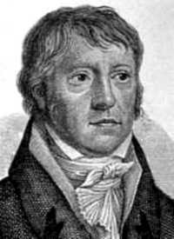
G.W.F. Hegel
1770-1831
Most important philosopher since Kant.
History was a process of developing Spirit.

Slide 5
Idealism
Hegel was dealing with Kant’s dismissal of metaphysics.
“The Real is the rational, the rational is the Real, therefore all things are knowable.”

Slide 6
The Dialectic
Thesis - Subject -> Idea
Antithesis - Object -> Nature
Synthesis - Absolute -> Spirit

Slide 7
Master and Slave
In The Phenomenology of the Mind Hegel explains the history of the world through the Master & Slave Dialogue.
The relationship between the individual and society.

Slide 8
The Process of History
Human desire and the individual arrive at the same sentiment of being a self. The desire to be desired!!!
The desire to RISE above these desires is the desire to be FREE.
Universal Recognition = Man’s telos.

Slide 9
German Freedom
The individual needs to be recognized in order to be someone.
Slave - Coward - Subjective
Master - Exploiter - Objective
Freedom - Recognition - Absolute

Slide 10
The Philosophy of History
The process of history is rational.
Hegel wanted to bring back teleology that the scientists throw out.
Hegel’s history is not just one damn thing after another….there is meaning to history.

Slide 11
The End of History
Freedom is doing what you want when you want to do it.
But you cannot exploit your freedom on the freedom of others.
A state that is the full embodiment of Universal Freedom…

Slide 12
The Meaning of Freedom
Hegel believed that no creature is absolutely ‘free’, but free only to realize its natural possibilities.
A bird is free to fly, but not to swim – human beings must realize freedom by developing their rational potential.

Slide 13
Problems
If we say this is the “end of history”, then the question remains: What do we do now?

Slide 14
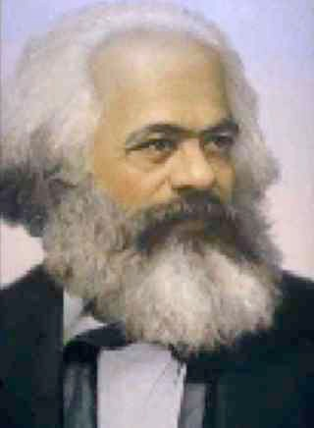
Marxism
1818-1883
German middle class family
University of Berlin
Communist Manifesto

Slide 15
Communist Manifesto
Marx and Engels wrote the manifesto in 1848.
Communism implied the outright abolition of private property
Combination of German Hegelianism, French Socialism, and British classical economics.

Slide 16
Marx’s Revolution
Revolution through class conflict
Bourgeoisie and Proletariat
Proletariat and Communist
“All that is solid melts into air, all that is holy is profaned, and man is at last compelled to face with sober senses, his real conditions of life, and his relations with his kind.”

Slide 17
Modes of Progress
The Second Industrial Revolution
Literacy Increase through out Europe.
Elementary Education
Intellectualism

Slide 18
Advances in Science
By the mid-nineteenth century the scientist became an active member of the community.
The religion of science or the notion of explaining the universe.
Auguste Comte & Positivism

Slide 19
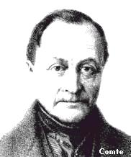
Auguste Comte
1798-1857
French Philosopher
Product of the Enlightenment & Saint-Simon
The Three Stages

Slide 20
Positivism
Theological - divinities of spiritual or supernatural explanations .
Metaphysical - abstract principles were regarded as the operative agencies of nature.
Positive - exact description of phenomena.

Slide 21
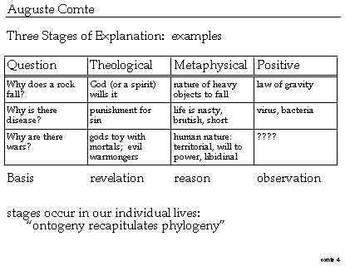

Slide 22
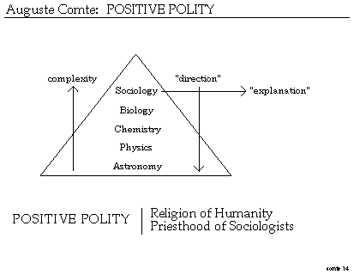

Slide 23
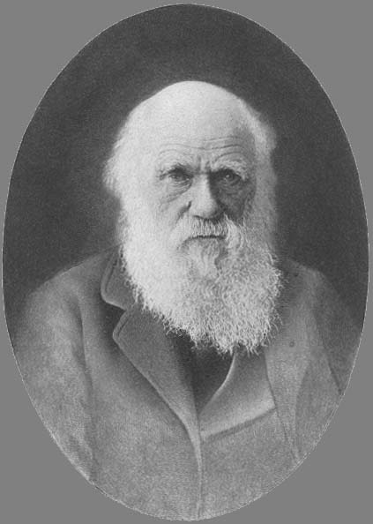
Charles Darwin
1809-1882
On the Origin of Species 1859
The Descent of Man 1871
Theory of Natural Selection

Slide 24
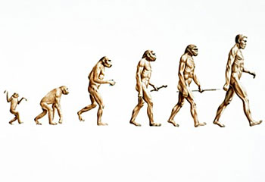

Slide 25
Natural Selection
In 1831, Darwin boarded the Beagle and traveled to the Galapagos Islands.
It was here that Darwin formed his theory of Natural Selection.
Basic principle - survival of the fittest.

Slide 26
Science & Ethics
Herbert Spencer: 1820-1903 coined the term “survival of the fittest”
Social Darwinism - applied the theories of Darwin and Malthus.
Human society progresses through competition…the dominate race wins.

Slide 27
Christianity in the Modern Age
Christianity was attacked by intellectual skepticism on three different fronts
- History
- Science
- Morality

Slide 28
The Individual & Will
The progress of Second Industrial Revolution and Darwin left the world lost and looking for meaning.
Idealism vs. Realism
Developments in Psychology:
- Nietzsche and Freud

Slide 29
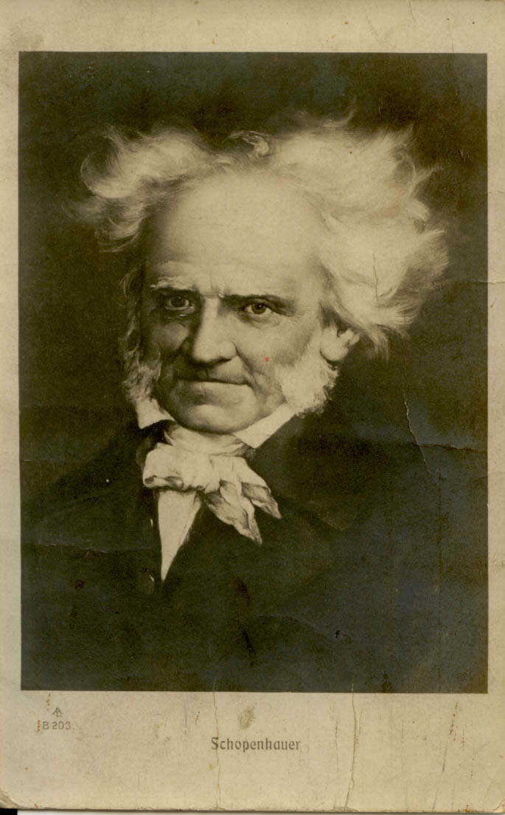
Arthur Schopenhauer
1788-1860
Contemporary of Hegel
Buddhist Nihilist
The World as Will and Idea

Slide 30
Ultimate Pessimist
Schopenhauer was deeply influenced by the Upanishads.
“Life is a pendulum that swings backward and forward from pain to boredom.”
You have a “will” to nothingness!!!

Slide 31
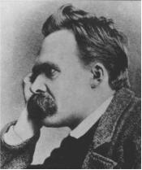
Friedrich Nietzsche
1844-1900
German Idealism
The Ego and Will
Genealogy of Morals
Beyond Good and Evil

Slide 32
Genealogy of Morals
Nietzsche said the slave is formed by negatives.
- Master is powerful - Slave praises weakness
- Master is selfish - Slave praises altruism
“Exert yourself, so you can assert yourself”

Slide 33
God is Dead!
Nietzsche adapted the pessimism of Schopenhauer and transformed it into a way of transcending reality.
An inverse of Rousseau
- Rousseau: Increase of Competition
- Nietzsche: Decrease of Competition

Slide 34
The Ego
Life is needy…meaning that ego is the will to power.
Influence of Darwin: The Drive for more--competition!!!
But with a dead God, how do we get rid of FEAR!

Slide 35
The Superman
Nietzsche deeply criticized democracy and Christianity because they were weak.
A return to heroism and greatness, we must look to Ancient Greeks.
The Superman - Ultimate Ego

Slide 36
Beyond Good and Evil
Nietzsche rejected the notion that there was a universal or absolute system of values.
An ahistorical approach to history
“Everything that occurs will occur again”

Slide 37
What is Valued???
All morality stands for something that is good for you…. Solipsism
What then is valued for Nietzsche?
The role of spirit was being destroyed in the wake of Darwin.
Therefore we should act rather than think!

Slide 38
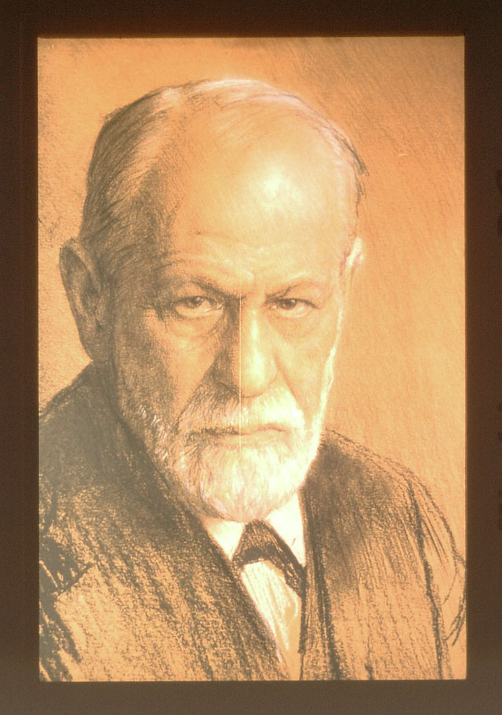
Sigmund Freud
1856-1939
Born into a wealthy Viennese Jewish Family
Fin de siècle
Psychoanalysis
Interpretation of Dreams

Slide 39
Psychoanalysis
The Idea of the Soul
- id: animal instincts, sexual drive
- superego: external moral imperatives
- ego: mediates between the id and superego

Slide 40
Collective Unconscious
The idea of the Unconscious. Sex at heart of the personality.
Civilization depends on the sublimation of sexual energy.
Background for all neurosis was sexual… look to the dreams!

Slide 41
Interpretation of Dreams
“The dream is the disguise fulfillment of a suppressed or repressed wish”
The Freudian Slip - occurs in the dream.
Not necessarily rational, but could explain depression.

Slide 42
Neurosis
Human beings are sexual at a very early age.
The libido comes in conflict with the ego.
Oedipus Complex
Electra Complex

Slide 43
Free Associations
Freud’s attempt to find meaning through dreams was called free association.
If you could find out what desire was being repressed, then you can find out what is wrong.
Happy life of “love and work”

Slide 44
Problems
What happens when you apply Freud’s theory to democracy?
Philosophers and artists increasingly became aware of these basic problems -- the problem of modern humanity.
We had lost faith, but what did we have to replace it?

Slide 45
Questions
The Biggest Take Away and any lingering questions for the final week.

Slide 46
Next Week
The last class is on the Postmodern Condition. We will revisit the theme from weeks one and two and look at the issues with modernity.

