Slide 1
Week 3
The Quest for Progress

Slide 2
Questions / Take Away
Reviewing some of the highlights from last week’s class on Medieval Thinkers
Take Aways - Go forward
Quest for Progress - Age of Reason

Slide 3
Rediscovery of the Universe
The main factors leading up to the scientific revolution:
Discovery of the New World
Invention of the Printing Press
Rivalry among Nation-States
Reformation
Renaissance Humanism

Slide 4
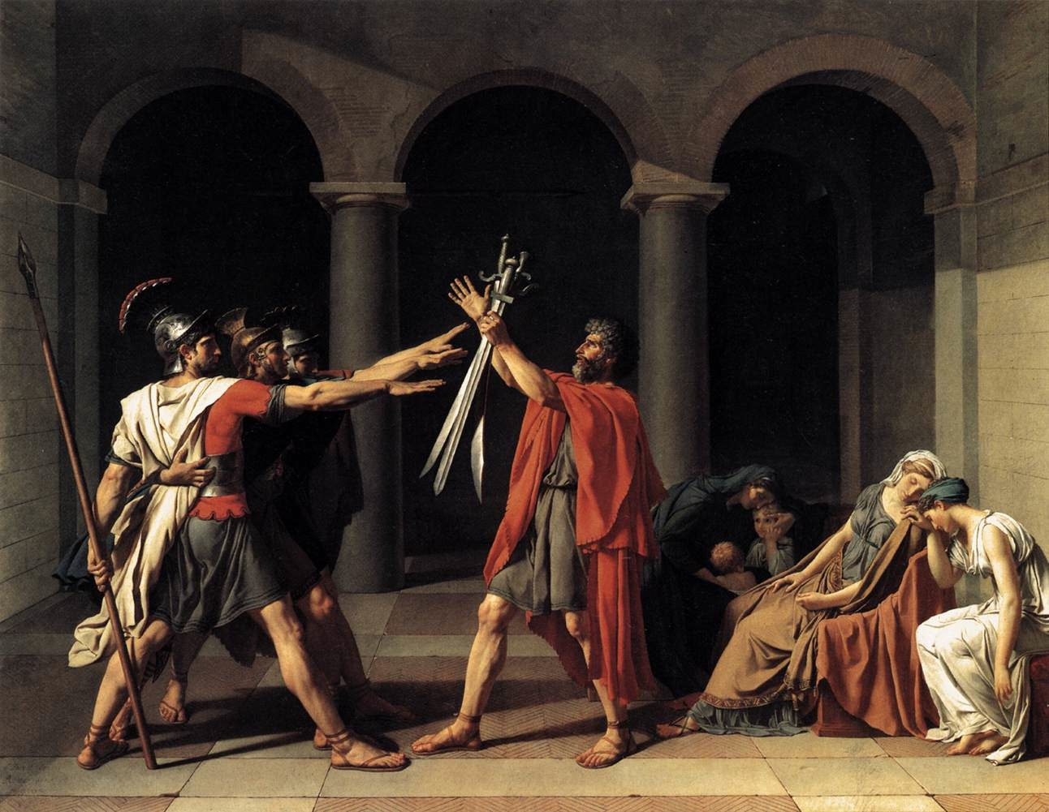
Modes of Progress
The Role of the Modern Man in society
Individualism
Signs of Progress - developments in the economy, society, and politics.

Slide 5
End of the Middle Ages
The 12th and 13th centuries Europe flourished.
In the 14th and 15th centuries there is a great decline.
Pre-Renaissance Europe was hit with social, political, and economic distress.

Slide 6
The Break Down
Hundred Years War - 1337-1453
Black Death - Plague hits Western Europe 1347-1430
Great Schism - 1378-1417
Conciliar Movement - 1415
Humanism - Reacting to Scholastics

Slide 7
Mercantilism
The Italian Peninsula became the HUB for Western Europe.
Merchant Class developed
Birth of the Banking System
Working Class - Manufacturing goods became popular.

Slide 8
Essence of Individualism
Individualism of the Renaissance gave way to the Reformers of the 16th century.
Man by himself achieves nothing through the gift of spirit or grace.
Faith through the salvation of Christ

Slide 9
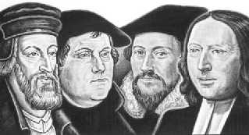
Reformation
Martin Luther and John Calvin main figures.
Failure in the face of the law - Antinomianism
Saving Faith - Not Works
Christian liberation paved the way for Individualism
Looking for something more worldly

Slide 10
The New Science
The “new” science was a diverse study of natural philosophy.
- Astronomy
- Math / Logic
- Physics
- Biology

Slide 11
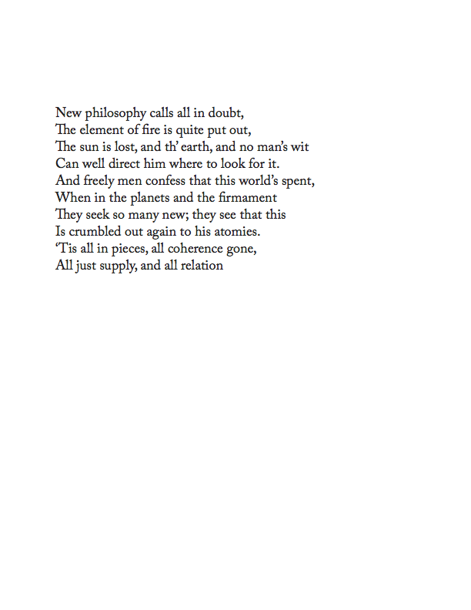

Slide 12
Astronomy
Ptolemy - Geocentric universe
Borrowed heavily upon Aristotle’s conception of the universe.
Mathematically based, no scientific reasoning for the model.

Slide 13
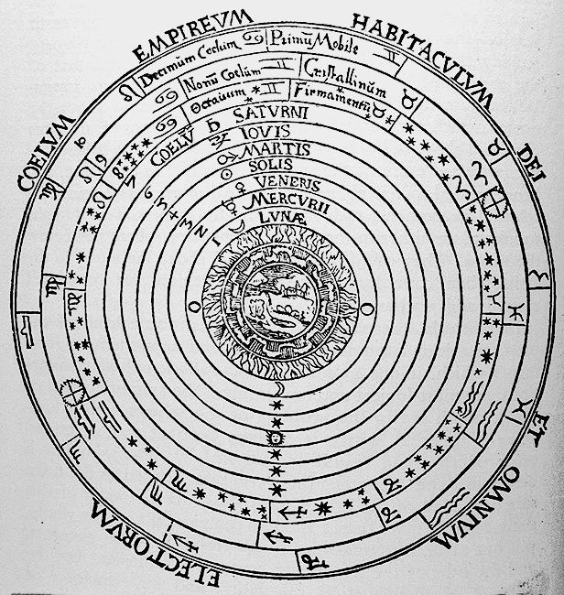

Slide 14
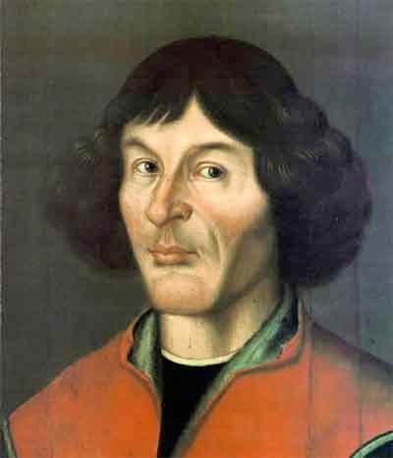
Nicolaus Copernicus
1473-1543
On the Revolutions of the Heavenly Spheres - 1543
Heliocentric Universe

Slide 15
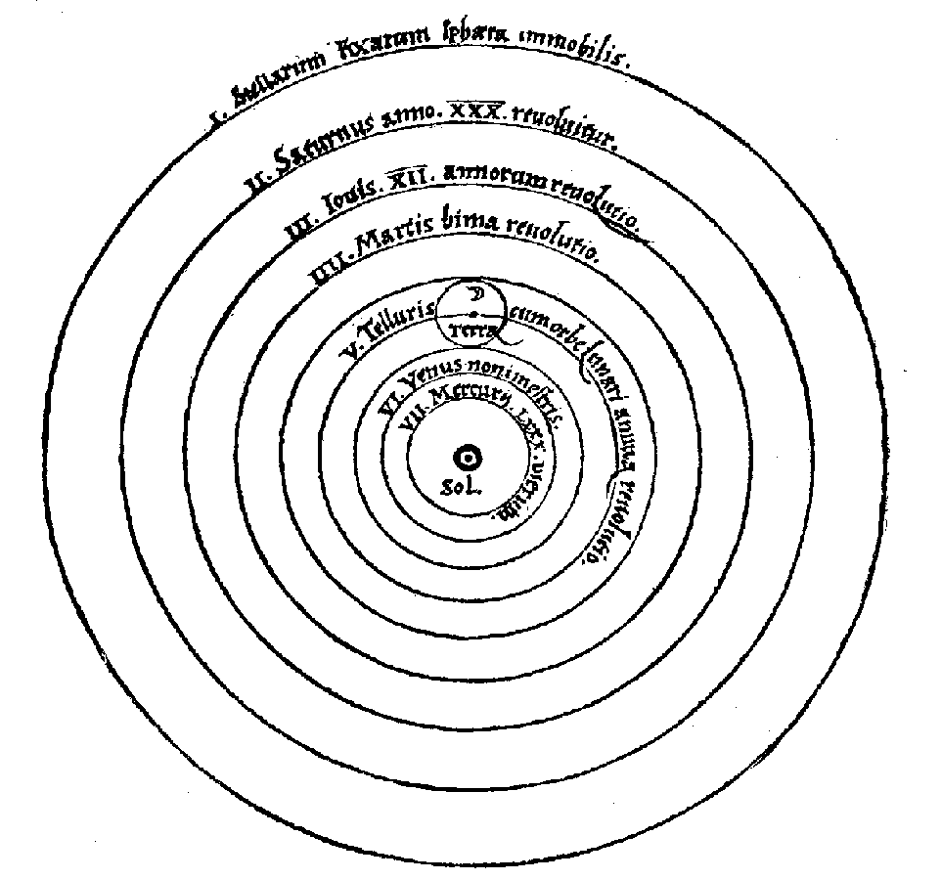

Slide 16
Copernicus’ Revolution
The sun-centered universe rejected Aristotle’s cosmology.
Revolutions = how long it took to ‘revolve’ around the sun.
Kept the epicycles of Ptolemy’s system into his work.

Slide 17
The New Astronomy
Tycho Brahe (1546-1601) worked on creating a mathematical way to explain Copernicus.
Did not buy into the sun-centered universe.
Collected a larger collection of astronomical data.

Slide 18
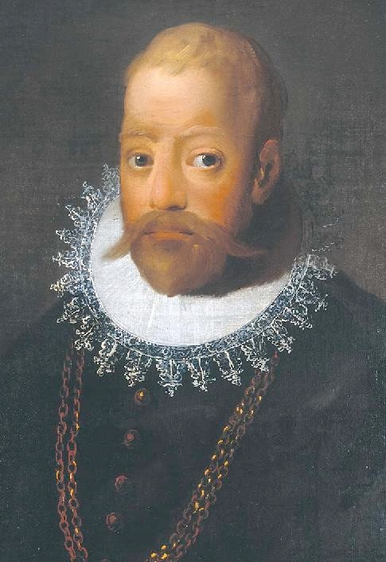
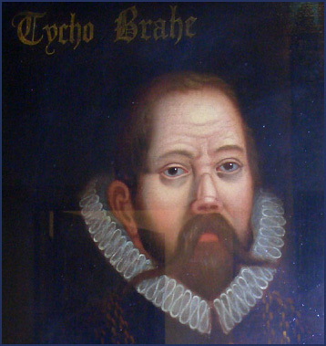

Slide 19
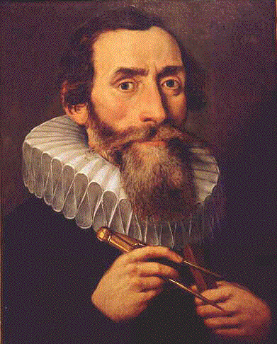
Johannes Kepler
1571-1630
Brahe’s assistant
Defends Copernicus’ theory
Elliptical motion of the planets

Slide 20
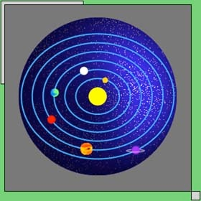

Slide 21
Physics
Isaac Newton (1642-1727) discovered the laws of gravity.
Principles of Natural Philosophy
His laws are the cornerstone of modern day physics.
Rounded out the Copernican Theory through his discovery.

Slide 22
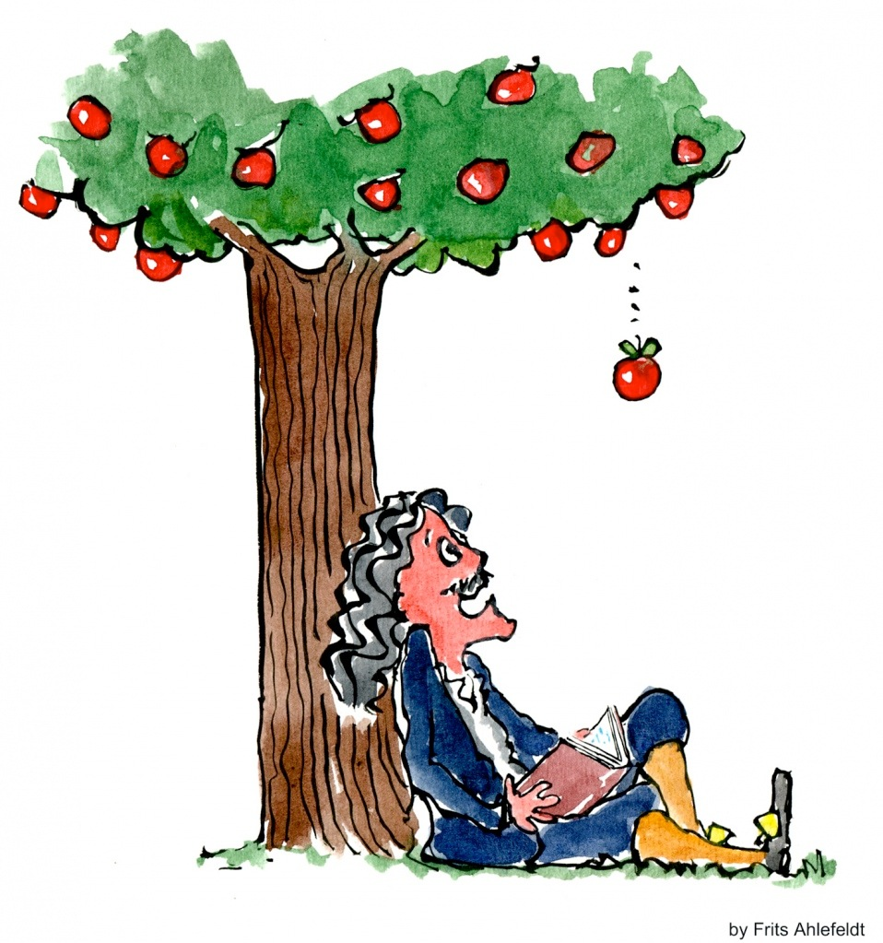
Laws of Motion
Newton’s synthesis developed the laws of motion, dynamics, and mechanics.
All motion could be timed and measured.

Slide 23
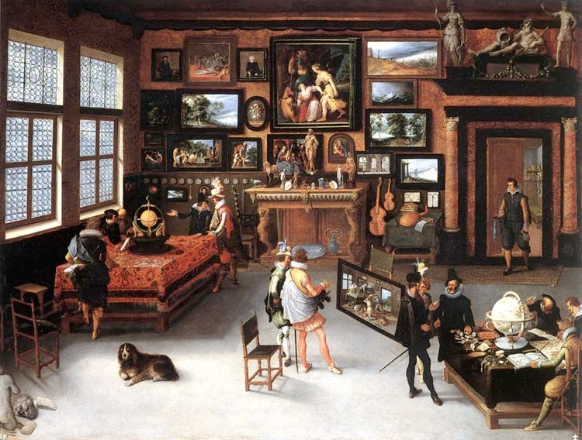

Slide 24
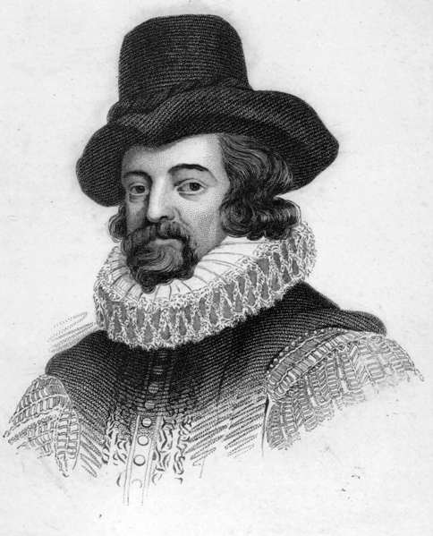
Francis Bacon
1561- 1626
Father of Empiricism
A man of letters
Known mainly for the inductive method

Slide 25
Empiricism
Empiricism follows the method of experimentation in science.
A natural philosopher that applies the inductive logic to solve problems.

Slide 26
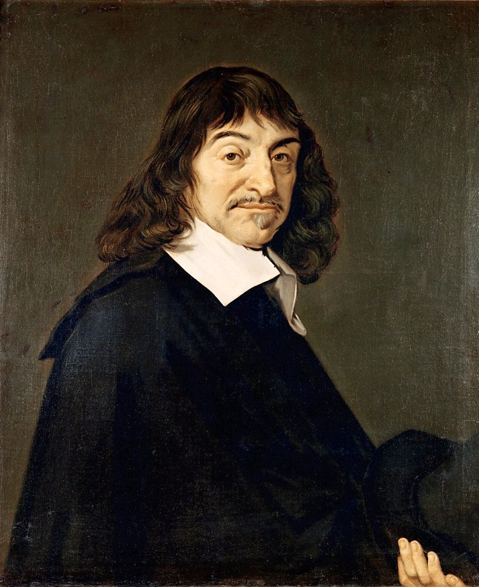
Rene Descartes
1596- 1650
Invented analytic geometry.
Discourse of Method
Deductive Method or Rationalism

Slide 27
Rationalism
Applies the deductive method of logic
Cogito Ergo Sum - I think therefore, I am.
From this principle, Descartes derived the Ontological Proof for the existence of God. ( SEE St. Anselm) Perceptions of the Universe

Slide 28
Baruch Spinoza: 1632-77
Jewish thinker
Attempted to construct a picture of the world based on ontology.
God is a part of totality, rather than above it.
Strive more to be the hammer and less the anvil.

Slide 29
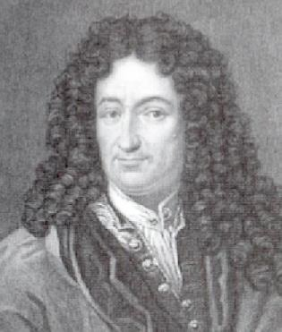
Gottfried Leibniz
1646-1716
The scale of nature
No windows and no doors a pre-established harmony with GOD!

Slide 30
All for the BEST!
Leibniz’s optimism is grounded in his rational conception of the universe.
Principle of Sufficient Reason
God simply chose this world to be the BEST of all possibilities…the choice follows NATURE.

Slide 31
Theodicy
In 1710, Leibniz developed his theory of Theodicy, which was the freedom to do what ever you wanted.
Learn how to recognize evil and transform it into GOOD.

Slide 32
Perceptions of the Universe
The World was thrown into amok following the Scientific Revolution.
“ I saw eternity the other night”
~ Henry Vaughan

Slide 33
Faith and Reason
The new science brought many challenges to religion.
Biblical fallacies
Natural philosophers vs. theologians
Material vs Spiritual World

Slide 34
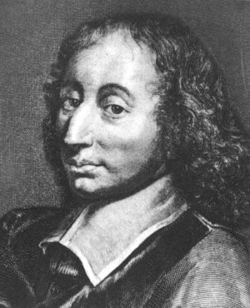
Blaise Pascal
1623-1662
French mathematician
Jansenist - apologist
Wrote against dogmatism and skepticism
Pensées

Slide 35
Leap of Faith
Pascal was trying to establish a means to be a Christian.
Christianity = Ultimate Happiness
Reason can only take you so far…
“ The heart has its reasons that
reason does not know…”

Slide 36
The Wager
Pascal made a bet with the skeptics.
Answers the question - “What is in it for me?
An infinite amount of gain vs. a finite amount of loss.

Slide 37
Points of the Wager
Man transcends that what kills him
“ The eternal of these infinite spaces terrifies me….”
You do not have the resources in yourself to make yourself happy.
For example, “ I am the King of France”

Slide 38
What is Enlightenment?
Was it a revolutionary body of thought?
Was it a unified body of thought generated by an established canon of thinkers?
Was it a stage in the development of the human spirit?

Slide 39
The Philosophes
Not usually “philosophers” but rather “men of letters”.
These philosophes “sought to apply the rules of reason and common sense to nearly all major institutions and social practices.”

Slide 40
Sapere Aude!
“ Have the courage to use your understanding…” ~ Kant.
The motto of the Enlightenment was “Dare to Know”.
What Kant suggests is a the policy of “reform” to increase freedom
Precursor to the Age of Revolutions

Slide 41
Influences on the Enlightenment
The Ideas of Newton and Locke
British Toleration and Stability after 1688.
Progressive religious reforms based on responsible government
Experiments from the Scientific Revolution Era.

Slide 42
The Public Sphere
The emergence of the Enlightenment was opening of the Public Sphere through an active print culture.
The Spectator by Joseph Addison and Richard Steele
Coffeehouses and Freemason lodges
Creation of the Encyclopedia (1751)

Slide 43
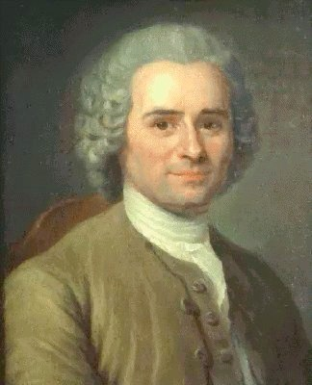
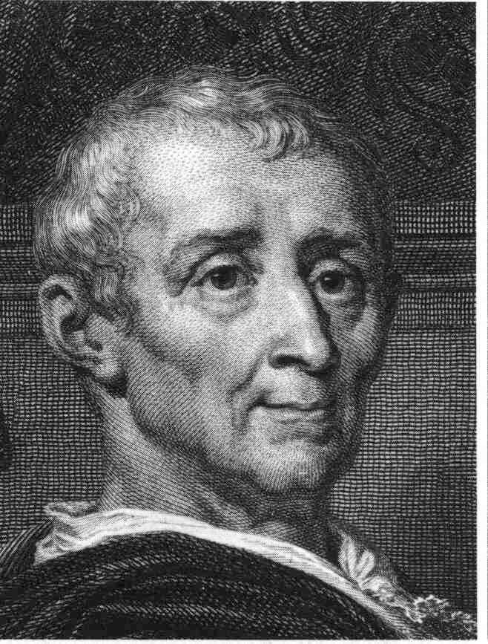
The Spirit of the Laws

Slide 44
Montesquieu:1689-1755
A lawyer and a member of the nobility.
The Father of Sociology
Looked to England as an example of what government should be like.
Separation of Power - Checks and Balances.

Slide 45
Persian Letters: 1721
Montesquieu wrote this tale as a critique of European Society through the eyes of foreigners.
Usbek and Mirza

Slide 46
Troglodyte Parable
Mirza writes Usbek and asks:
“Is man happier by pleasure or the practice of virtue?”
Usbek’s response is the parable, which discusses the three phases of the Troglodytes.

Slide 47
Balance of Power
The final decline of the Troglodytes was a result of a moral problem, not a military issue.
“Men are born virtuous and ought to be this way.”
Economic connection - “Fable of the Bees”

Slide 48
Rousseau:1712-1778
Born in Switzerland of lower middle class family.
Moved to France and lived a wayward life… Confessions
Became involved with social circles of the philosophes through publications.

Slide 49
The Second Discourse: 1755
What is the origin of inequality?
Rousseau gave a speculative analysis of human beings.
Man was not originally social.
The drive for inequality was the desire to be desired.

Slide 50
The Social Contract: 1762
The Social Contract was Rousseau’s political theory.
“All men are born free, but everywhere they are in chains.”
BUT WHY????
What is Rousseau’s answer for this bondage?

Slide 51
Next Week
We shall continue looking at the mind and how it was further shaped by the drive of capitalism and science.
Question Cards - What was the biggest take away from today’s lecture? What questions do you still have lingering?

