Slide 1
Week 1
The Philosophy of the Mind
The Grandeur of the Greeks

Slide 2
The Mind
How do we know things?
What is the cause of all this knowledge?
Is there something beyond us?
Contemplation of the Mind

Slide 3
Epistemology
The study of how we ‘know’ things.
Guiding question for the mind
What do you see?

Slide 7
Classical Greek Civilization
750 - 550 BC - The Age of Expansion
550 - 400 BC - The Age of Democracy
500- 479 BC - The Persian War
431- 404 BC - Peloponnesian War
400 - 300 BC - The Age of Philosophy

Slide 8
The Polis
Polis - “City-State” expands the length of the Mediterranean World.
Originally aristocratic republics
Government and Politics
Unique structure fostered development of philosophy.

Slide 9
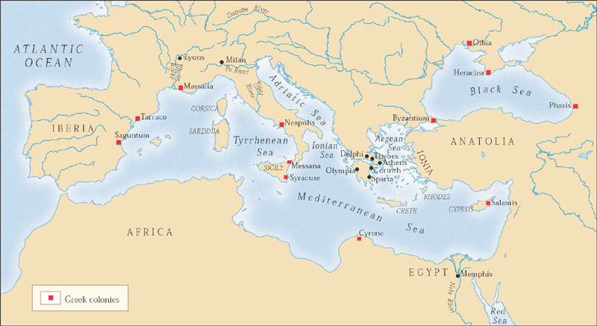
Classical Greece and the Mediterranean basin, 800-500 B.C.E.

Slide 10
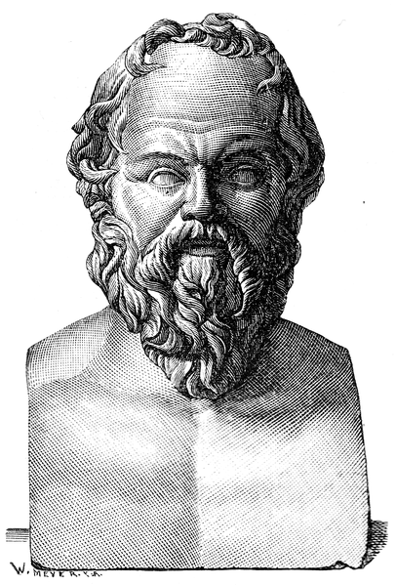
Socrates (470-399 BC)
The Socratic Method
Student: Plato
Public gadfly, condemned on charges of immorality

Slide 11
Socratic Method
Questioning
Priority of Definition
Knowledge is perception > Knowledge is true judgment > Knowledge is true judgment plus an account

Slide 12
The Apology
Socrates was accused of corrupting the youth by his contemporaries.
In his defense speech, Socrates admits his ignorance and proceeds to the stress the priority for the care of the soul.
“An unexamined life is not worth living” > Connection to the polis and democracy.

Slide 13
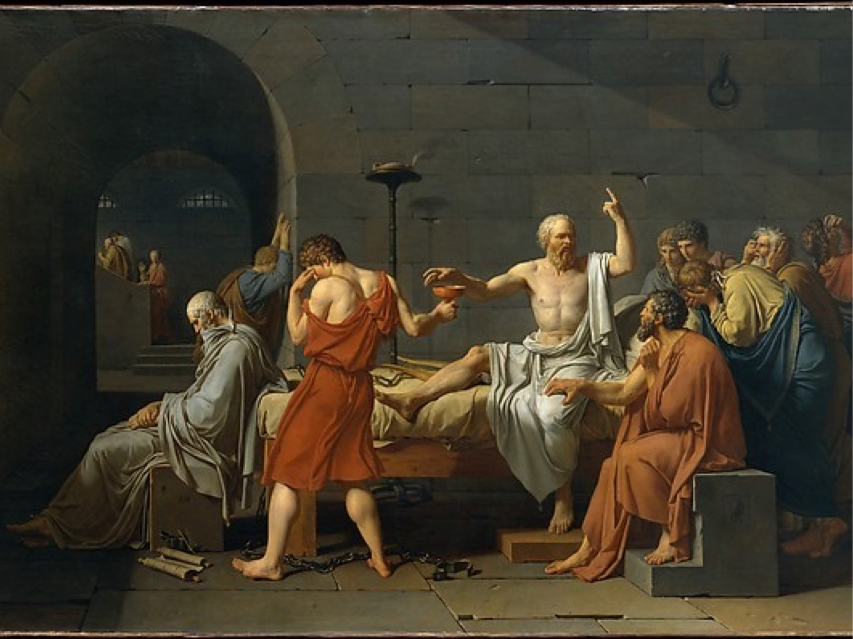

Slide 14
Plato (430-347 BC)
Systematized Socratic thought
The Republic
Allegory of the Cave
Theory of Forms/Ideas
Ring of Gyges - Morality

Slide 15
What do we know?
What if you found out the reality you perceived was full of lies and deceptions?
What is real and what is fake?

Slide 17
Awakening
Once the body wanders and the mind perceives the truth and awakening occurs. This is the meaning of enlightenment.
“I want you to go on to picture the enlightenment or ignorance of our human conditions somewhat as follows.”

Slide 19
Theory of the Forms
A set foundation for Plato’s theories
Metaphysics, Ethics, Justice, Morality, Education, and the Soul.
Euthyphro

Slide 20
The Forms
Objective - They exist ‘out there’ as objects, independently of our minds or wills.
Transcendent - Though the exist ‘out there’ they do no exist in space and time
Eternal- as transcendent realities they are not subject to time and therefore not subject to motion or change
Intelligible - as transcendent realities they cannot be grasped by the senses only the intellect
Archetypal - models for every kind of thing that could exist
Perfect - they include absolutely and perfectly all the features of the things within models.

Slide 21
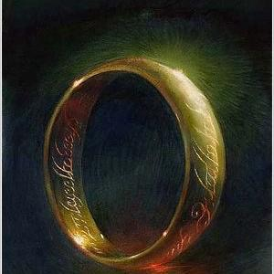
Self-Interest - Morality
Is acting out of self-interest always a bad thing?
Are we doing good out of virtue or to get noticed?
The Ring of Gyges - “To know the good is to do the good”

Slide 22
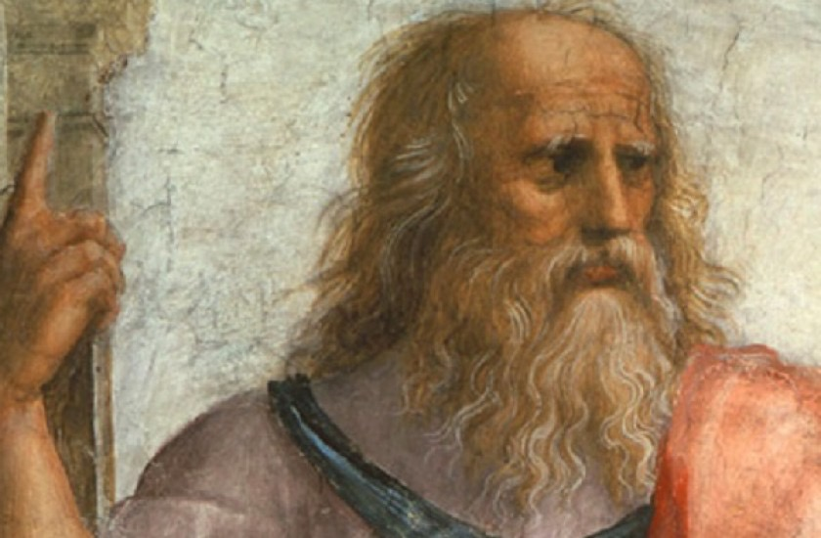
The Philosopher King
Philosopher Kings = men guided by reason
According to Plato, these men would balance out the democracy in society, and prevent any vicious self-interested individual from taking over.

Slide 23
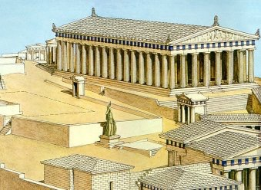
Government & Self-Interest
Plato’s concept of the Philosopher King helps explain the birth and development of Western Civilization.
What is the “right” form of government? morally guided?
“Government is best which governs the least”

Slide 24
Aristotle (389-322 BC)
Student of Plato
Broke with Theory of Forms/Ideas
Emphasis on empirical findings, reason
Massive impact on western thought
Metaphysics - Logic -> teleological
Nicomachean Ethics - Self Realization
golden mean

Slide 25
Metaphysics
Aristotle believed that from were embedded in particular ways and not heavenly realities.
Change can mean motion, growth, decay, generation, or corruption.

Slide 26
The Four Causes
Formal Cause - determines what a thing is
Material Cause - determines what it is made of
Efficient Cause - determines what a thing was made by
Final Cause - determines the end for which it is made

Slide 28
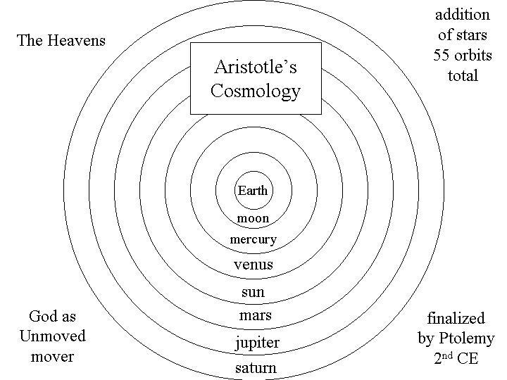
Unmoved Mover
Potentiality —> Actuality
Nature is life. All things are in motion, in the process of becoming and dying. Therefore, form and matter are never separate.
The Unmoved Mover

Slide 29
Aristotle’s View on Happiness
There will always be limitations to happiness.
Many people live in unimaginable conditions that are anything but happy.
Social and Cultural Reform

Slide 30
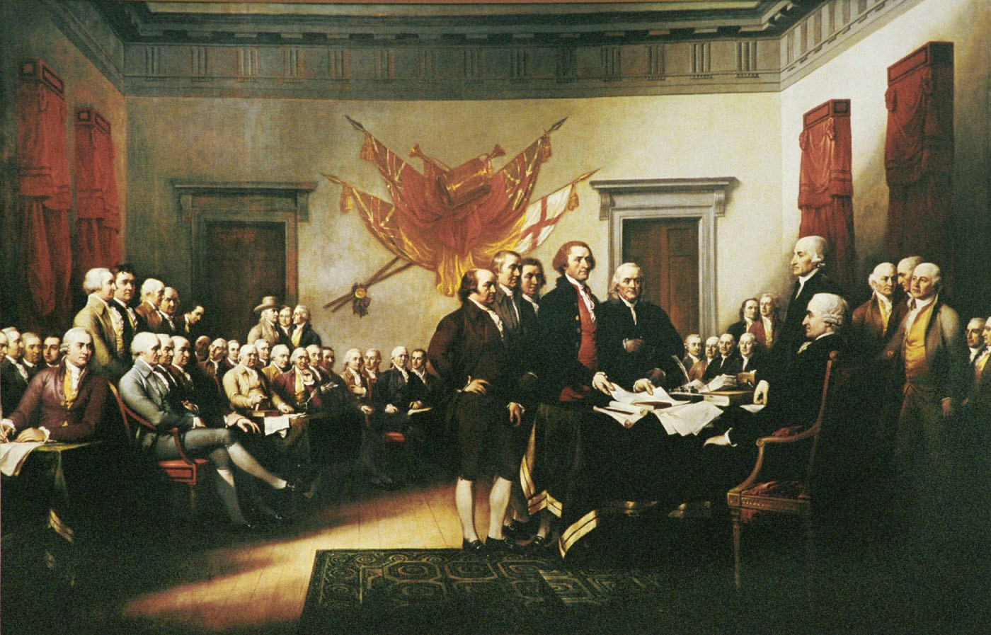
The Government’s Role
If morality is crucial to the concept of good government, then so too is the idea of happiness.
The basic function of government is to provide happiness for each citizen
American Revolution began with this concept.

Slide 31
Declaration of Independence
“We hold these truths to be self-evident, that all men are created equal, that they are endowed by their Creator with certain unalienable rights that among these are life, liberty, an the pursuit of happiness.”

Slide 32
Greek Achievement
Undesirable and Unique features of Greek Life
Democracy - Role of Freedom
Value of Life - Philosophy
The Art of the Humanities

Slide 33
Next Week
We will continue to look at how the mind has been shaped throughout history and focus on the big medieval philosophers and how they shaped the universe.

