Slide 1
Week 4
Coping with Change

Slide 2
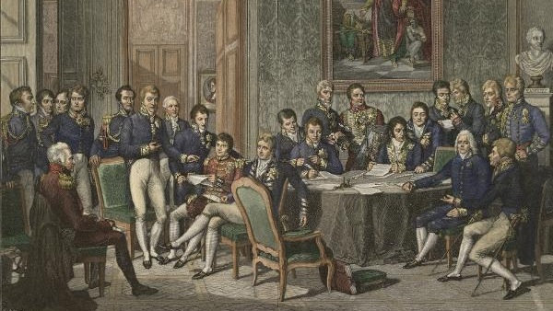
The Congress of Vienna

Slide 3
A Gathering of Victors
Metternich wanted to assure that peace in Europe was maintained.
Authority of the monarchies and aristocracies.
Mutual consultation of politics
Concert of Europe
The Rise of Ideology in politics

Slide 4
Rise of Conservatism
Opposed the rule of popular sovereignty and economic liberty.
Limited constitutions - power control by monarchies & aristocracies.
The alliance system -> Concert of Europe

Slide 5
Liberalism
Liberalism grew out of the nineteenth-century political turmoil.
Steeped in Enlightenment ideals.
Wanted Constitutions and political freedom.
Responsible Government

Slide 6
Political & Economic Goals
Wanted boarder political participation, but not direct democracy
Privilege based on wealth and property.
The rising Middle Class - Bourgeoisie
Laissez-faire Economics - Capitalism

Slide 7
Nationalism
The belief that a nation is composed of people who are joined by common bonds.
Opposed the Congress of Vienna
The notion of “popular sovereignty”
The Nation and Nationhood.

Slide 8
Nations on the Rise
Developed a “national” language that did away with dialects.
The Printed Word
Nationhood as way to bridge together people of an ethnic group.
Nationalists put pressure on Empires

Slide 9
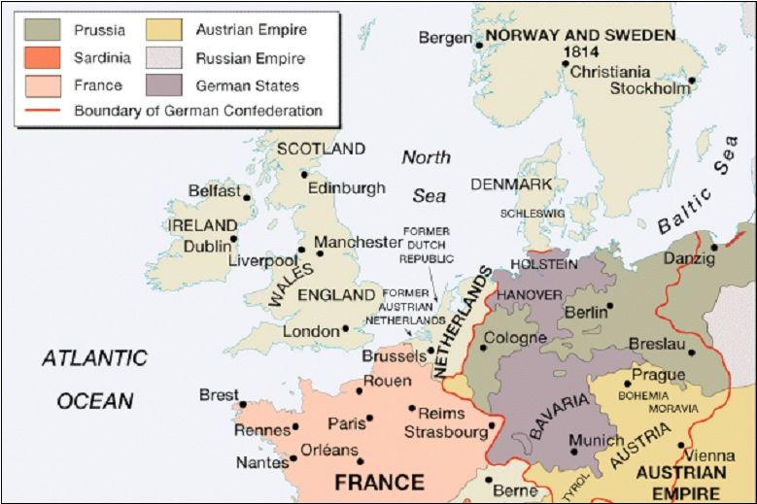

Slide 10
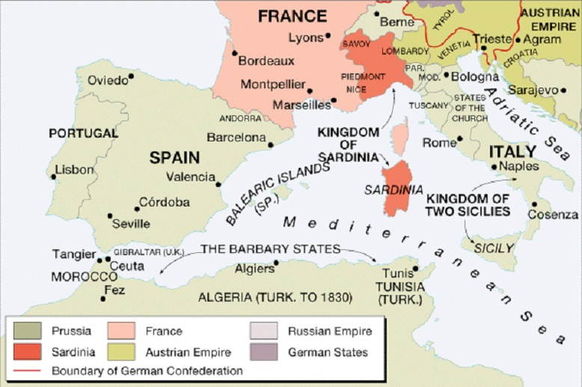

Slide 11
Socialism
Early socialist applauded the new productive industrialism.
Opposed the classical economists
Mismanagement, low wages, poor distribution of goods arose from unregulated industrial system

Slide 12
Restoration and Repression
Coping with Change
The aftermath of the Congress of Vienna sparked a number of opposition uprisings.
Crisis, Revolt, and Revolutions
Reform Movements on both sides liberal and conservative

Slide 13
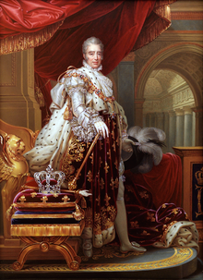
Revolution of 1830
Louis XVIII died in 1824, leaving his brother Charles X heir to the throne
Charles X = divine right.
Historical mistakes lead to blood shed.

Slide 14
Reactionary Policies
Gave land back to the emigres
Restored the primogeniture rule
Made Roman Catholicism the official and only religion of France
In 1827, denied the Chamber of Deputies constitutionality.

Slide 15
July Revolution
July 25, 1830
Restricted freedom of the press
Dissolved the recently elected Chamber of Deputies
Restricted the franchise to the wealthiest people in France
Call for new elections.

Slide 16
Down goes Charles!!!
The royal army could not gain control of Paris.
On August 2, 1830 Charles abdicated and fled to England
The Chamber of Deputies named Louis Philippe “King of the French”

Slide 17
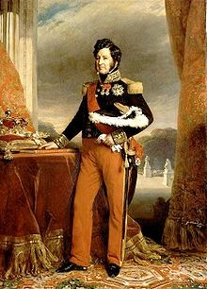
Fit for a King?

Slide 18
July Monarchy
The July Monarchy established under Louis Philippe was politically liberal
Socially, however, he was a conservative.
Money was the path to power, and the working class was downtrodden
A series of revolts broke out between 1832-1834.

Slide 19
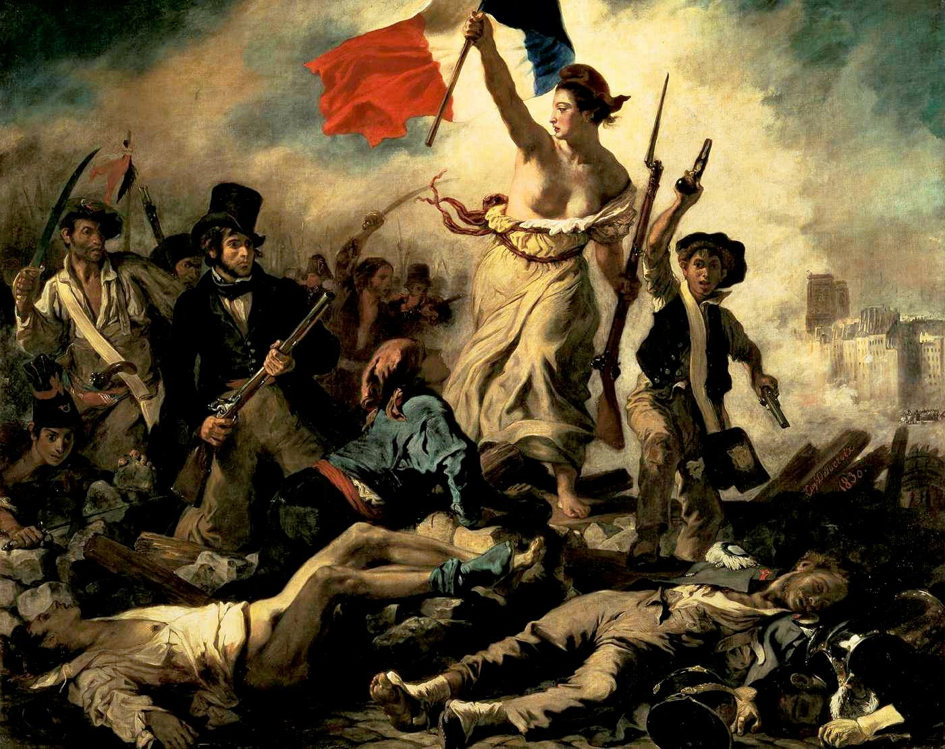
Les Miserables

Slide 20
1848 Revolutions
Spring of Nations
Severe food shortages
Commercial and Industrial economy was depressed.
Unemployment & poor living conditions.
Discontent of the working classes

Slide 21
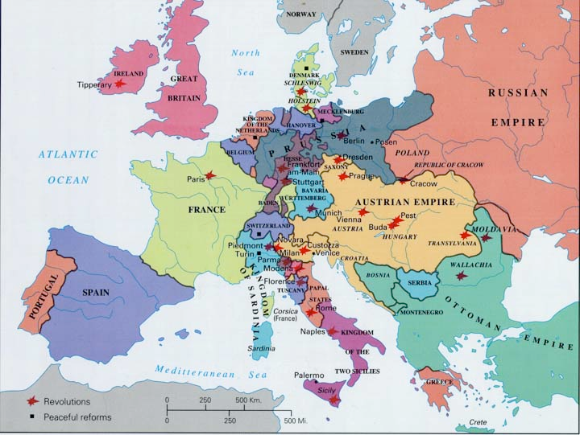

Slide 22
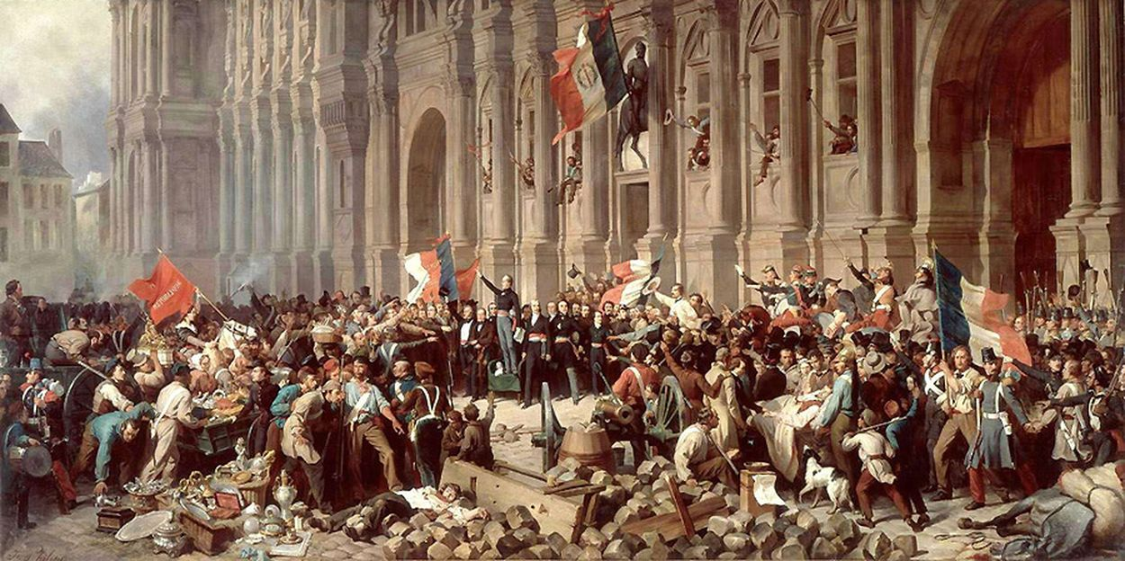
France
Liberal opposition to the corrupt regime -> July Monarchy
February 23rd Guizot resigned, on February 24th Louis Philippe abdicated.

Slide 24
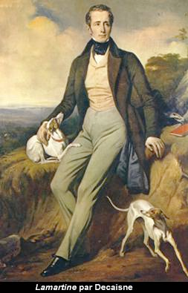
National Assembly & Paris Workers
Alphonse de Lamartine (1790-1869)
Re-write a new constitution -> 2nd Republic
But workers wanted social revolution too!

Slide 25
Habsburg Empire
The Habsburg Empire cut across national lines.
Nationalism was preached throughout the Empire.
1848 rebellions broke out in Vienna, Prague, Hungary, and Italy.

Slide 26
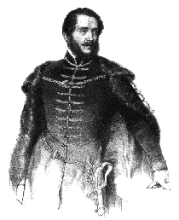
Louis Kossuth (1802-1894)
Magyar Nationalist
March 1848 made moving speeches at the Hungarian Diet

Slide 27
Rebellion in North Italy
March 18, 1848 in Milan a group of Italian Nationalists rebelled against the Habsburg rule in North Italy.
Radicals Mazzini and Garibaldi move to establish a Roman Republic.

Slide 28
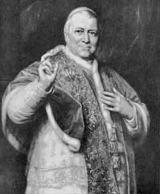
Republicanism
November 15, 1848 radicals assassinate the minister of the Papal States Count Rossi
Pius IX fled to Naples for refuge.
February 1849 declare the Roman Republic

Slide 29
Magyar Revolt
The incident in Vienna encouraged Magyar leaders in Hungary.
Magyars wished to have a separate Hungarian state within the Habsburg domains.
Forcing Romanians, Serbs, & Croatians to abide by Magyar policy a revolt broke out!

Slide 30
Czech Nationalism
At the same time of the Hungarian revolt, Czech nationalism also arose in the spring of 1848.
Czech nationalist demanded Bohemia and Moravia to be permitted to the Slavic state.
Pan-Slavic Congress called for Slavic recognition.

Slide 31
Vienna Uprising
Kossuth speeches influence student organizations … riots break out in Vienna.
Metternich resigned and fled the country
May 17, 1848 Ferdinand agreed to a moderately liberal constitution.
Hungarian Diet abolished serfdom.

Slide 33
Germany
1848 brought liberalism to the fore-front of German states.
Numerous states such as Wurttemberg, Saxony, Hanover, and Bavaria called for a liberal government and German unity.

Slide 34
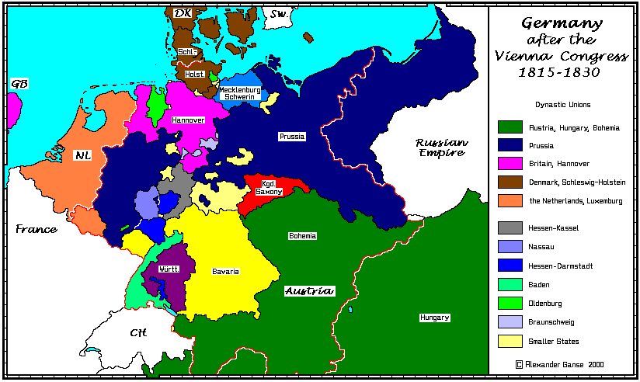

Slide 35
Revolution in Prussia
March 15, 1848 large popular disturbances had erupted in Berlin.
Frederick William IV called for an assembly to write a constitution.
Appointed a liberal minister to head the cabinet -> David Hansemann

Slide 36
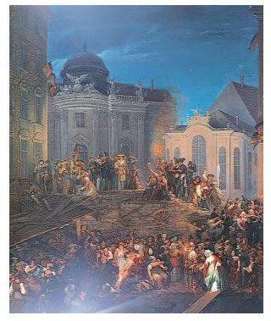

Slide 37
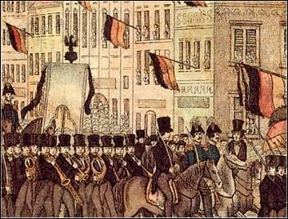
Frankfurt Parliament
May 18, 1848 representatives from all over Germany met in St. Paul’s Church to write a constitution
Grossdeutsch vs. Kleindeutsch Solution

Slide 38
Rise & Fall of the Second Republic
Revolution heats up during the summer of 1848 in Paris… “June Days” (Flaubert)
Social order & protection of property.
Failure of the National Workshops
The election of “Little Napoleon”

Slide 39
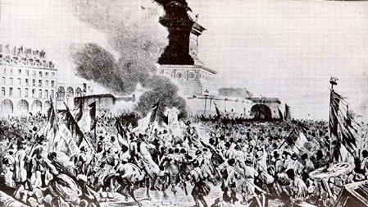

Slide 40
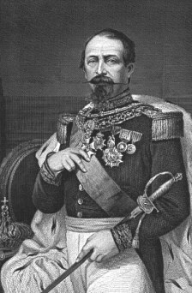
Little Napoleon
December 2, 1851 seized power to call for a reelection.
December 2, 1852 declared the 2nd Empire
Napoleon III

Slide 41
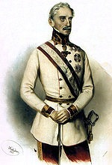
Divide and Conquer
Gen. Alfred Windisch-Graetz
June 17, 1848 moved against the Czech Nationalists
Germans and Middle Classes approved
Radicals suppressed

Slide 42
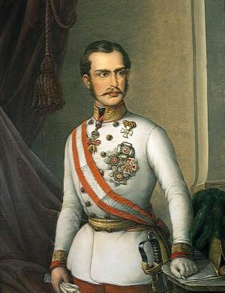
Habsburg Victory
Franz-Joseph takes over the Habsburg Empire
Supported by Tsar Nicholas I, the Habsburgs put down every revolt and returned order.

Slide 43
Arrivederci Republica
In March 1849, radicals forced Piedmont to renew war with Austria.
Piedmont defeated and the new Republic was on its own.
June 1849, Napoleon III sends 10,000 troops to put down the radical rebellion
Pius IX renounces liberalism and returns

Slide 44
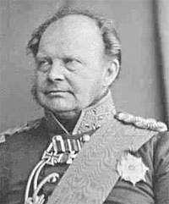
Frankfurt Flounder
By April 1849 Frederick William IV rejects the constitution
There was nothing legal or binding about the actions
Junker support was not interested in Germany unity
He feared opposition from Austria
He did not want “a crown picked up from the gutter.”

Slide 45
Questions ???
Why did the revolutions of 1848 fail throughout Europe?
What roles did liberals and nationalists play in the revolutions?
Why did they sometimes clash?
Idealism vs. Realism -> Flaubert

Slide 46
What Happened?
Internal divisions among the middle-class liberals, radicals, socialists, artisans, and workers.
Holding power: Liberalism vs. Nationalism
Power of the Conservatives - Ruling Class
People have a difficult time accepting ‘change’

Slide 47
Communist Manifesto
Revolution through class conflict
Bourgeoisie and Proletariat
Proletariat and Communist
“All that is solid melts into air, all that is holy is profaned, and man is at last compelled to face with sober senses, his real conditions of life, and his relations with his kind.”

Slide 48
Va, Pensiero

Slide 49
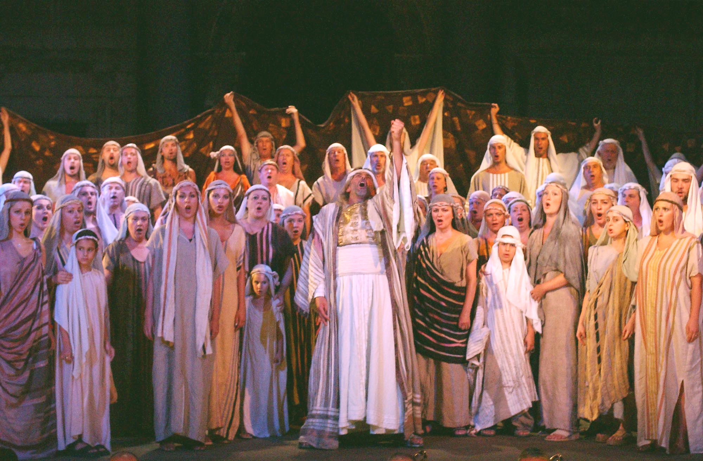

Slide 50
semper Libre

Slide 51
Analysis of La Traviata
On the surface we see a tragic love story that had obvious connections to real life drama
Under the surface, however, we can see a crestfallen revolutionary whose dream was literally consumed by the conservative forces, which highlights the issues people have with change.

Slide 52
Full Circle
What is the meaning of all this change?
“We shall not cease from exportation”
~ T.S. Eliot

Slide 53
Next Week
In the final week, we shall look at the developments of science and technology and how they have created such a need for change that is perpetual.

