Slide 1
Psychology of Change
Week 3 - The Age of Revolutions

Slide 2
Modern Age
Revolutions - Process of Change
Middle Ages —> Modernity
Role of the Individual in Society
Social Contract

Slide 4
Background to the Age of Revolutions
Renaissance and Reformation
Scientific Revolution
English Civil War
Enlightenment

Slide 5
Eighteenth Century
The process of reasoning and rationalizing the universe led to a series of significant and sudden changes.
Why does the need for change occur in society?

Slide 6
Toward an Industrial Society
Industrialization was one of the final steps in ushering tin change from medieval to modern society.
Great Britain led the charge for the Industrial Revolution.
Society becomes transformed.

Slide 7
Britain’s Advantage
Commercial Vigor
Transportation
Raw Materials
Labor
Capital
Entrepreneurship

Slide 9
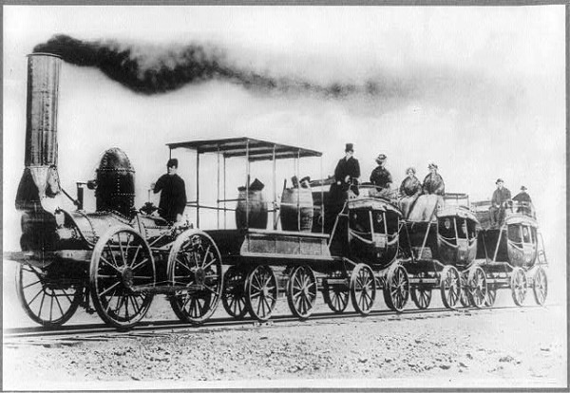

Slide 10
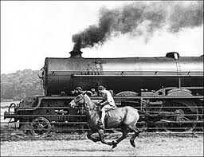

Slide 11
Working Class
Proletariat meant the workers of the means of production.
Workers contribute their labor for a wage…no longer own the means to production.
The emergence of factories

Slide 12
American Revolution
Social Change - Industrialism
Growing Demands for Liberty and Equality
Enlightenment ideas = Reform and Change —> Politics
Seven Years’ War 1756-1763 = Growing Need for Tax

Slide 13
The Need to Tax
The cost of war increased the need to tax
Proclamation Line of 1763
British maintained a large army in the colonies which sets off a series of tax acts.

Slide 14
Britain takes ACTion
1764 - Sugar & Currency Acts
1765 - Stamp & Quartering Acts
1767 - Townshend Revenue Acts
1773 - Tea Act
1774 - Coercive “Intolerable” Acts

Slide 15
Declaration of Independence

Slide 16
1775-1783
The Spanish, Dutch, and French all side with colonists.
Through a series of battles, the colonists were able to oust the British troops in 1781.
Treaty of Paris 1783
Articles of Confederation 1783-1791

Slide 17
Factors Leading to France’s Revolt
Economic Crisis
- Seven Years’ War: 1756-1763
- American Revolution
Unstable Monarchy
Enlightenment Ideas
- Reform

Slide 18
On the Eve of Revolution
The death of Louis XV in 1774 brought political turmoil to France
Depleting economic system
New Tax Scheme failed (Rene Maupeou) and the French parlements were at war with each other.

Slide 19
The Burden of Debt
Rene Maupeou: 1770-74
Jacques Turgot: 1774-76
Jacques Necker: 1776-1783
Charles de Calonne: 1783-87
Archbishop Brienne: 1787-88
Jacques Necker: 1789 returns

Slide 20
Assembly of Notables
Charles de Calonne: 1734-1802 became the minister of finance
New Land Tax and Internal Revenues.
In 1787, called for a meeting of the Assembly of Notables—a group of the top aristocrats in France.
The meeting backfired!

Slide 21
Estates General
The Assembly of Notables refused Calonne’s policy and demanded direct control of the government.
The Notables called for the reappointment of Necker and an Estates General.
Enlightenment established a need for REFORM … and gave aristocrats leverage.

Slide 22
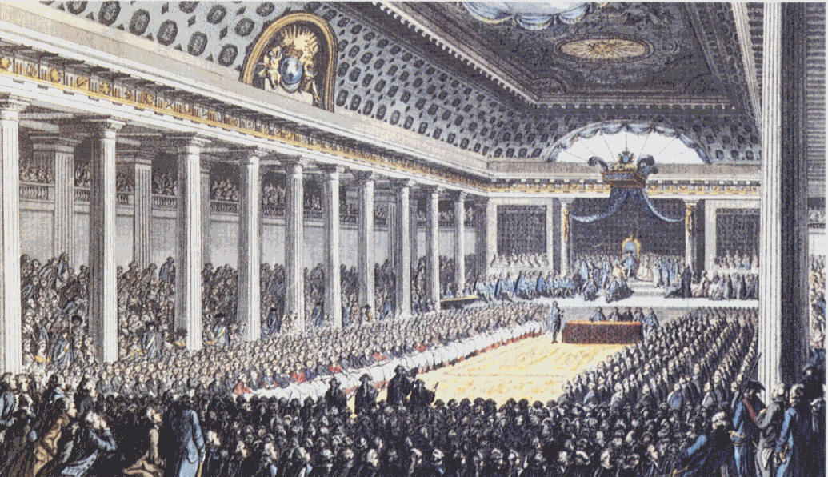

Slide 23
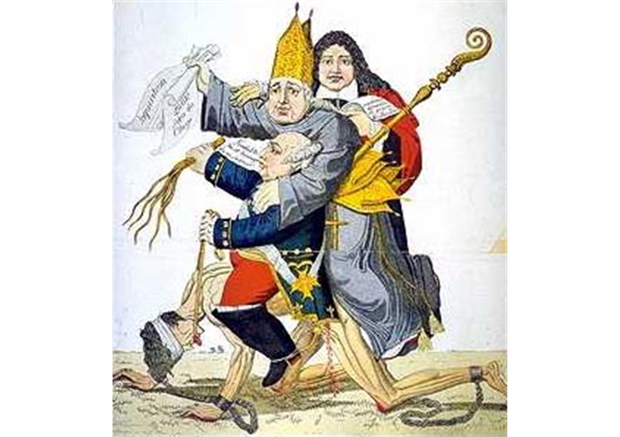

Slide 24
The Meeting
Versailles: May 5, 1789
Royal council had doubled the membership of the Third Estate
- economic reform
- political reform
Cahiers de Doleances - Grievances

Slide 25
National Assembly
The Third Estate organized a standoff against Louis XVI.
The standoff lasted a few weeks - wanted a new legislative body.
They circumvented the Monarchy and formed a National Assembly on June 17, 1789.

Slide 26
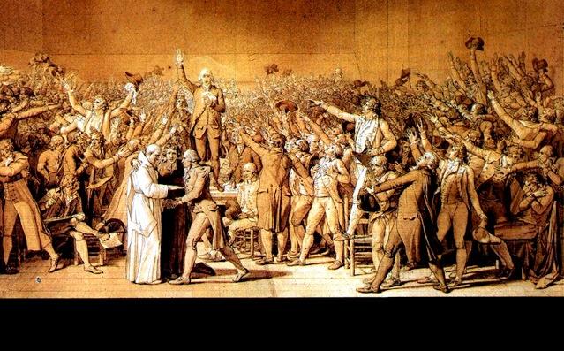

Slide 27
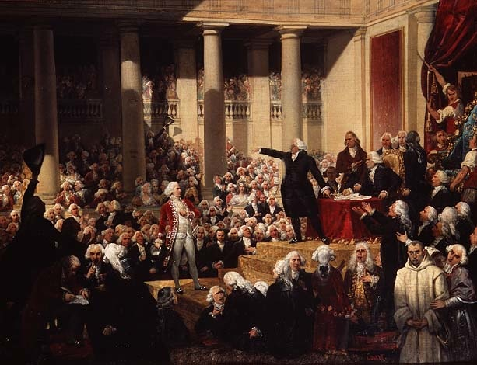

Slide 28
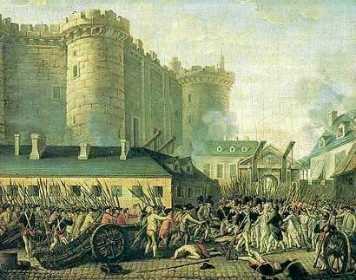

Slide 29
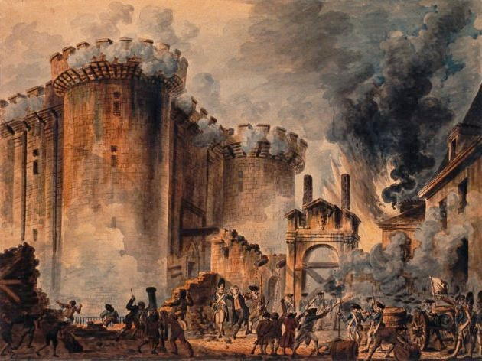

Slide 30
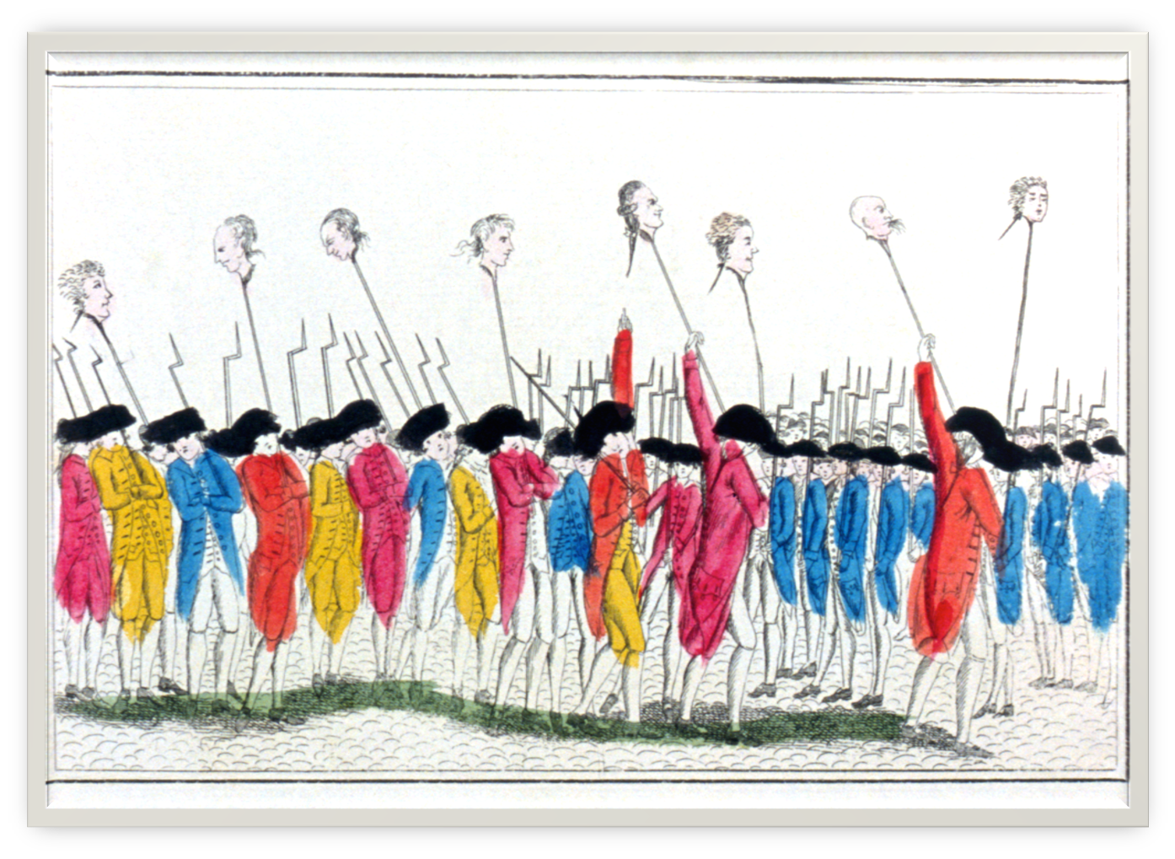

Slide 31
The Constitution
Declaration of the Rights of Man and Citizen – August 27, 1789
The Assembly, however, will not ratify the Constitution until 1791.
Political goal was to establish:
- Constitutional Monarchy
- Legislative Assembly

Slide 32
Political Changes
Active and Passive Citizens.
Only men paying annual taxes equal to three day of local labor could vote.
Status based on property, not heritage.
Split up the Provinces into Departments.

Slide 33
Unstable Elements
Louis XVI was reluctant to change.
Resentment from the aristocracy.
Workers & Peasants felt left out.

Slide 34
The Second Wave
Deposed the Monarchy and established a Republic.
Liberty, Equality, & Brotherhood
In 1792, Paris Commune formed and the September Massacres began.
Sans-Culottes - The Convention

Slide 35
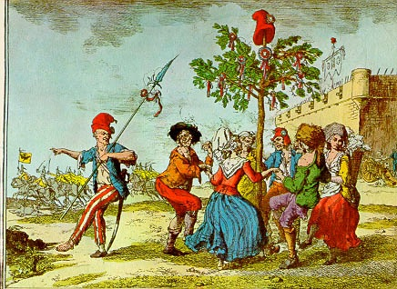

Slide 36
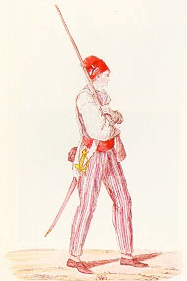

Slide 37
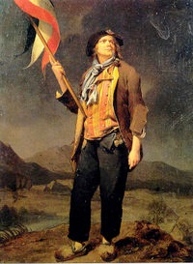

Slide 38
Sans-Culottes
In French “Without Breeches” basically the working man.
Left out of the Constitution…felt neglected.
Believed in shared political power and wanted to end the HUNGER!

Slide 39
A Turn of Events
The Jacobins and the sans-culottes formed the Mountain in Paris.
Main Goal was to overthrow the monarchy and establish a REPUBLIC!
In 1793, they put Louis XVI on trial for conspiring against liberty.

Slide 40
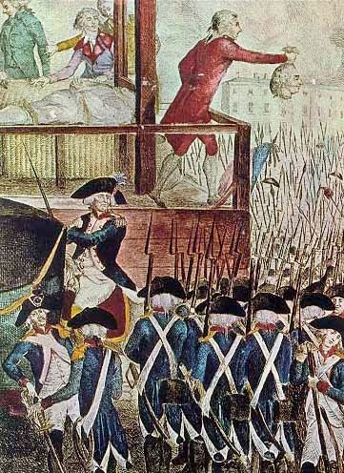

Slide 41
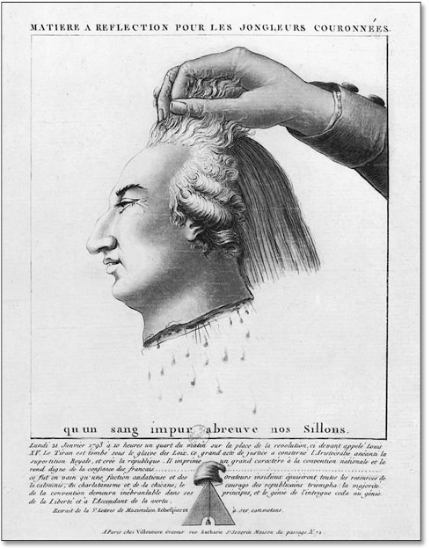

Slide 42
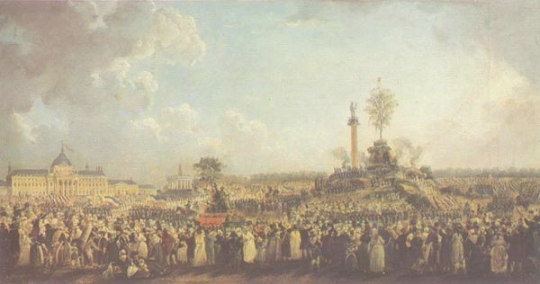
The Supreme Being

Slide 43
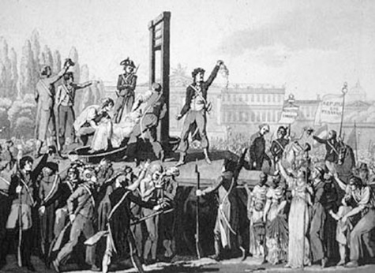

Slide 44
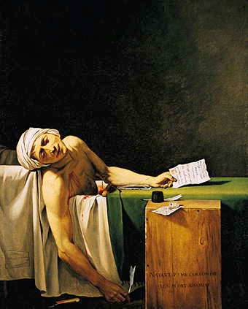

Slide 45
The Directory
Constitution of the Year III (1795)
Legislature of two houses: (Bicameral)
- Council of Elders
- Council of Five Hundred
Executive Body was a five person directory.

Slide 46
Romanticism
Coping with Change = Transformative Property
William Wordsworth
The Prelude 1805
Lyrical Ballads

Slide 47
“While with an eye made quiet by power of harmony, and the deep power of joy, we see into the life of things”

Slide 48
“The best laid schemes of mice and men do often go awry and leave us not but grief and pain for promised joy”
Clearly the Age of Revolutions ignited change but did the revolutionaries take it too far?

Slide 49
Next Week
We will continue to explore how revolutions ignite change in the shiftings of nineteenth century Europe. Focus will be on the 1848 revolutions and the aftermath.

