Slide 1
Psychology of Change
The Scientific Revolution & Enlightenment

Slide 3
Rediscovery of the Universe
The main factors leading up to the scientific revolution:
Discovery of the New World
Invention of the Printing Press
Rivalry among Nation-States
Reformation
Renaissance Humanism

Slide 4
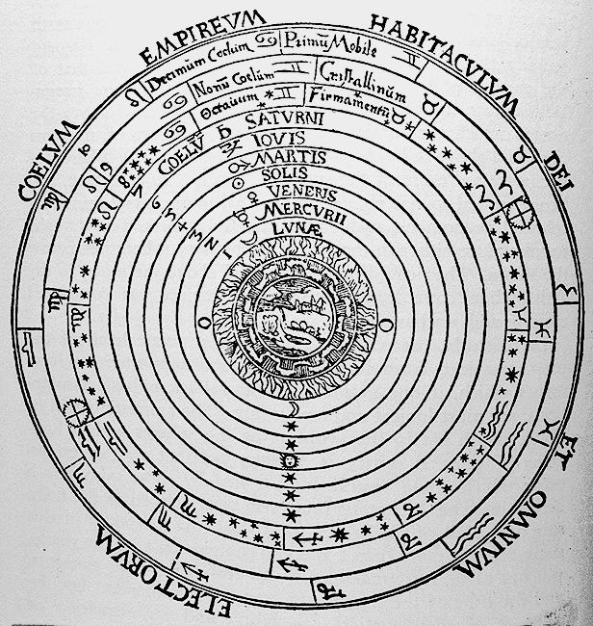

Slide 5
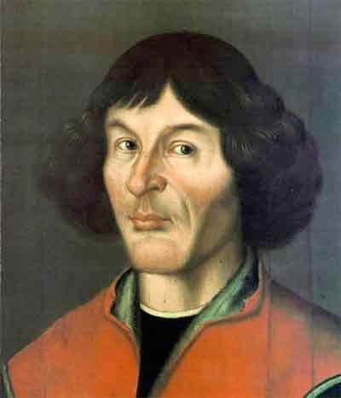
Nicolaus Copernicus
1473-1543
On the Revolutions of the Heavenly Spheres - 1543
Heliocentric Universe

Slide 6
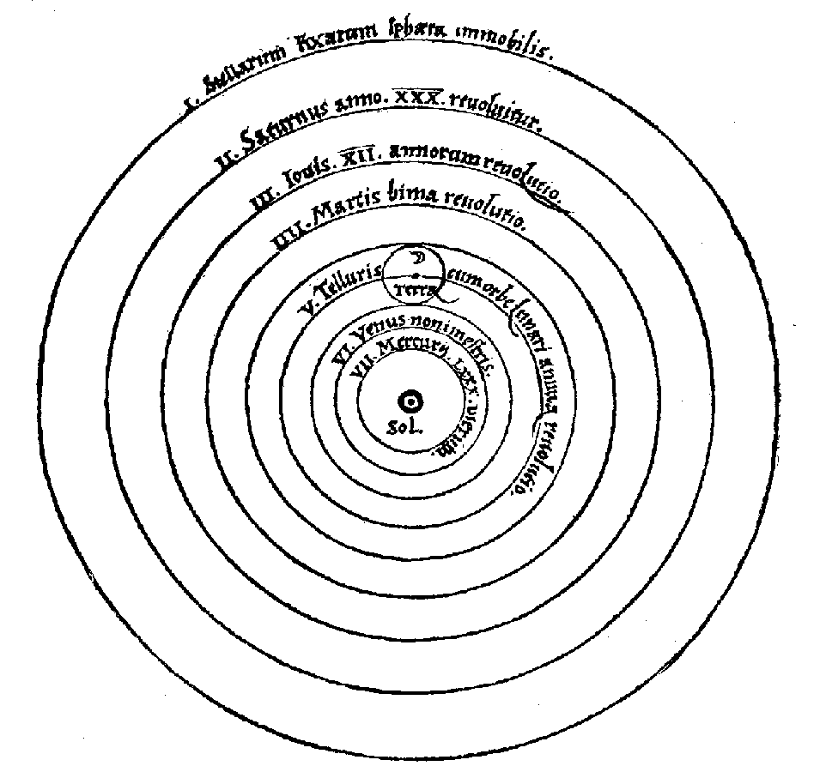

Slide 7
Brush Up Your Shakespeare
Hamlet: “Doubt that the stars are fires …”
Macbeth: “Fair is foul and Foul is fair…”
Troilus and Cressida: “And hark what discord follows!”

Slide 9
Copernicus’ Revolution
The sun-centered universe rejected Aristotle’s cosmology.
Revolutions = how long it took to ‘revolve’ around the sun.
Kept the epicycles of Ptolmey’s system into his work.

Slide 10
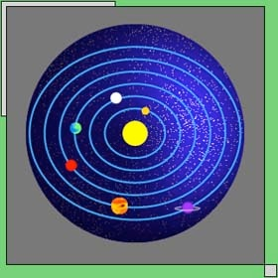

Slide 11
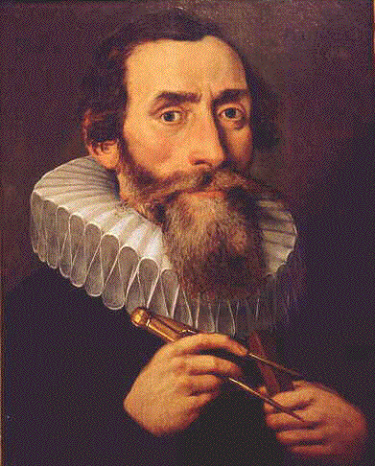
Johannes Kepler
1571-1630
Defends Copernicus’ theory
Elliptical motion of the planets

Slide 12
Physics
Isaac Newton (1642-1727) discovered the laws of gravity.
Principles of Natural Philosophy
His laws are the cornerstone of modern day physics.
Rounded out the Copernican Theory through his discovery.

Slide 13
Laws of Motion
Newton’s synthesis developed the laws of motion, dynamics, and mechanics.
All motion could be timed and measured.

Slide 14
Biology
Until the 16th century, all knowledge of human body based on Galen.
Four bodily humors:
Blood, Phlegm, Yellow Bile, Black Bile
Bright Blood (Arteries)
Dark Blood (Veins)

Slide 15
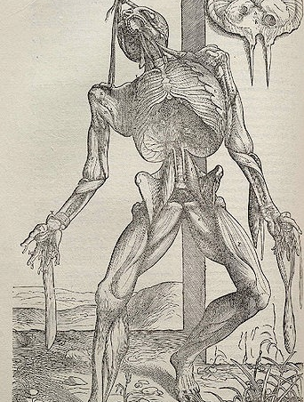
Medical Advances
Vesalius: On the Fabric of the Human Body 1543
Studies cadavers and the first to assemble a skeleton
Details the structure of the human body

Slide 16
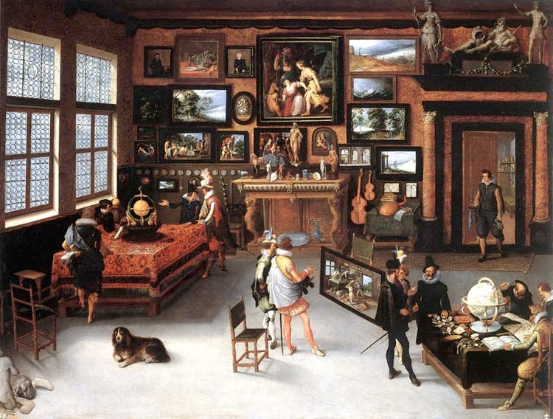

Slide 17
Expanding Knowledge
Middle Ages – Rediscovery of Aristotle.
Late Middle Ages – Humanism
Early Modern Period – Birth of the Scientific Method.

Slide 18
The Method
Combination of applied knowledge, religious toleration, mutual forbearance, and political liberty.
Beginning of the Enlightenment

Slide 19
Faith and Reason
The new science brought many challenges to religion.
Biblical Fallacies
Natural Philosophers vs. Theologians
Material vs Spiritual World

Slide 20
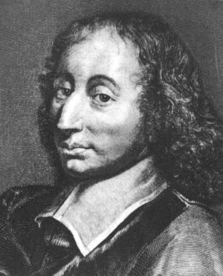
Blaise Pascal
1623-1662
French mathematician
Jansenist - apologist
Wrote against dogmatism and skepticism
Pensées

Slide 21
Leap of Faith
Pascal was trying to establish a means to be a Christian.
Christianity = Ultimate Happiness
Reason can only take you so far…
“ The heart has its reasons that
reason does not know…”

Slide 22
The Wager
Pascal made a bet with the skeptics.
Answers the question - “What is in it for me?
An infinite amount of gain vs. a finite amount of loss.

Slide 23
Points of the Wager
Man transcends that what kills him
“ The eternal of these infinite spaces terrifies me….”
You do not have the resources in yourself to make yourself happy.
For example, “ I am the King of France”

Slide 24
What is Enlightenment?
Was it a revolutionary body of thought?
Was it a unified body of thought generated by an established canon of thinkers?
Was it a stage in the development of the human spirit?

Slide 25
The Philosophes
Not usually “philosophers” but rather “men of letters”.
These philosophes “sought to apply the rules of reason and common sense to nearly all major institutions and social practices.”

Slide 26
Sapere Aude!
“ Have the courage to use your understanding…” ~ Kant.
The motto of the Enlightenment was “Dare to Know”.
What Kant suggests is a the policy of “reform” to increase freedom
Precursor to the Age of Revolutions

Slide 27
Influences on the Enlightenment
The Ideas of Newton and Locke
British Toleration and Stability after 1688.
Progressive religious reforms based on responsible government
Experiments from the Scientific Revolution Era.

Slide 28
The Public Sphere
The emergence of the Enlightenment was opening of the Public Sphere through an active print culture.
The Spectator by Joseph Addison and Richard Steele
Coffeehouses and Freemason lodges
Creation of the Encyclopedia (1751)

Slide 29
Political Theory
Politics was the biggest area of “change” in the Enlightenment.
A precursor to the revolutionary age that followed it.
Philosophes felt discontented with the way things were run.

Slide 30
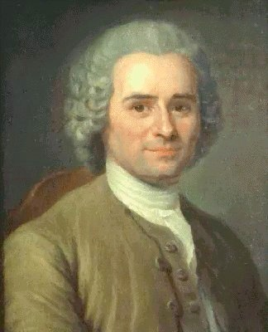
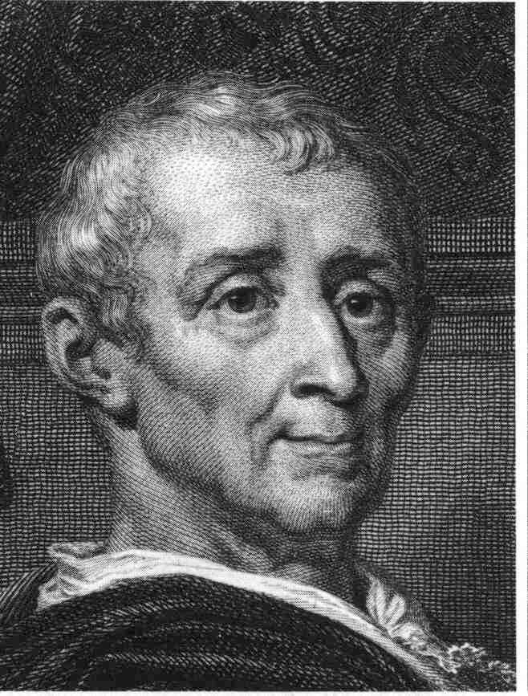
The Spirit of the Laws

Slide 31
Montesquieu:1689-1755
A lawyer and a member of the nobility.
The Father of Sociology
Looked to England as an example of what government should be like.
Separation of Power - Checks and Balances.

Slide 32
Persian Letters: 1721
Montesquieu wrote this tale as a critique of European Society through the eyes of foreigners.
Usbek and Mirza

Slide 33
Troglodyte Parable
Mirza writes Usbek and asks:
“Is man happier by pleasure or the practice of virtue?”
Usbek’s response is the parable, which discusses the three phases of the Troglodytes.

Slide 34
Balance of Power
The final decline of the Troglodytes was a result of a moral problem, not a military issue.
“Men are born virtuous and ought to be this way.”
Economic connection - “Fable of the Bees”

Slide 35
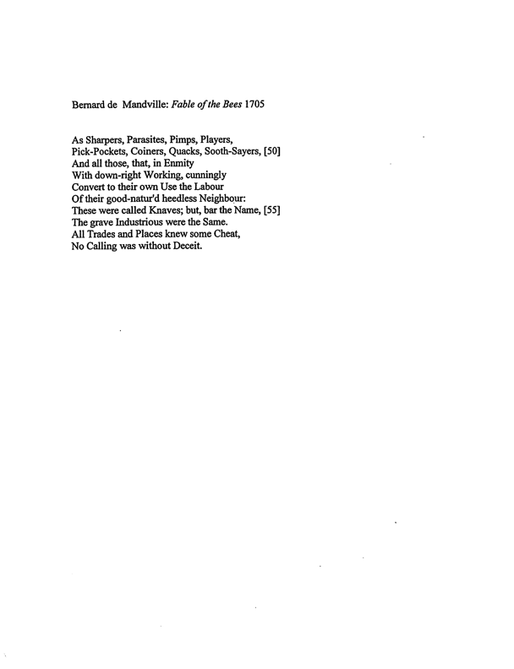

Slide 36
Rousseau:1712-1778
Born in Switzerland of lower middle class family.
Moved to France and lived a wayward life… Confessions
Became involved with social circles of the philosophes through publications.

Slide 37
The First Discourse: 1750
Have the Arts and Sciences contributed to mankind or not?
Rousseau said NO! because they have tended to created needs and destroy morality.
“Better to be a first rate cabinet maker, than a third rate geometrician”

Slide 38
The Second Discourse: 1755
What is the origin of inequality?
Rousseau gave a speculative analysis of human beings.
Man was not originally social.
The drive for inequality was the desire to be desired.

Slide 39
The Social Contract: 1762
The Social Contract was Rousseau’s political theory.
“All men are born free, but everywhere they are in chains.”
BUT WHY????
What is Rousseau’s answer for this bondage?

Slide 40
What’s Changed?
Society - Public Sphere
Politics / Government - Modern Democracy
Intellectual / Philosophy - Rising Bourgeoise
Economic - Capitalism = Factories
Cultural - Individualism

Slide 41
Next Week
We shall see how the Enlightenment ideas were reflected in the values and reforms of the French Revolution. What promoted the ‘change’ that ignited all these revolutions?

