Slide 1
Week 1
The Modern World Emerges

Slide 2
Psychology of Change
History = Study of Change
Many courses of study also correlate this idea.
Chemistry
Calculus
Physics
Geography
Psychology

Slide 3
The Measuring Stick
How exactly do we measure change?
Life / Goals
School / Education
Career / Job
History

Slide 4
Subtlety of Change

Slide 5
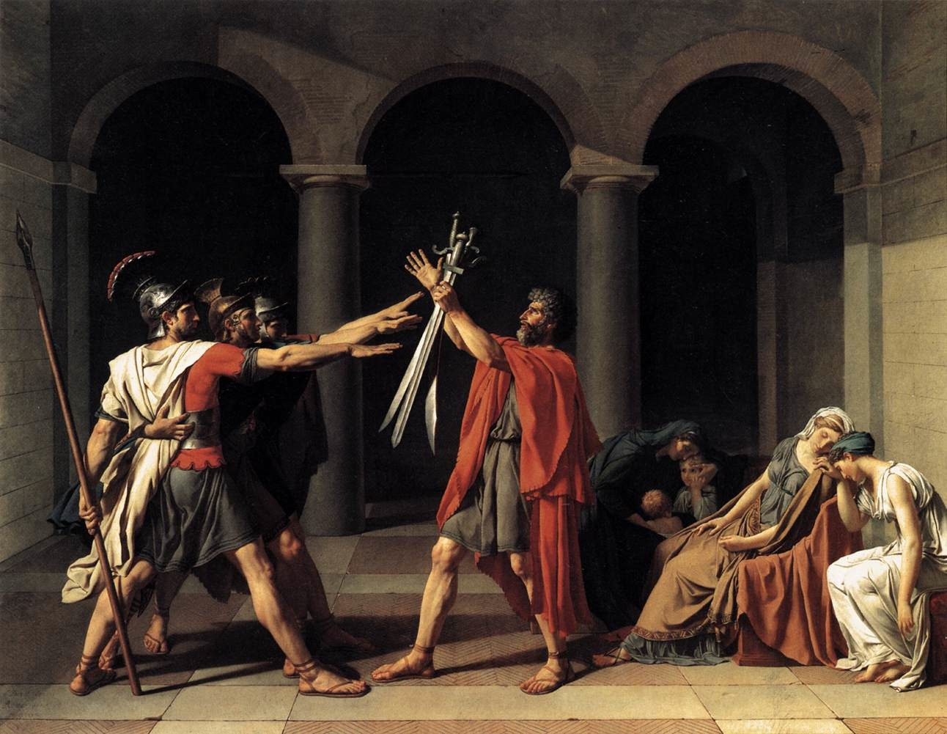
Modes of Change
The Role of the Modern Man in society
Individualism
Signs of Progress - developments in the economy, society, and politics.

Slide 6
How the “World” Was
Middle Ages - Medieval Period
Society - Agrarian
Politics/Gov’t - Feudalism
Religion/Intellectual - Catholic / Scholasticism
Economic - Manorialism

Slide 7
End of the Middle Ages
The 12th and 13th centuries Europe flourished.
In the 14th and 15th centuries there is a great decline.
Pre-Renaissance Europe was hit with social, political, and economic distress.

Slide 8
The Break Down
Hundred Years War - 1337-1453
Black Death - Plague hits Western Europe 1347-1430
Great Schism - 1378-1417
Conciliar Movement - 1415
Humanism - Reacting to Scholastics

Slide 9
How the “World” Changes
Renaissance = Rebirth
Society - Urbanization
Politics/Gov’t - Absolutism
Religion/Intellectual - Christianity splits / Humanism
Economic - Mercantilism

Slide 10
Mercantilism
The Italian Peninsula became the HUB for Western Europe.
Merchant Class developed
Birth of the Banking System
Working Class - Manufacturing goods became popular.

Slide 11
Essence of Individualism
Individualism of the Renaissance gave way to the Reformers of the 16th century.
Man by himself achieves nothing through the gift of spirit or grace.
Faith through the salvation of Christ

Slide 12
Eve of the Reformation
Social and Political Divisions
Centralization of Imperial Governments
Spiritual Problems
Weakened Church Authority
Northern Humanism
Literacy & the Printing Press
Laypeople’s Religious Revival

Slide 13
The Printing Press
Increase in universities from 1300-1500.
Johann Guttenberg: 1455 invents the a movable type of machine
Mass production of pamphlets and indulgences.

Slide 14
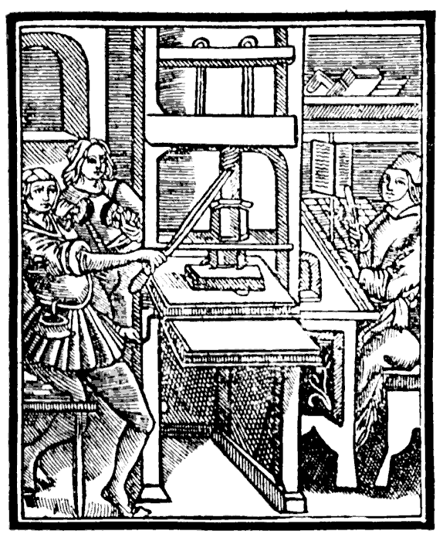

Slide 15
Ecclesiastical Reform
Modern Devotion – established by Gerard Groote (1340-1384).
- Brothers of a Common Life
- Imitation of Christ
Humanism & Vernacular
Lay Control over Religious Life

Slide 16
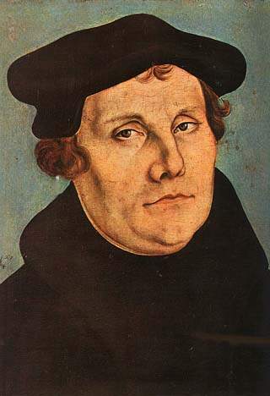
Martin Luther
1483-1546
University of Erfurt
Pursued a Law Degree
Augustinian Monk
Studied the works of Ockham and Biel

Slide 17
Luther’s Position
Reform the Church within, like it was done in the past.
Two major problems:
1. God’s Righteousness
2. Indulgences

Slide 18
Sola Fide
Luther struggled with the meaning behind God’s Righteousness
A perfection no one could know, or ever achieve.
Justification of Faith Alone:
- To believe is to stand before God
- Romans 1:17

Slide 19
Attack on Indulgences
Luther was concerned on the abuses of Indulgences.
1476 - Pope Sixtus IV - Purgatory
The selling of Indulgences became a huge commodity for the Church.
Can salvation be bought or sold?

Slide 20
John Tetzel
“Don’t you hear the voices of your dead parents and other relatives crying out, ‘Have mercy on us, for we suffer great punishment & pain. From this you could release us with a few alms. We have created you, fed you, cared for you, and left you land. Why do you treat us so cruelly and leave us to suffer in the flames, when it takes only a little to save us?’”

Slide 21
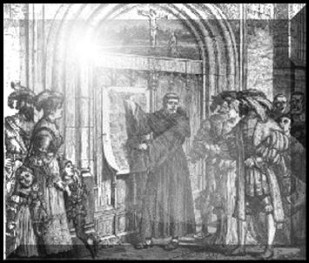
Ninety-Five Theses

Slide 22
Luther’s Break
Luther’s ninety-five theses became the rage of the age.
Sola Scriptura
Excommunicated January 3, 1521
Charles V crowned Emperor
Diet of Worms – April, 1521
A Priesthood of Believers

Slide 23
Luther’s Stand
“ Unless I am convicted by Scripture and plain reason—I do not accept the authority of popes and councils, for they contradicted each other—my conscience is captive to the Word of God; I cannot and I will not recant anything, for to go against conscience is neither right nor safe. God help me, Amen.”

Slide 24
Reformation Spreads
Charles V - Habsburg Dynasty was too occupied to really quell Luther’s uprising.
War with France and Turkey.
Princely Control over lands.
The Printing Press -> Pamphlets!

Slide 25
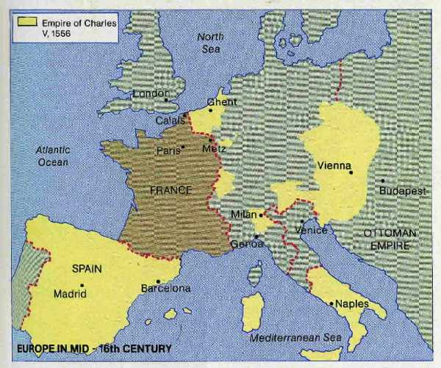

Slide 26
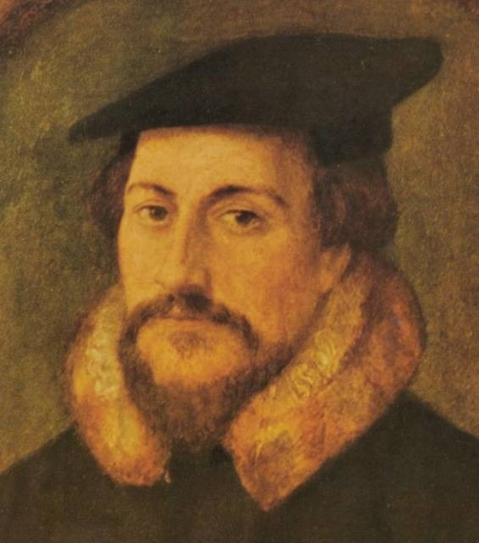
John Calvin
1509-1564
Born into nobility
Held Church benefices.
Studied Law & Philosophy
Geneva Reform

Slide 27
The Zealous Reformers
Calvinism was a religious ideology centered on political resistance.
Wanted to transform society to a moral and orderly state.
By 1550, Calvinism replaced Lutheranism as the most popular Protestant Religion.

Slide 28
Sovereignty of God
Geneva rare case for protestantism-political turmoil leads to conversion.
Calvin drawn in as political refugee writes new church doctrine.
By 1540, Calvin takes over Geneva and preaches his theology of the ‘elect’.

Slide 29
Geneva Church Organization
Pastors: of whom there were 5 to preach the good news
Teachers/Doctors: to instruct populace and defend the new doctrine
Elders: Group of 12 layman to oversee the Church and Society.
Deacons: to dispense church goods and services

Slide 30
Calvin’s Principles
Institutes of the Christian Religion
Brings works back into faith.
It’s all about God’s Glory, not Love.
Doctrine of Predestination
Moral Reform

Slide 31
Political Consolidation
1530 - Diet of Augsburg: meeting between Catholics and Protestants
Augsburg Confession - Protestant Creed
Charles V too occupied with the War against the French and Turks.
1555 - Peace of Augsburg: Made the divisions in Christendom permanent.

Slide 32
English Reformation
England a rare ‘reform’ case
Different Groups:
- Northern Humanists
- Parliament
Reformation in England a Top-Down Process.

Slide 33
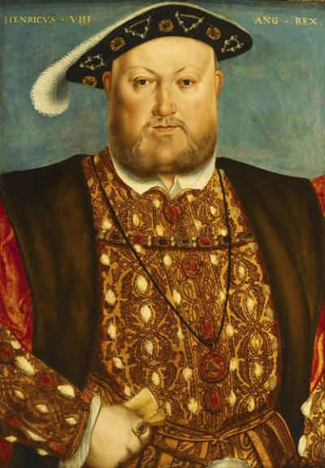
Henry VIII
Early career no intention of breaking away.
“Defender of the Faith”
Attacked Luther and Protestantism

Slide 34
A Series of Unfortunate Events
1527 - problems arose in England that eventually led to its break with Rome.
Henry requested an annulment from Pope Clement VII
Papa said “NO”

Slide 35
The Position Shifts
1529- Henry outraged sought advice from Parliament.
Parliament had many Luther supporters.
Thomas Cranmer: 1489-1556
Thomas Cromwell: 1485-1540
Henry’s break with Rome was a political move, not religious!

Slide 36
The Anglican Church
England not concerned with faith and salvation …strictly a politics!
Anglican Church – in its earliest stage Catholic without the Pope.
1534 - Act of Supremacy: officially made the King of England the head of the English Church.

Slide 37
Conservative Reform
Six Articles of 1539
Priests were not allowed to marry
Reaffirmed Transubstantiation
Denied Eucharistic cup to the laity
Declared celibate vows inviolable
Continued Private Mass
Continued Oral Confession

Slide 38
A Reform Within
Catholic Church attempted reform before Luther
Fifth Lateran Council 1513-1517
Many new religious orders sprung up, during this time.

Slide 39
The Council of Trent
1545 - 1563
Council met over three sessions that spanned the careers of four different popes.
The Council did not give one single doctrinal concession to the Protestants.

Slide 40
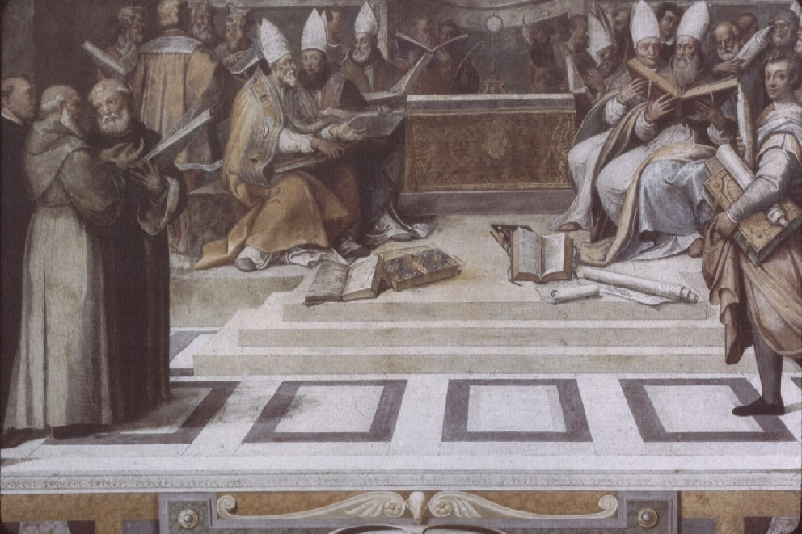

Slide 41
Issues at Trent
Original Sin - baptism does wash away original sin.
Predestination - God’s decision to save people in time.
Justification - faith formed by love, need both faith and good works.

Slide 42
Other Points
Indulgences - kept them, but you could no longer sell them.
Cult of the Saints - Important part of converting people back to the faith.
Seminary - isolate priests so they can control them…prevent another Luther.

Slide 43
Beyond Religion
Luther and Calvin went beyond religion when they mounted their attack on Catholicism.
Magisterial Reformers
Transition into the social and political realm

Slide 44
Reform or Revolt???
Both ‘reform’ and ‘revolt’ are forms of change … so to determine which is more accurate think about what actually changed?
- Religion?
- Society?
- Politics?

Slide 45
Sociopolitical Development
On the surface, the Reformation did not change politics or society.
Underneath the surface, however, it greatly affected the sociopolitical development of Europe.

Slide 46
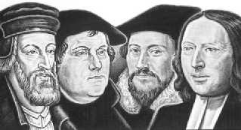
Reformation
Failure in the face of the law - Antinomianism
Saving Faith - Not Works
Christian liberation further paved the way for Individualism
Looking for something more worldly — Public Sphere

Slide 47
Making of Modernity
End of the Middle Ages - Collapse of Feudalism - New Nation-States emerge
Renaissance and Reformation - Cities Grow
Age of Exploration - Mercantilism and Capitalism
Scientific Revolution - The Method
Enlightenment - The Public Sphere

Slide 48
Next Week
We will further look at the developments of change in society by exploring the developments of the Scientific Revolution and Enlightenment.

